Slide 1

Rezekne,
first Comenius meeting,
November 17-22

Slide 2
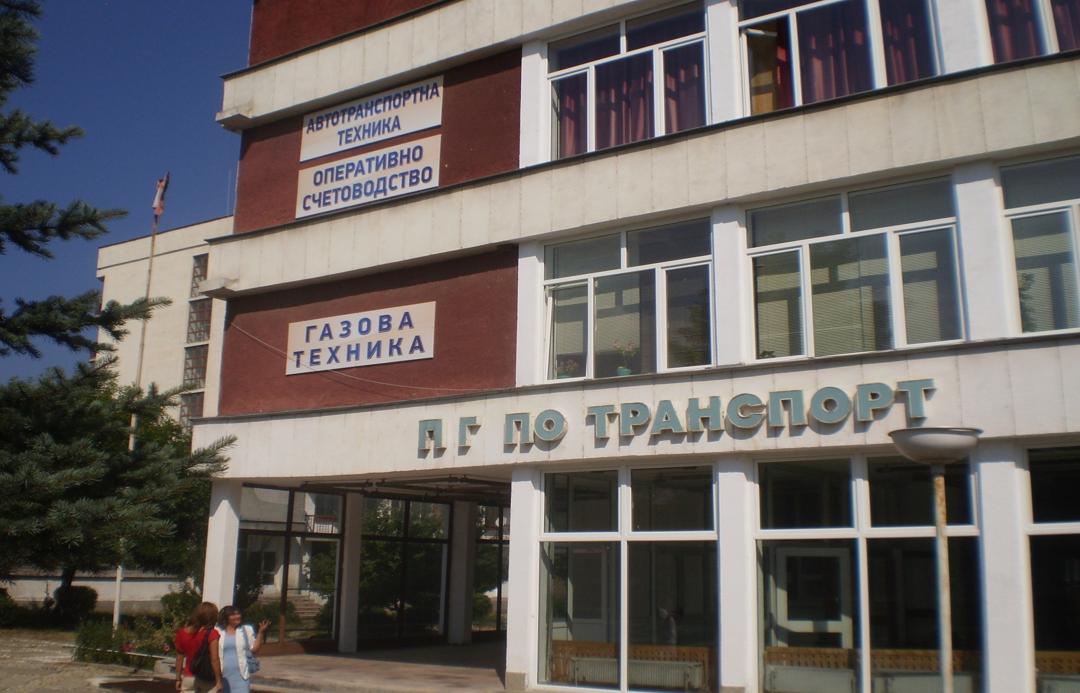
High Vocational School of Transport, Razlog, Bulgaria

Slide 3
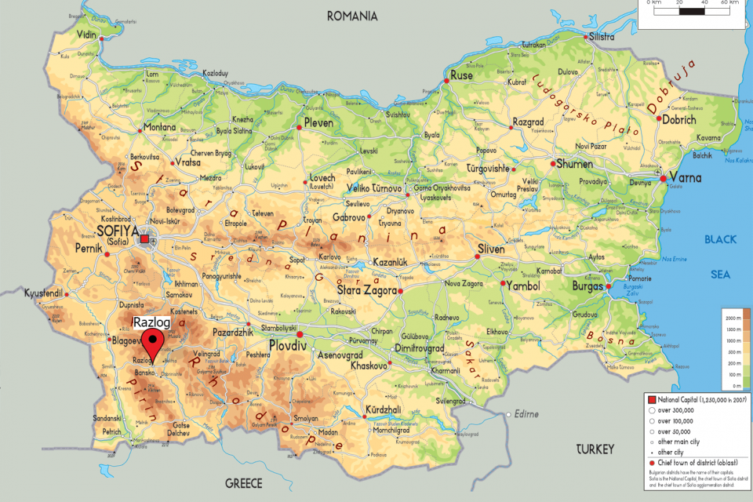

Slide 4
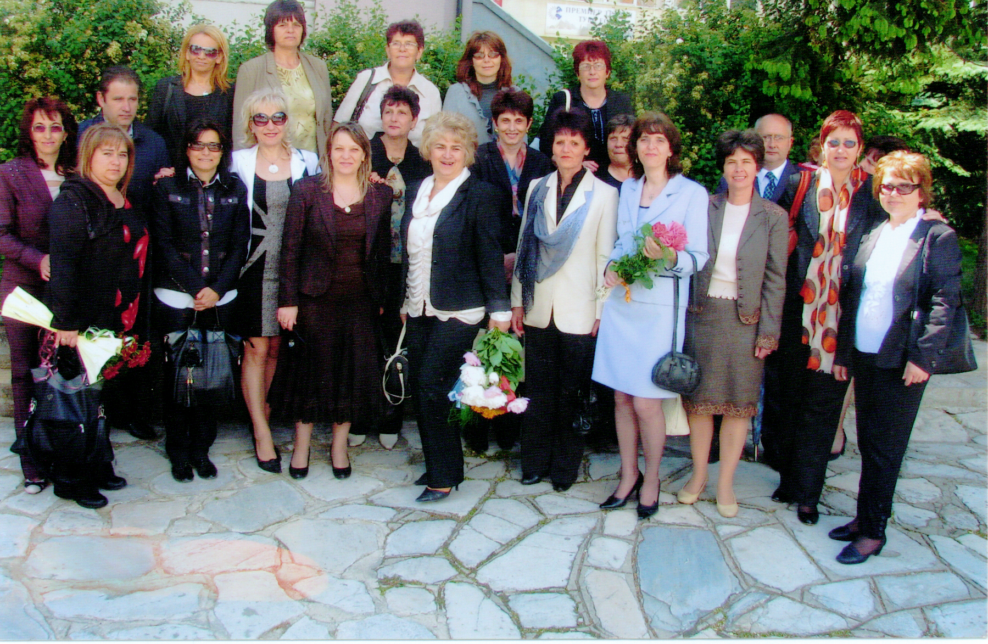
The pedagogic staff

Slide 5
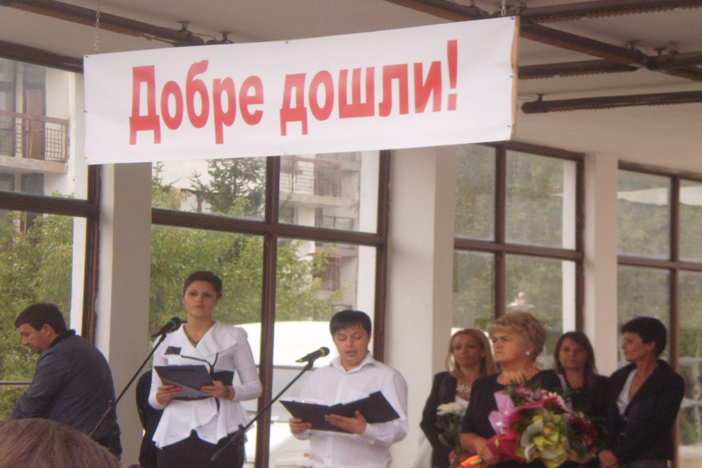
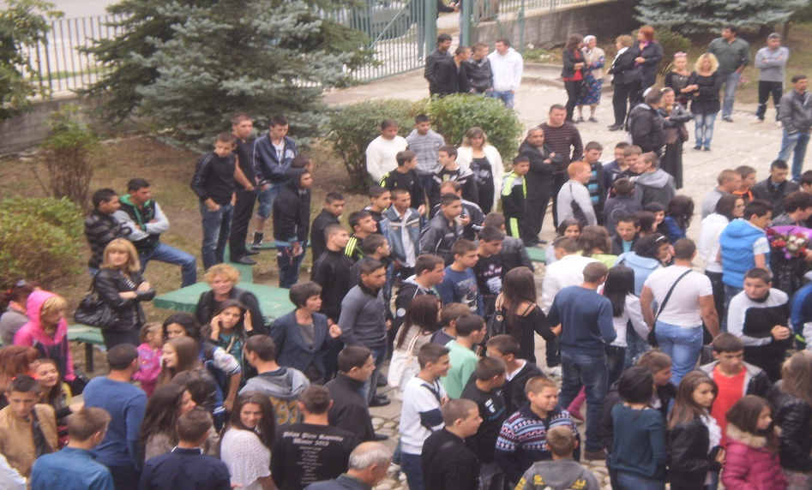
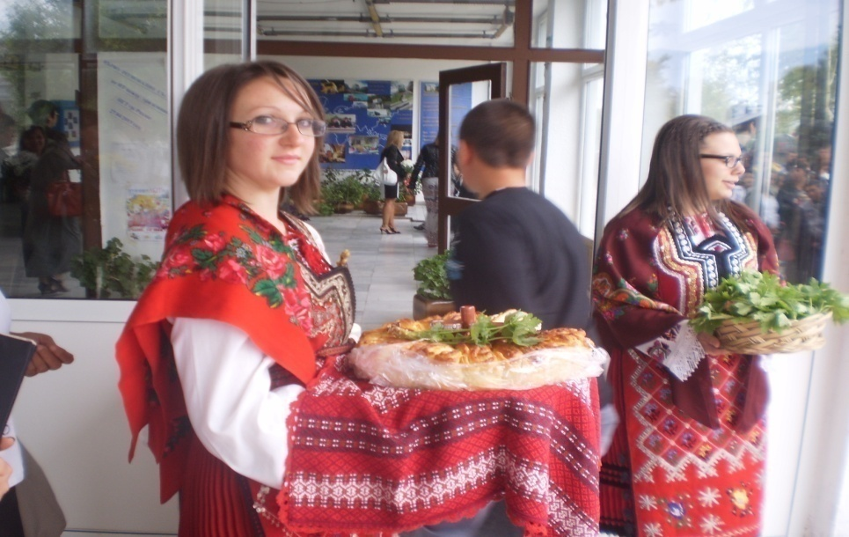
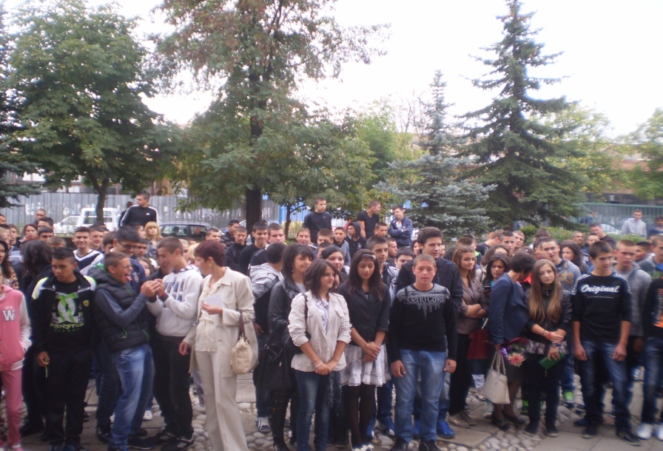
Welcome back to school!
15 September 2013g

Slide 6

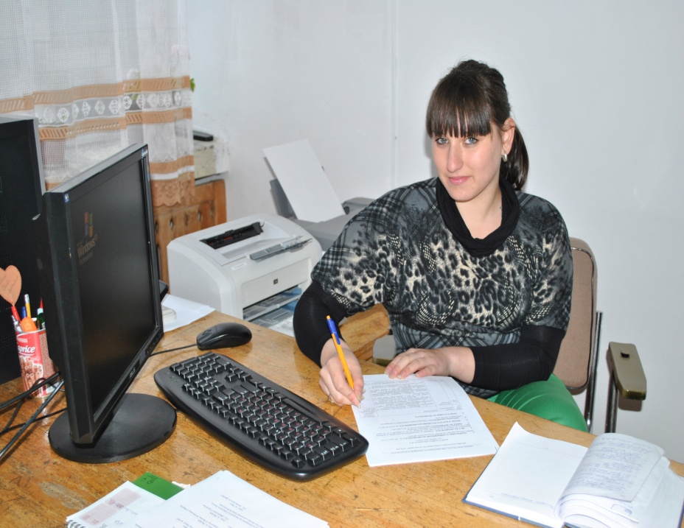
Courses of study in High Vocational School of Transport
Vocational High School of Transport 75, Hristo Botev str., 2760 Razlog, Bulgaria phone: +359(0)74780144; fax: +359(0)74780147 www.pgt-razlog.com, e-mail: pg_po_tr@yahoo.com
After 7 grade –Operational accounting

Slide 7
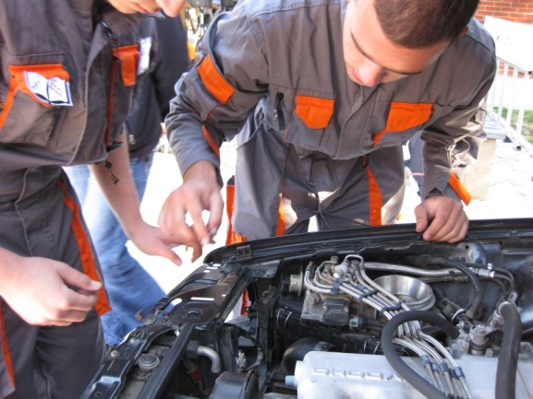
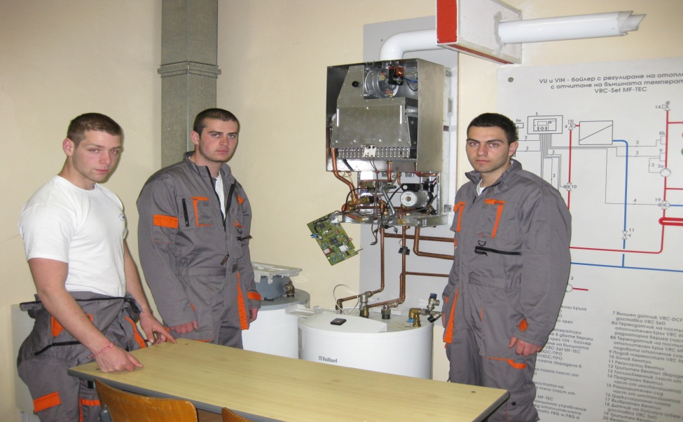

After 8 grade- Motor transport vehicle
After 8 grade- Operational accounting
After 8 grade –Gas appliances
We have got students aged 15-19 and also part-time students - we provide education for adults.

Slide 8
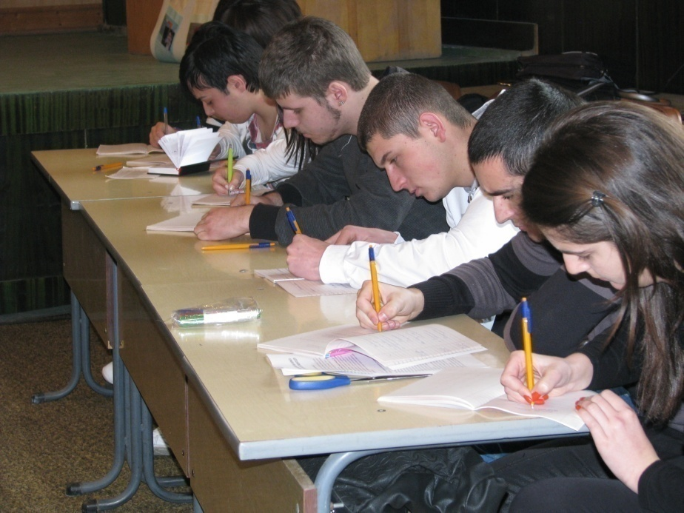
Operational accounting
Profession: Operational accountant
The course of study includes all economical and technical knowledge and skills which are necessary in work with financial and accounting systems in the government, private enterprises and firms.

Slide 9
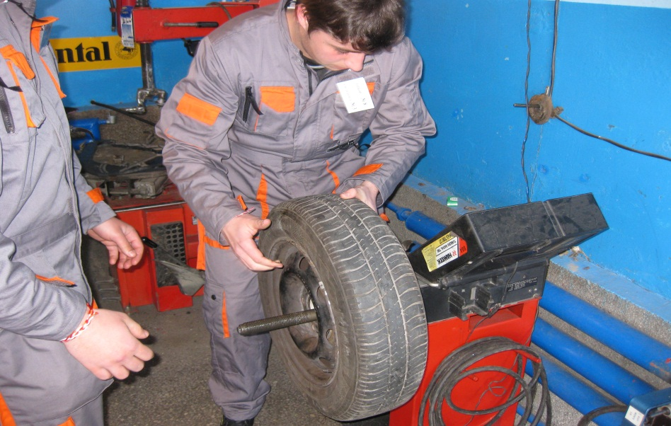
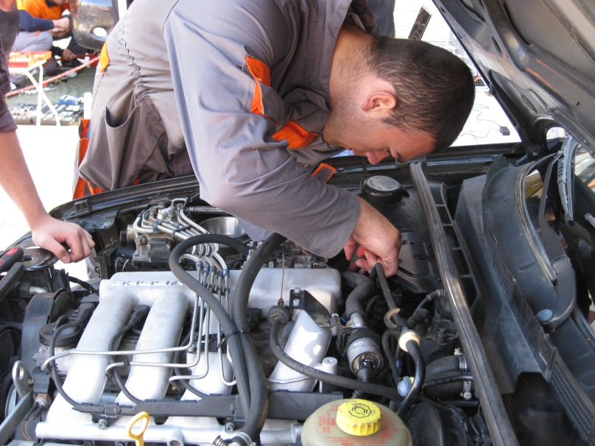
Admission after VIII grade
Course of study :
Motor transport vehicle
Profession: Motor transport technician
Period of training: 4 school years.
The course of study includes:
Maintenance, diagnosis and repair of mechanisms and systems of the engines with internal combustion engines and motor transport equipment.

Slide 10
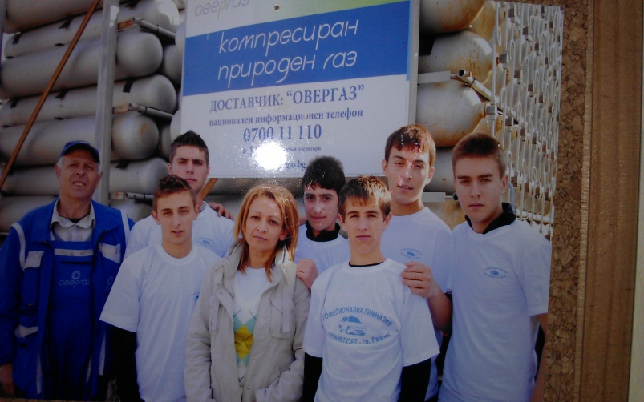
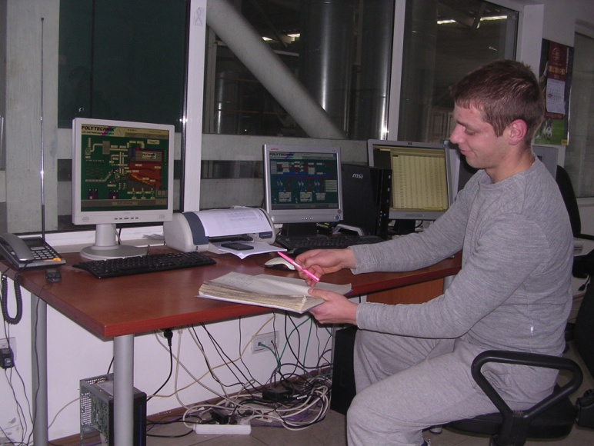
Course of study: Gas Appliances

Slide 11
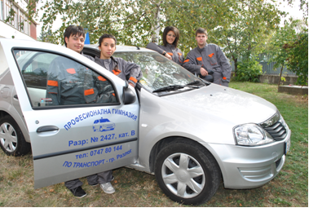
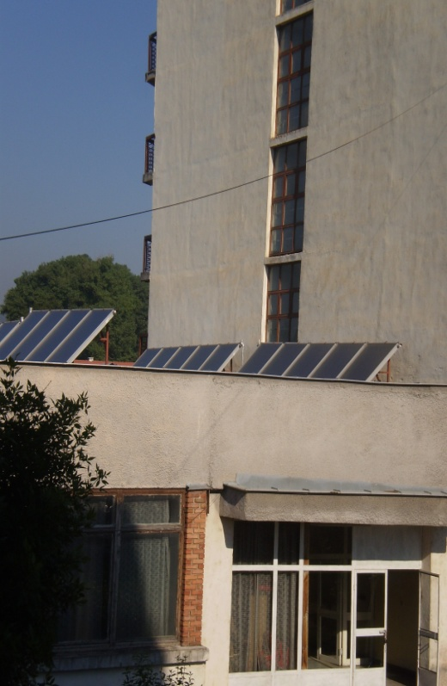
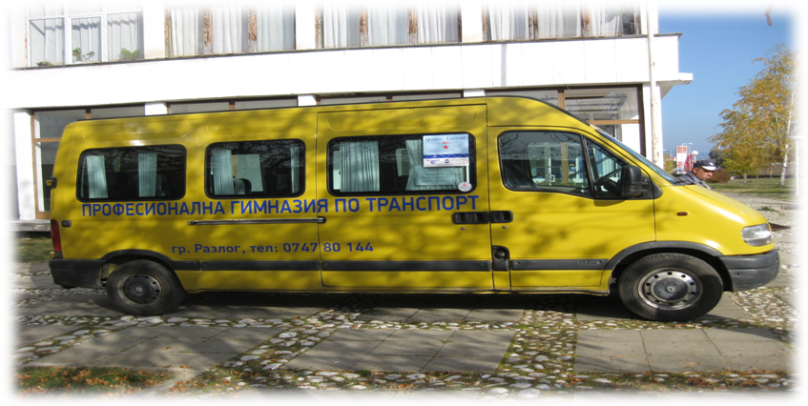
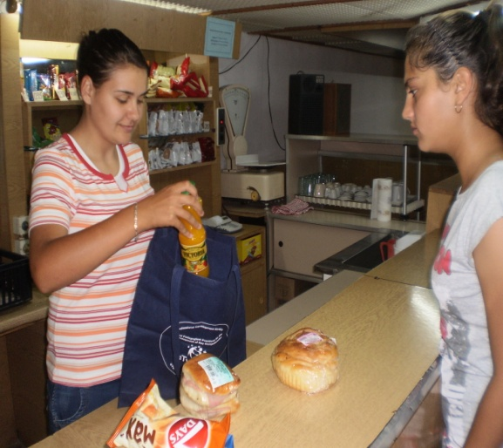
Our school offers:
Own training center and a license for training of drivers category A, B and C
A dormitory with apartments with two bedrooms and bathroom and school canteen.
We provide transport for our students from the region.
A school café.

Slide 12
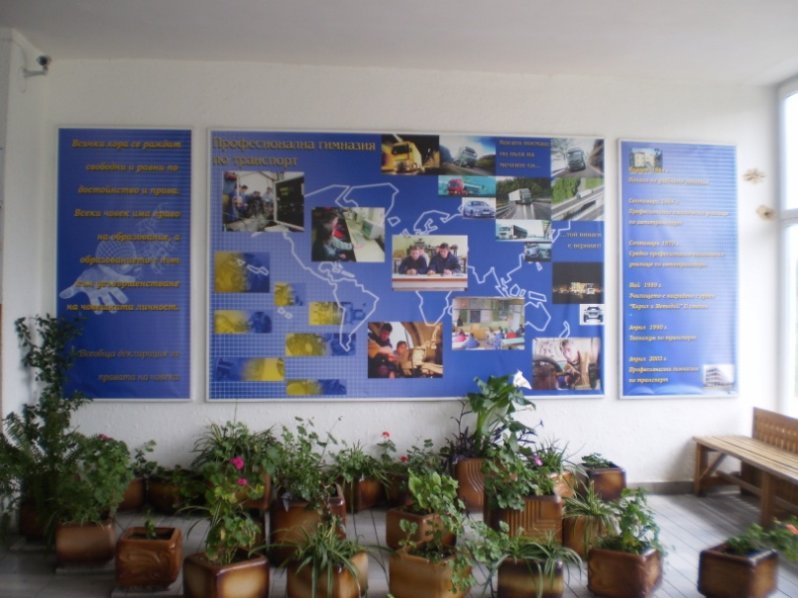
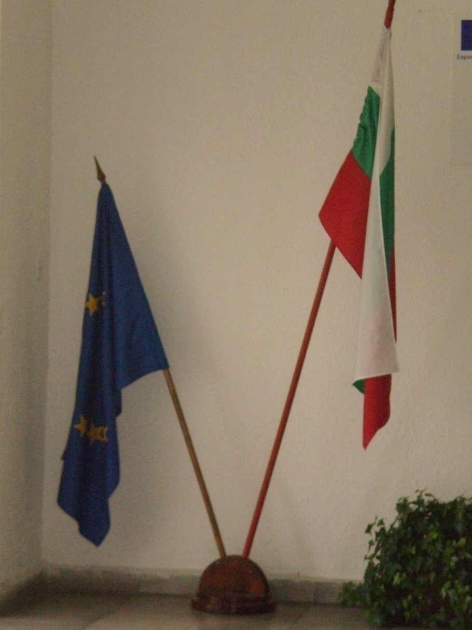
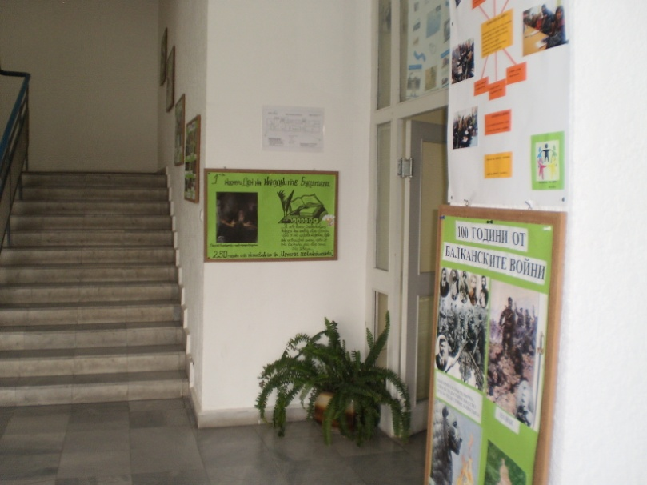
The school hall
Universal Declaration of Human Rights

Slide 13
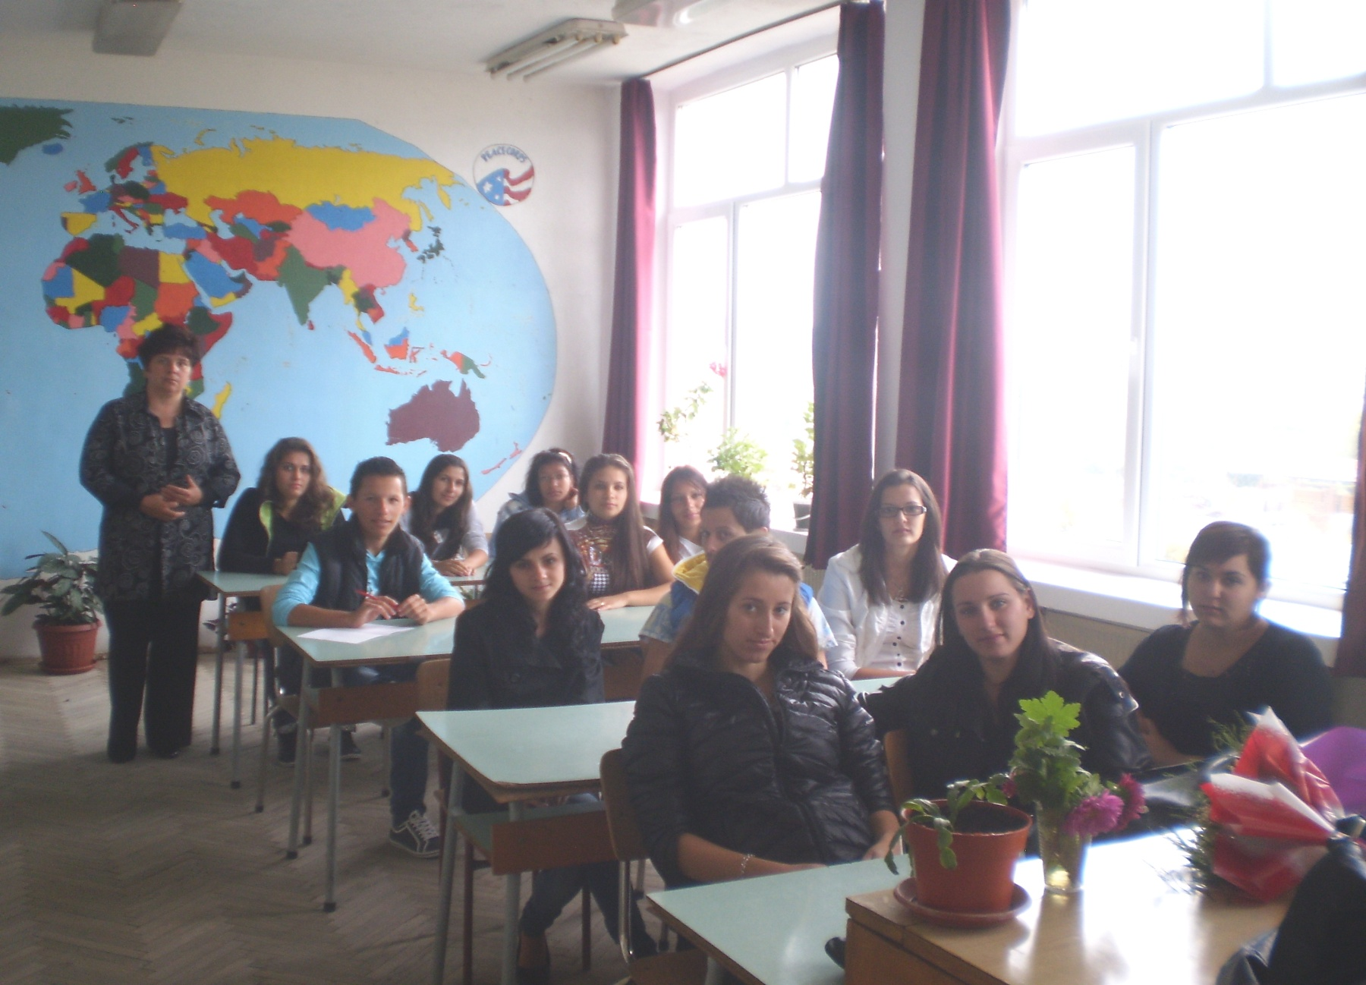
Geography lab

Slide 14
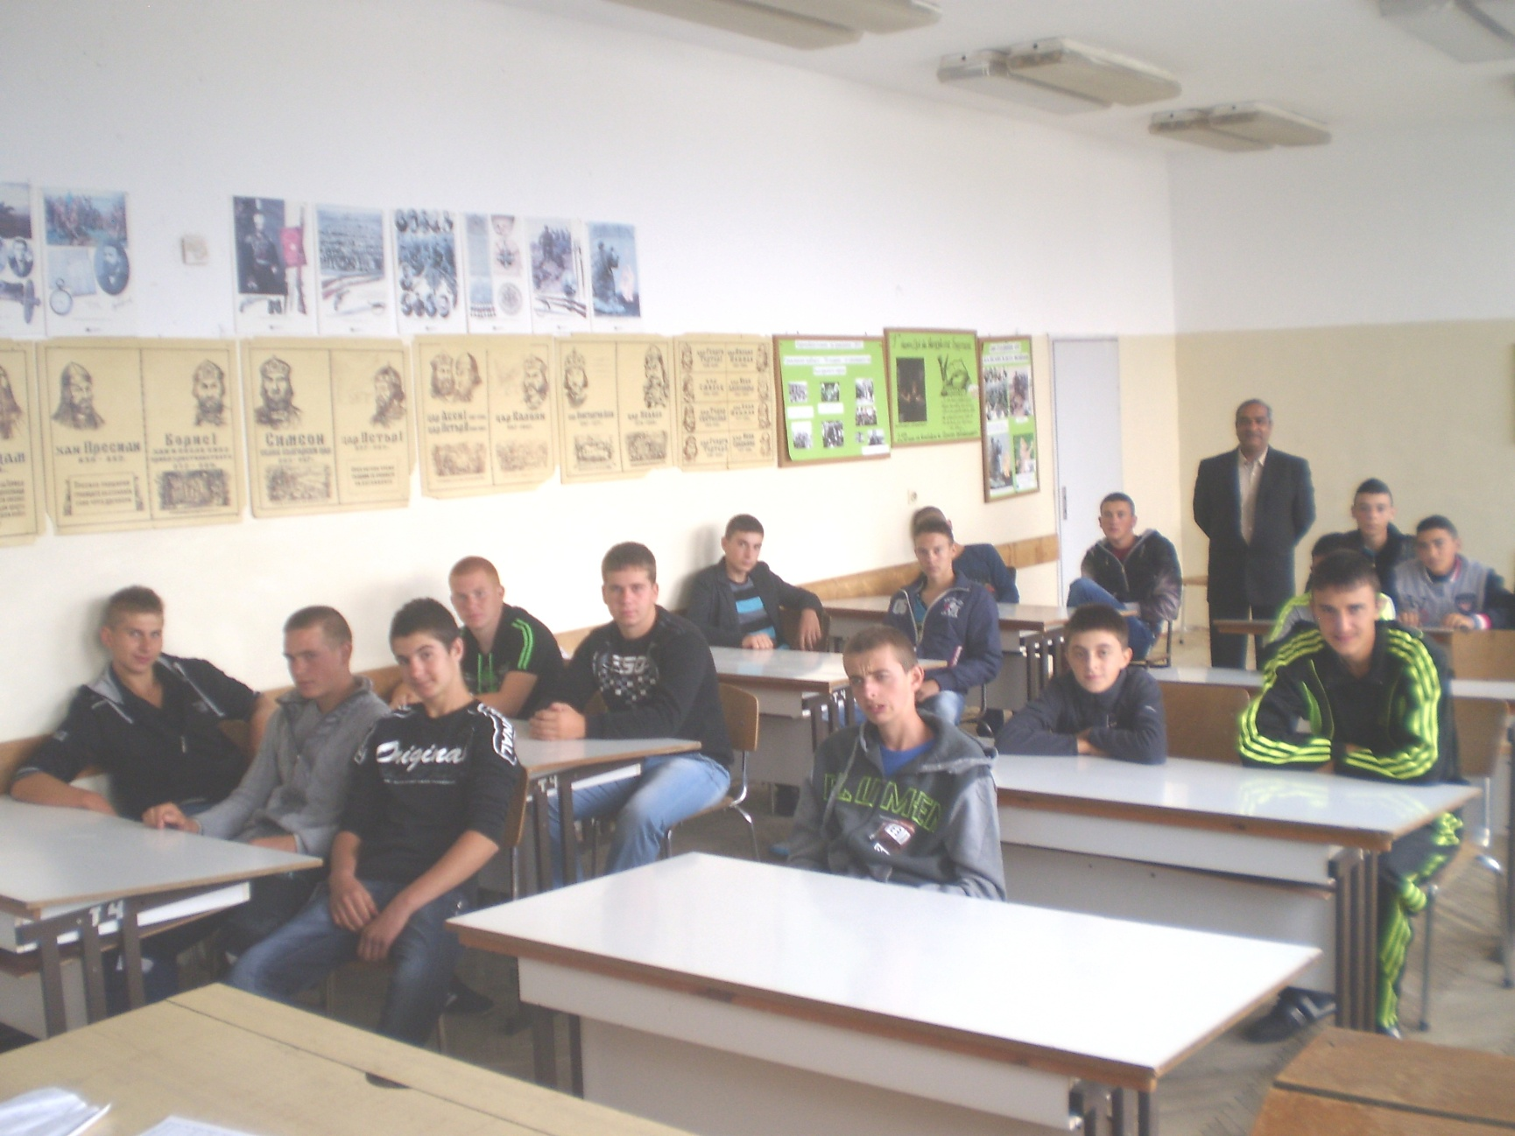
History lab

Slide 15
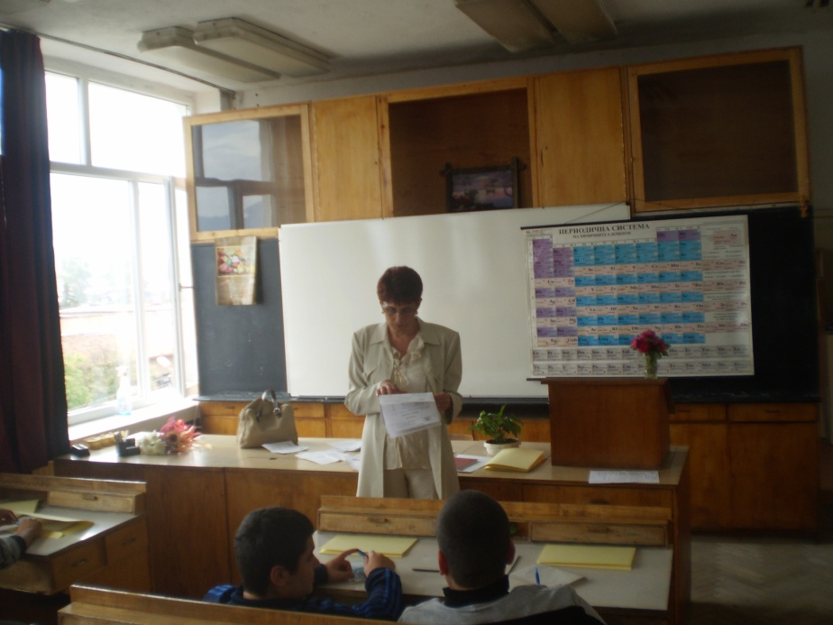
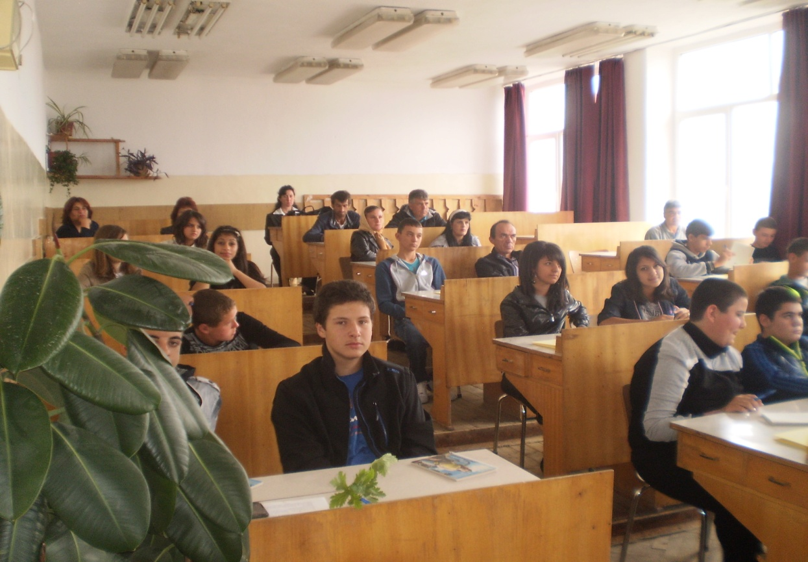
Biology and chemistry lab

Slide 16
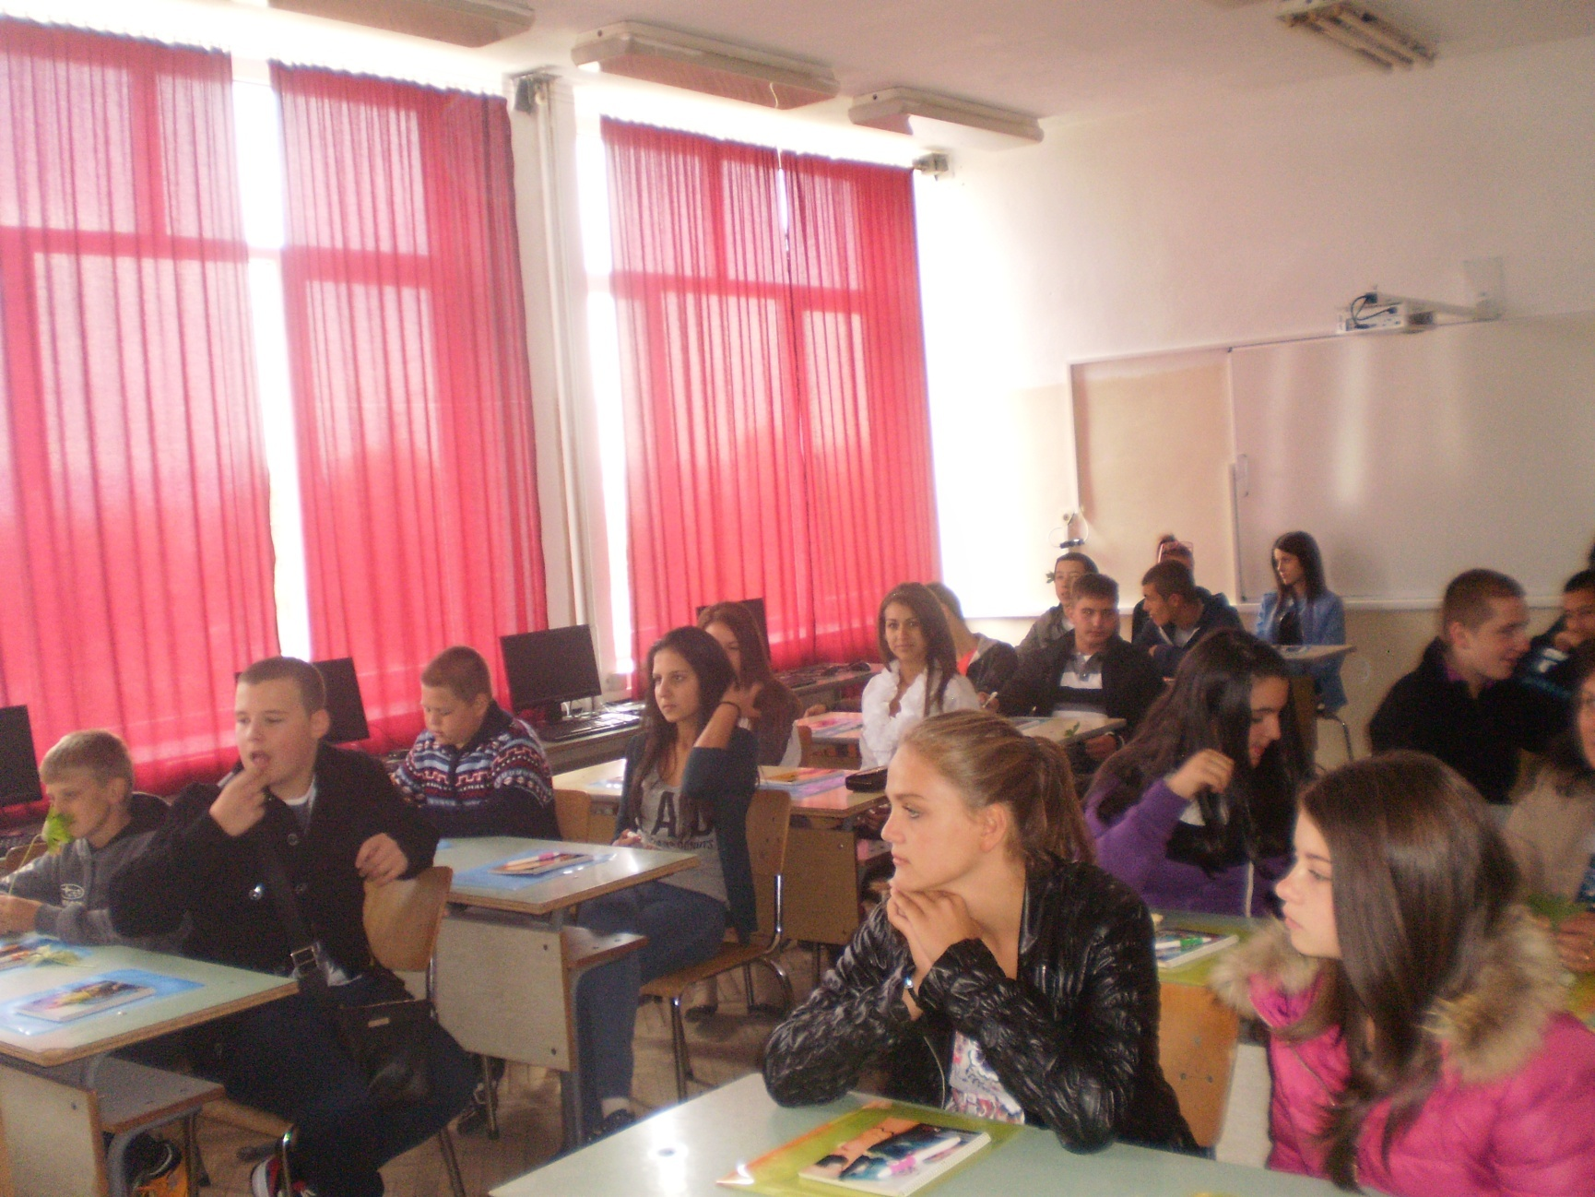
Our foreign language lab

Slide 17
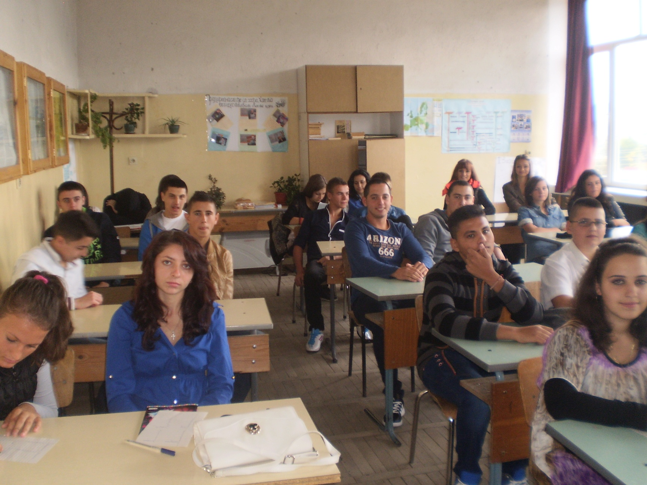
The lab of our future accountants

Slide 18
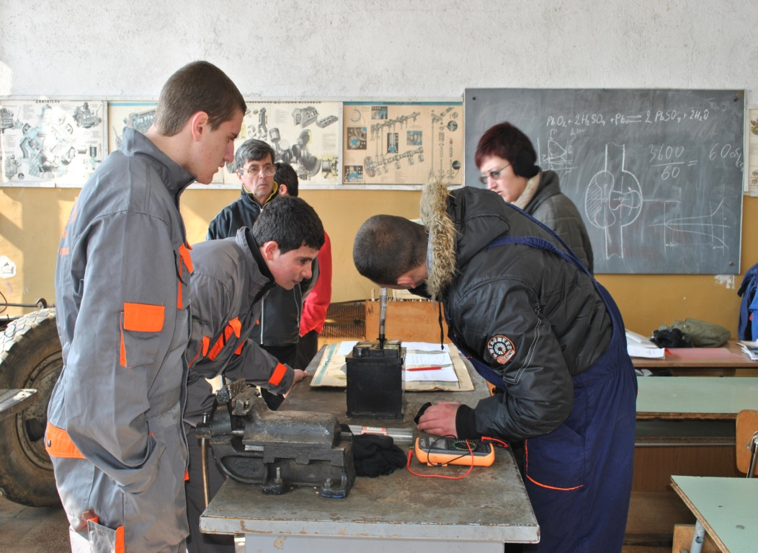
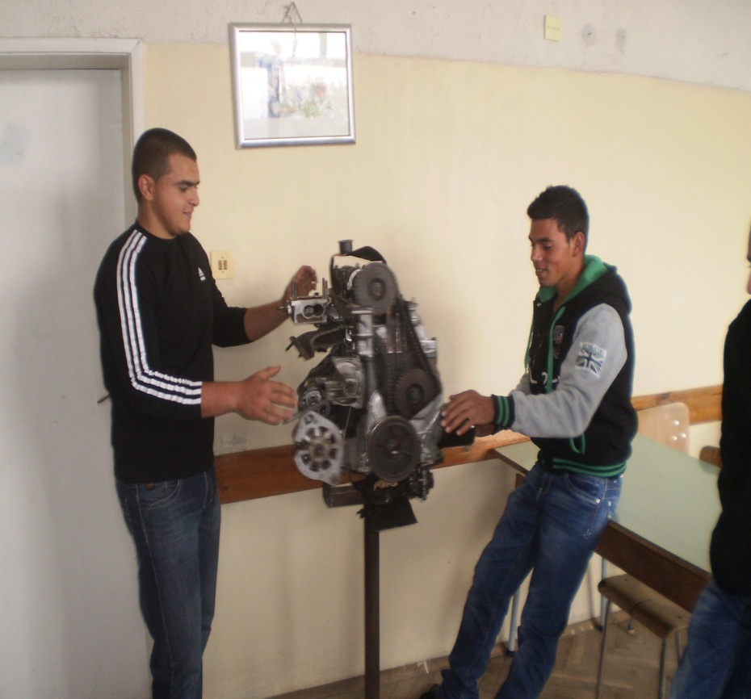
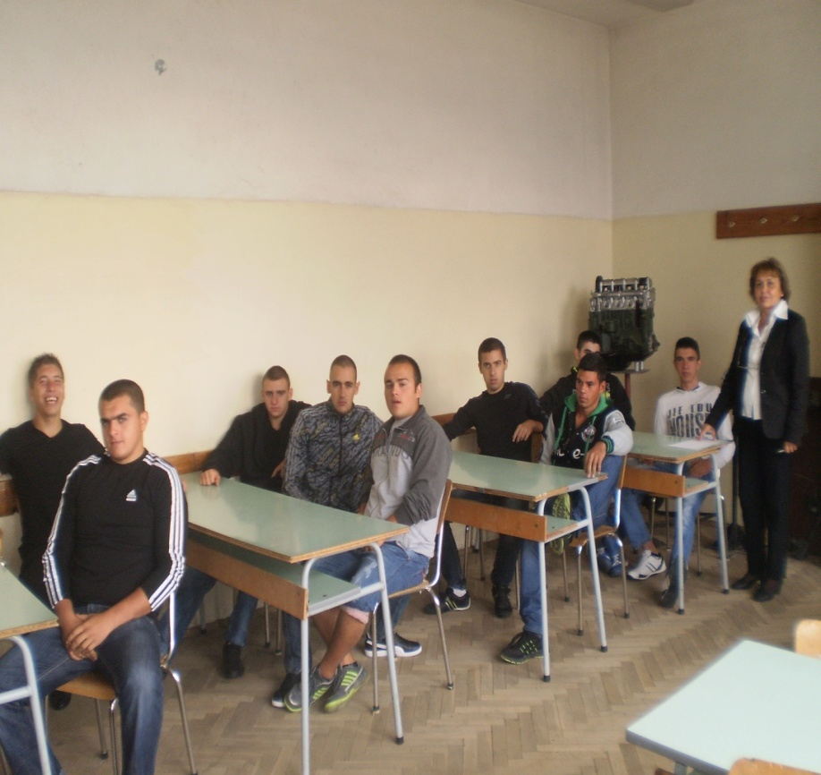
Labs for theoretical and practical lessons for maintains of transport vehicles.

Slide 19
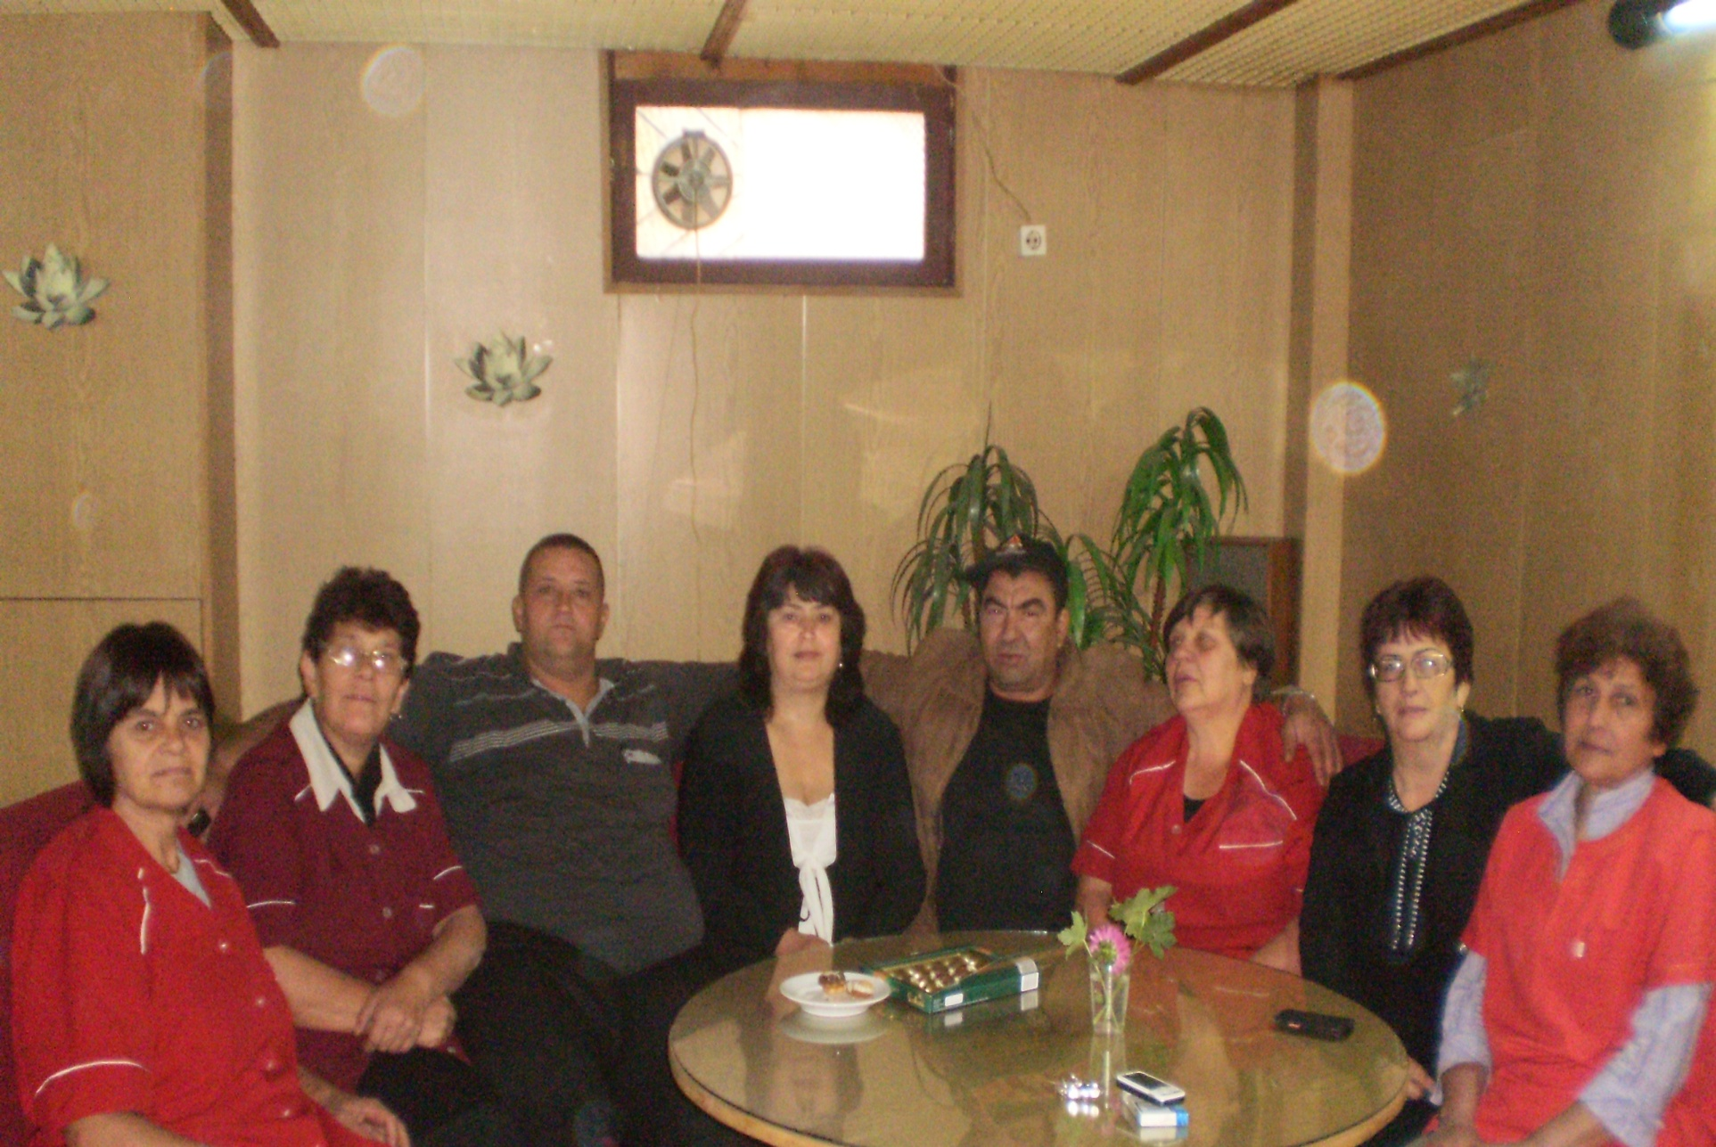
Our non pedagogical staff

Slide 20

National

Slide 21


Project
To Make the School Attractive for Young People
The project is realized by the financial support of Operational Program “Development of Human Recourses ”,
co-financed by European social fund of the European Union.

Slide 22
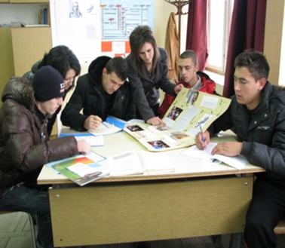
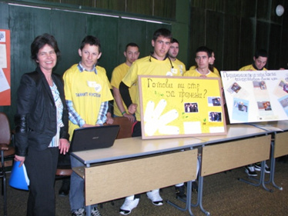
Club
“The secrets of the success ”
Project manager :
Milena Georgieva

Slide 23
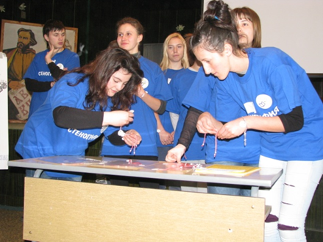
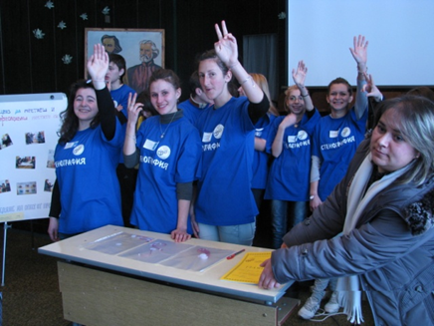
Club
“Shorthand and quick learning”
Project manager: Silvia Blagoeva

Slide 24
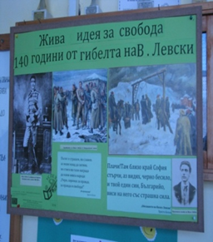
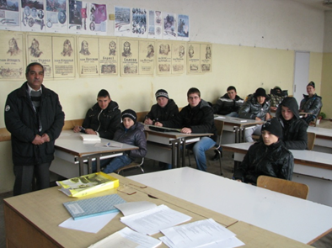
Club
“Razlog-history, traditions and customs”
Project manager: Velko Kovachev

Slide 25
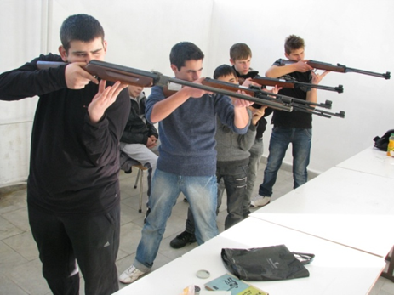
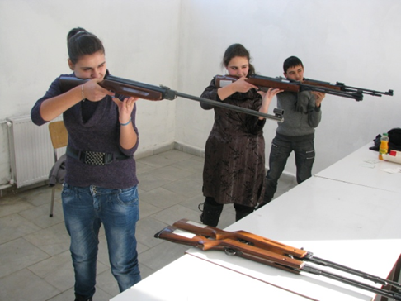
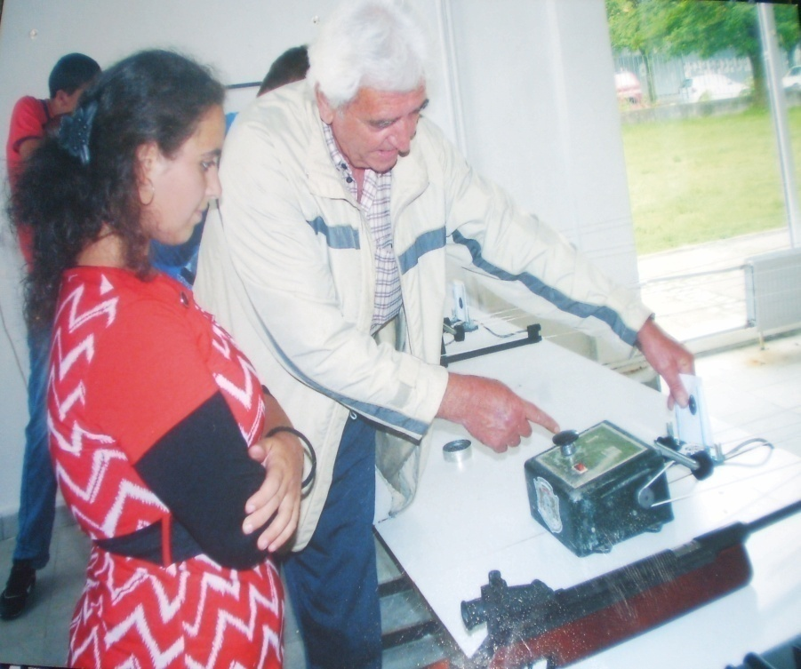
Club
«”Shooting”»
Project manager: Simeon Damianov

Slide 26
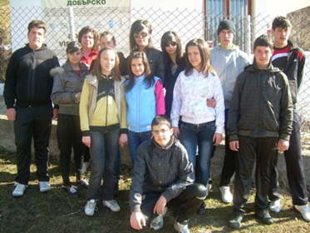
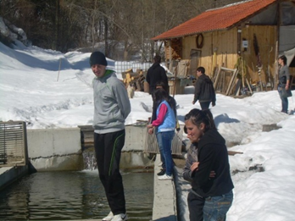
Club
“Young ecologist”
Project manager: Hrisitna Popova

Slide 27
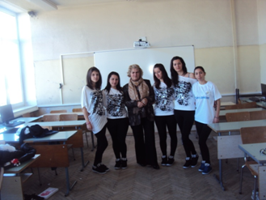
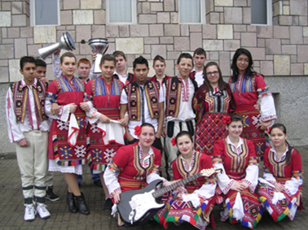
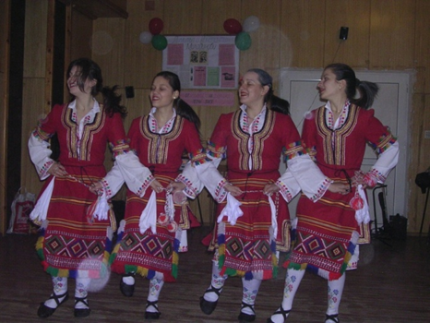
Club
«To express myself by dance»
Club
“Sing and Dance”
Project managers:
Zina Toncheva,
Krasimir Dragunun,
Ivan Chakalov

Slide 28
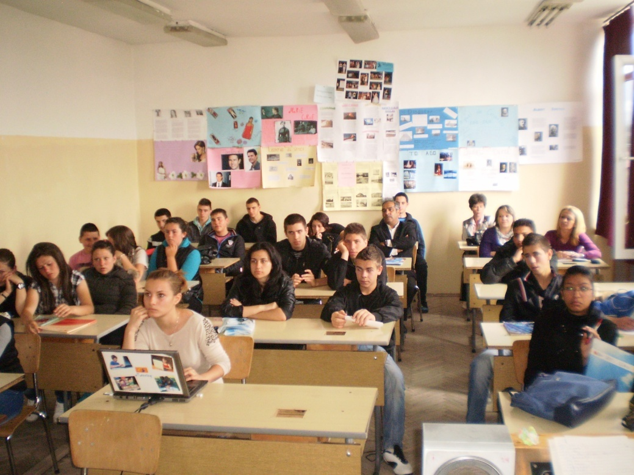
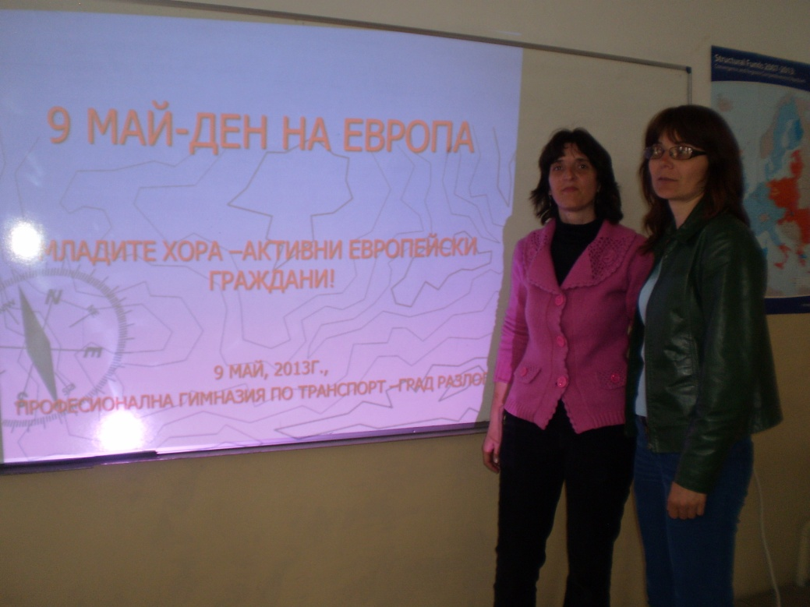
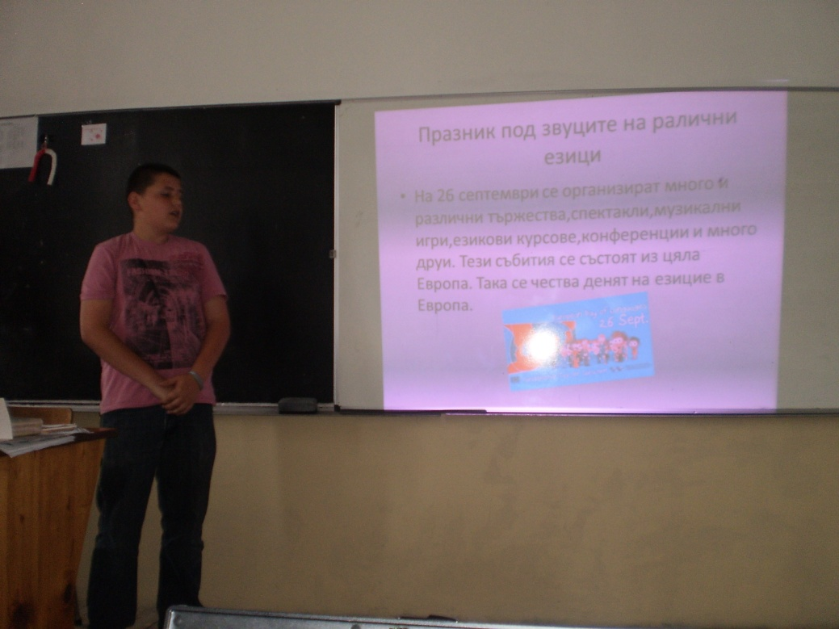
Club
“Europe”
Project manager: Goritsa Lazarova

Slide 29
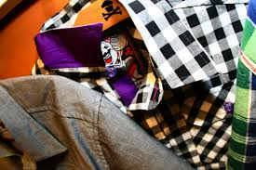
Club “Taekwondo”
Club “Understanding the nature of Razlog valley and river valley Mestа”
Club
“Photography”
Project manager: Simo Strahilov
Club
“Successful entrepreneur-cut and sew”
Project manager: Gergana Tonina

Slide 30





Project
Students’ placement
BG 051PO0001-3.3.07-0001
In this project students can work in a real places.
It is the beginning of dual system in VET in Bulgaria.

Slide 31

Project BG 051PO0001-3.1.03-0001
„Qualification of pedagogic specialists”
In this project are included our headmistress, our deputy director and 10 teachers. ”

Slide 32
International

Slide 33

The treasure chest and ICT or ICT in reading and writing”
LLP-2013-COM-MP-064
Comenius program of LLP
With partners from
Poland, Romania, Turkey, Hungary, Estonia and Latvia

Slide 34
Project
“Enrich Vocational Training through Unconventional Methods in EU Countries”
Leonardo da Vinci program of LLP- NUMBER - LLP-2012-LEO-MP-10
With partners from: Poland, Romania, Turkey, Spain, Greece, Italy, Germany, UK

Slide 35




Slide 36

We have just started a new project of WWF, ERSTE stiftung and ESFALP about topics for Active citizenship and Footprint or how to reduce the consumption of natural resources and to save the nature for the future generations.

Slide 37


Etwinning projects по програма «e Twinning» with partners almost from all over European countries
High Vocational School of Transport in Razlog is the only school in South-Western Bulgaria with eTwinning ambassador.

Slide 38

Study visits program
In this session were approved only about 30 people from Bulgaria and 3 of them are from our school.
My headmistress Mrs Yordanova was in Dania, 29.09-05.10.2013;
The deputy headmistress Mrs Darckchieva was In Turkey, 07.10-12.10.2013
Me as a teacher in VET and a teacher trainer – I was in Bonn, Germany.

Slide 39
Legends of Our Car Industries
Europe Celebrates Spring
Students profession tree
2014 Winter Olympics, Sochi, Russia
lots of people just one world

Slide 40



In Bulgaria there are 7 eTwinning ambassadors and one is working with students in our school and with teachers from all over Bulgaria.

Slide 41

International competitions

Slide 42



National competitions
“Young people –active European Citizens”
We are the winners in a national completion “Young people –active European Citizens”
and we were awarded with 5 day eco camp in old historical mountain city Koprivshtitsa.
Taking part in eco camp: “We are the citizens of Europe”

Slide 43
THANK YOU VERY MUCH
FOR YOU ATTENTION!

