Slide 1
Rezekne,
first Comenius meeting,
November 17-22

Slide 2
ESTONIAN EDUCATION
The principal objective of Estonia's educational system is to develop Estonian society into an open learning society, where every person is a lifelong learner.
The education system is divided into the following parts:
Pre-school education
Basic education
General Upper Secondary Education
Vocational Education
Higher education
Hobby education

Slide 3
PRE-SCHOOL EDUCATION
The state and local governments are responsible for children's education and studies in pre-school institutions. Child care institutions are:
crèches – for children of up to 3 years of age;
nursery schools – for children of up to 7 years of age;
nursery schools for children with special needs – for children with special needs who are of up to 7 years of age.
A rural municipality or city government shall provide all children permanently residing in their administrative territory whose parents so wish with the opportunity to attend a child care institution in the catchment area. Participation in a child care institution is voluntary; a child may start school straight from home as well.

Slide 4
BASIC EDUCATION
Compulsory school attendance generally begins at the age of 7 and lasts until completion of basic education or up to the age of 17. Basic education is acquired in basic schools, or in general upper secondary schools which have basic school classes and which cover the grades 1-9. Basic education is funded by the state budget and the local government. An academic year must include no less than 175 days and lasts from September 1st until June.
In lower secondary and secondary schools, there is a uniform grading system with a range from one to five, where "5" represents the best result and "1" the worst result. But there are others grading systems too.
For children with special needs compulsory school attendance may be fulfilled at mainstream schools or in special educational institutions.

Slide 5
SECONDARY EDUCATION
Secondary education is a level of education that is based on basic education. Secondary education is divided into general secondary education and vocational secondary education. The acquisition of secondary education is a necessary prerequisite for continuing studies in institutions of higher education.
In order to complete a general upper secondary education, a three-year study period has to be completed. Like basic education, general secondary education is funded by the state and the local government.

Slide 6
VOCATIONAL EDUCATION
The main emphasis in vocational education lies in acquiring professional skills and practical experience. Vocational education institutions are primarily funded by the state. Vocational education may be acquired either after graduation from basic school or after graduation from upper secondary school. Studies in the vocational secondary education curricula on the basis of basic education last at least 3 years. The duration of studies in the post-secondary vocational education curricula on the basis of secondary education is from 0.5 to 2.5 years.
There were altogether 43 vocational education institutions in Estonia.

Slide 7
HIGHER EDUCATION
The provision of higher education in Estonia began in 1632 with the establishment of the University of Tartu. Today, there are 33 institutions that provide higher education curriculums in Estonia; there are 9 universities, including 3 private universities, 22 institutions of professional higher education.
Higher education may be acquired as professional higher education or academic higher education.
Professional higher education is provided in institutions of professional higher education or at universities' colleges.
At a university, higher education can be acquired at three levels: Bachelor's Study, Master's study and Doctoral study. The nominal duration of Bachelor's study is three to four years (180-240 ECTS), Master's study one to two years (60-120 ECTS), and Doctoral study three to four years (180-240 ECTS). The standard period of Bachelor's and Master's study is at least five years in total.

Slide 8
HOBBY EDUCATION
Hobby education is an area of youth work that provides young people with knowledge and skills outside formal education. Hobby education is organised by local governments and legal persons. The local government budget has funding for cultural and youth issues, which is also used for financing hobby education.

Slide 9
There is a sun shining in each one of us. Let it shine bright.

Slide 10
Peetri Primary School is located near Tallinn, the capital of Estonia
500 students (aged between 7 and 16)
Peetri Primary School was opened in 2009
Our most important achievement this far has been to become the heart of local community

Slide 11
Vision
Peetri Primary School is quite a new school. Our goal is to create such a study environment that enables each child to become a motivated learner with positive attitude. Our aim is to achieve that all our students know how to learn and willing to do that.
For doing this there has been put together a strong cooperative team of highly dedicated teachers whose task is to bring into life the vision of a NEW GOOD SCHOOL. That was set as our aim from the very beginning and it still is.

Slide 14
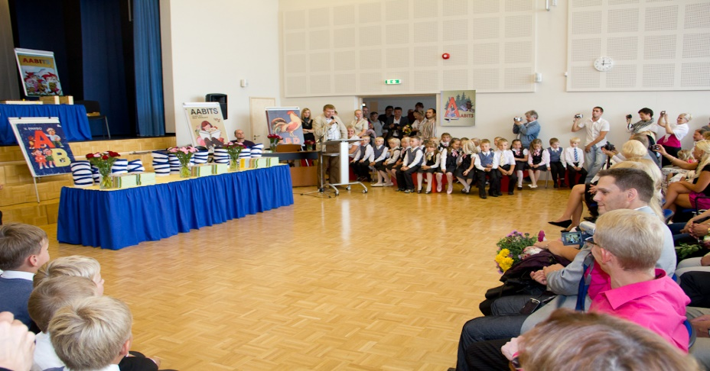
1.SEPTEMBER 2009

Slide 15
In September 2009 we had a team of teachers who were willing to work to achieve the goals set forth. Each year we need new teachers.
It is important that all our new colleagues would understand and share our vision and would be ready to work hard for that.
Many of newcomers have never given feedback nor written assessments or guided students to self-examination and self-evaluation.

Slide 16
WHAT IS IT – A GOOD NEW SCHOOL?
Studying is supported by positive atmosphere;
Teachers provide support, guidance and help;
We notice and support the development of each student;
We use methods of active learning and modern teaching facilities;
In learning process we create opportunities that enable students to choose, decide and take responsibility.

Slide 17
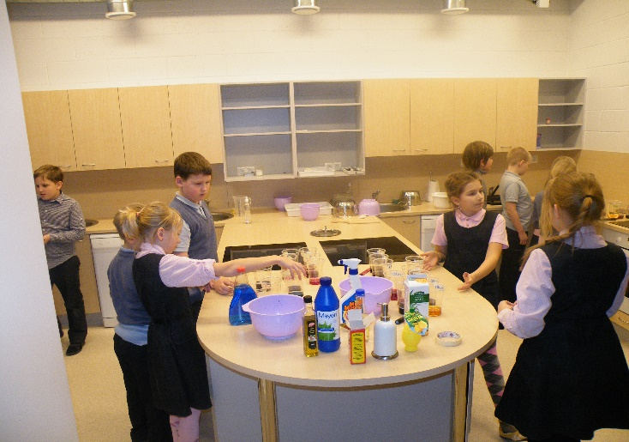
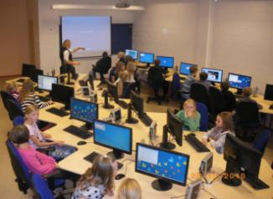
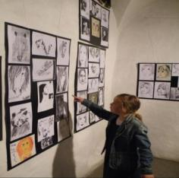
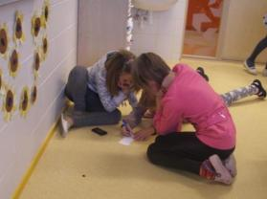
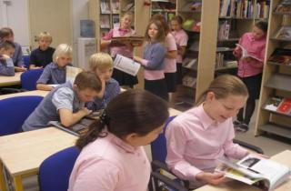
Great variety of teaching methods (group work, project work, theme based weeks, excursions, outdoor lessons)

Slide 18
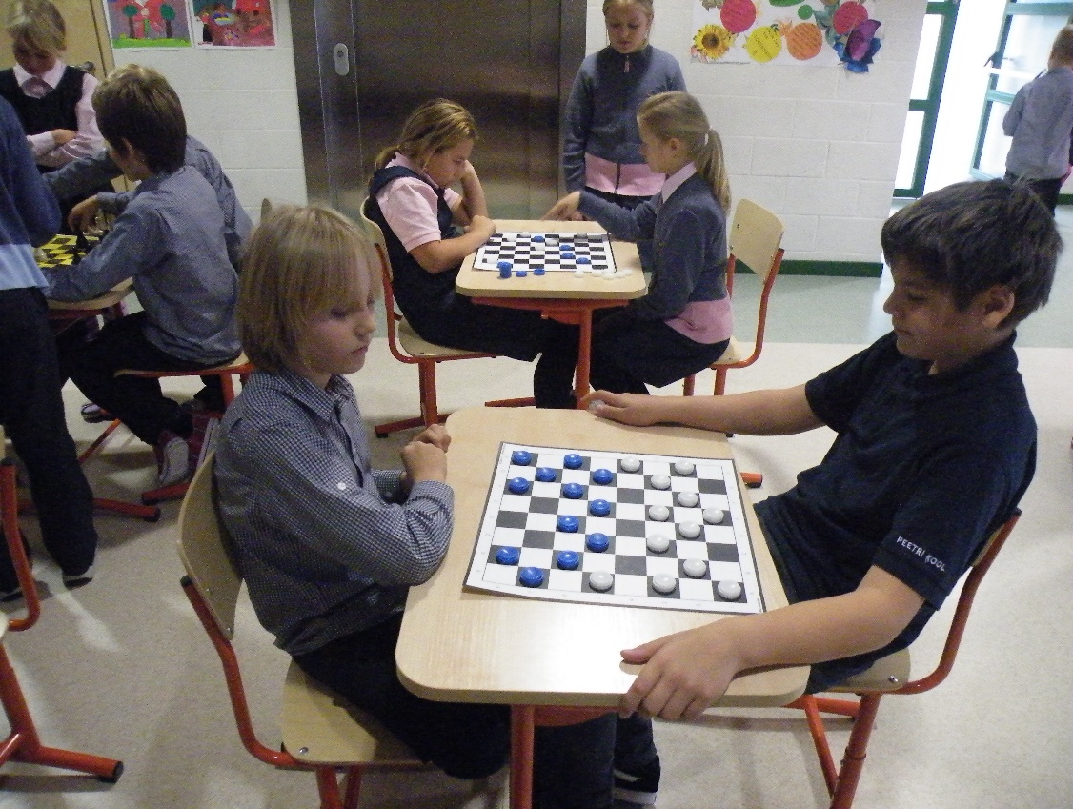
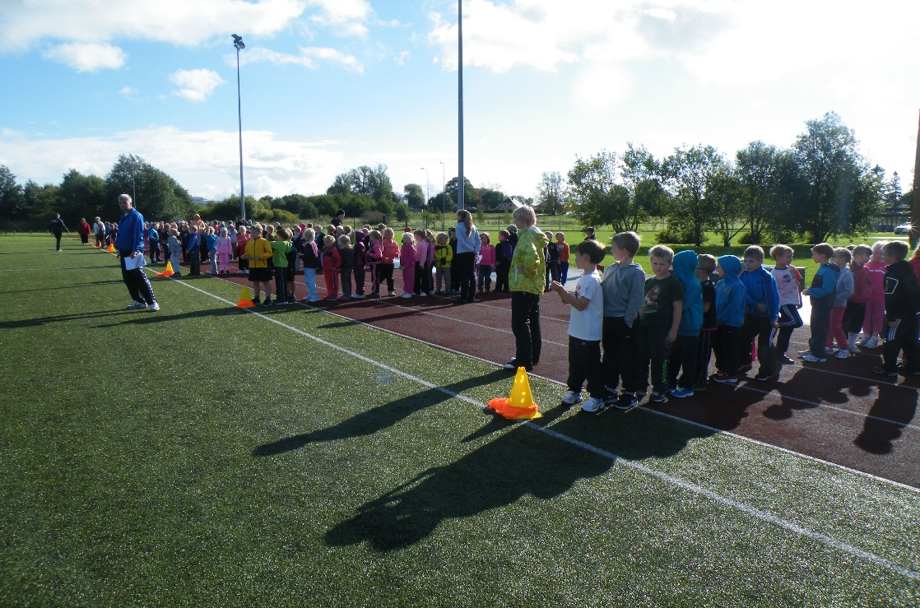

Slide 19
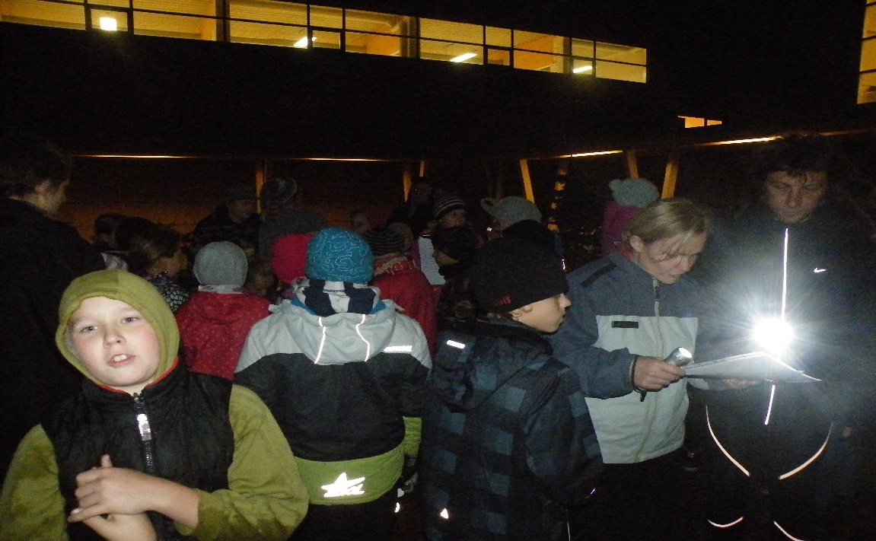
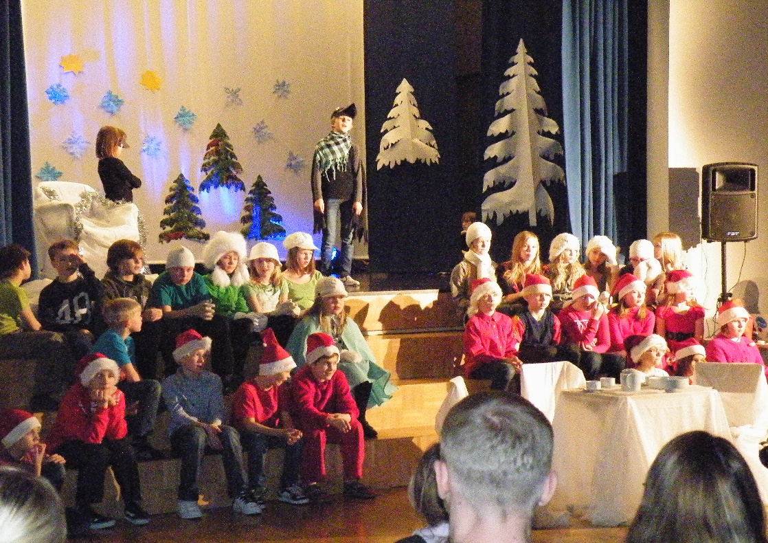
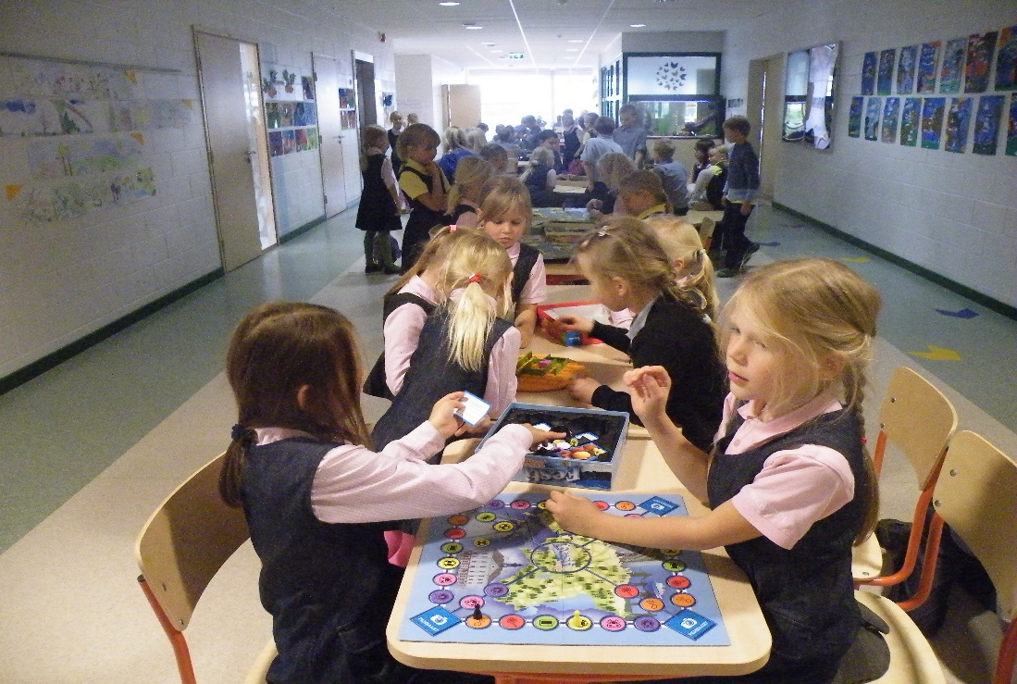

Slide 20
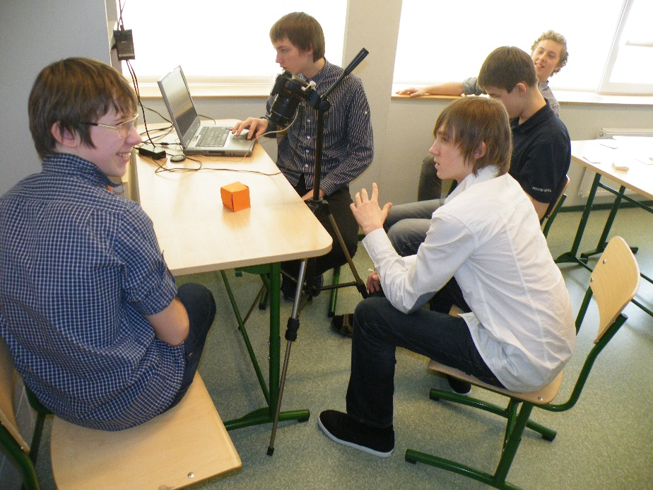
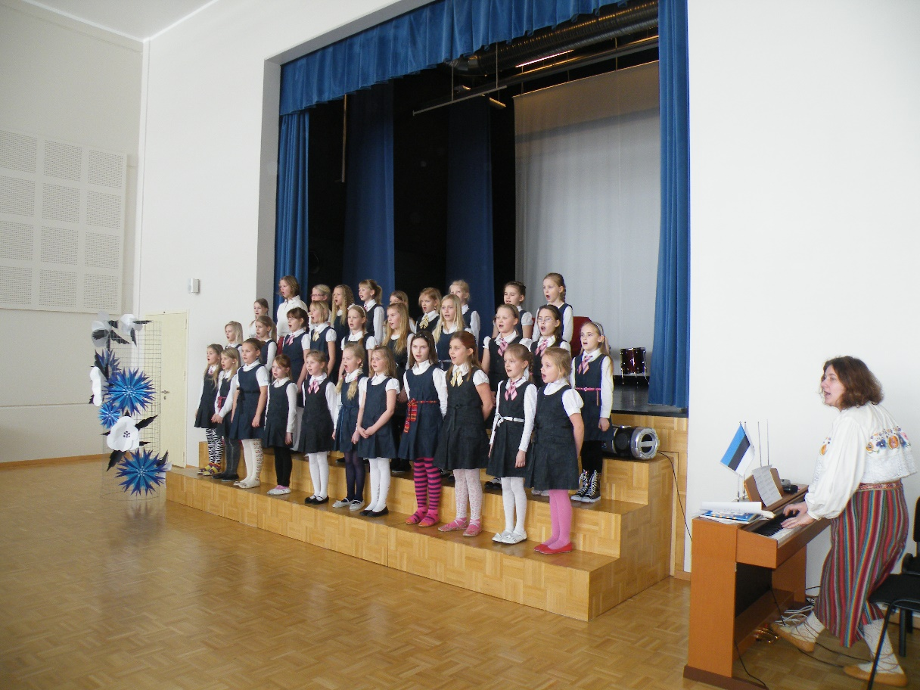
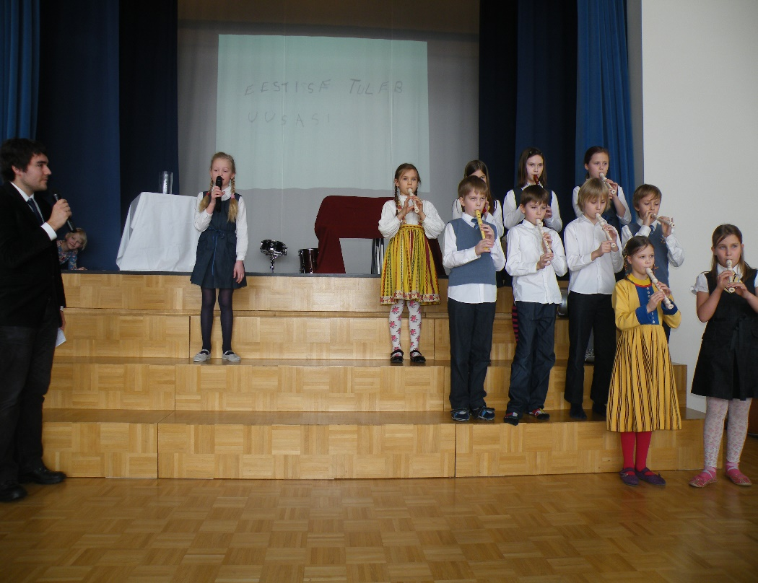

Slide 21
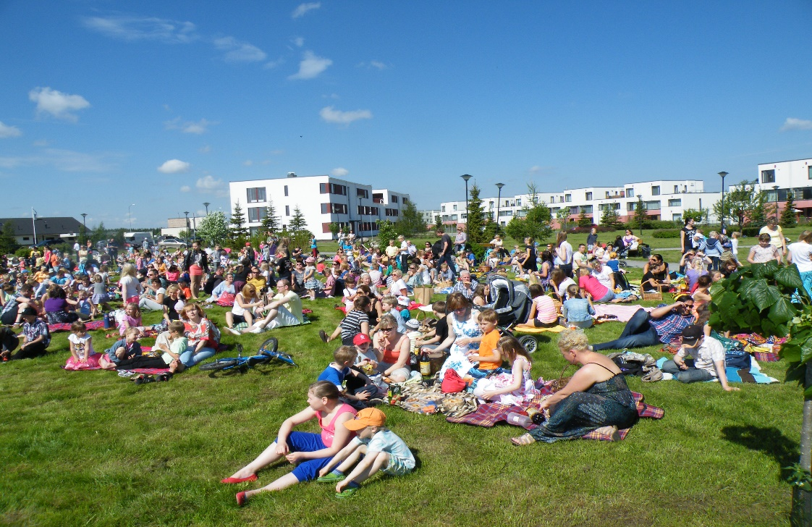
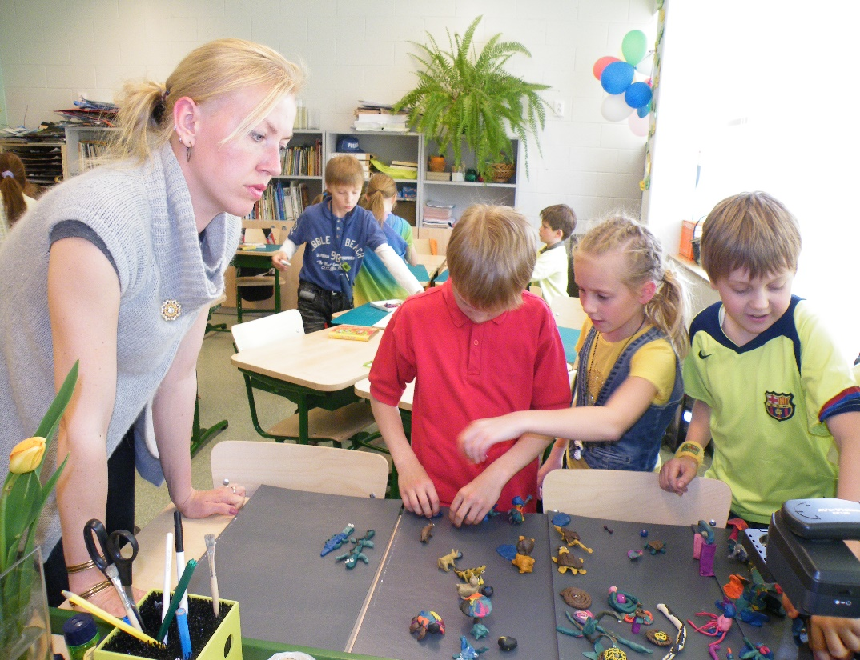
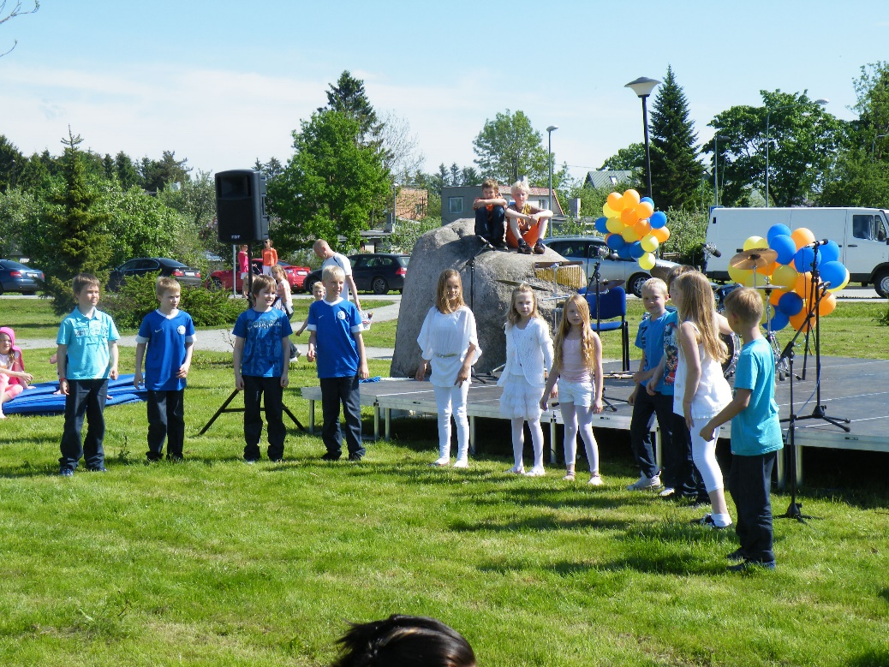

Slide 22
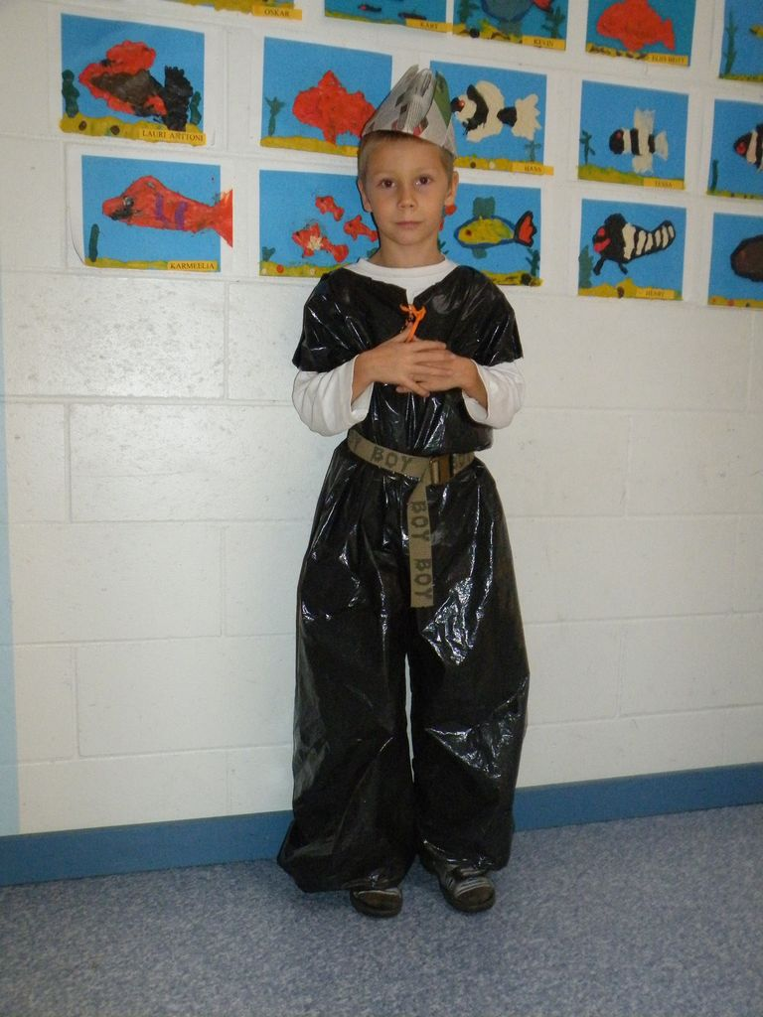
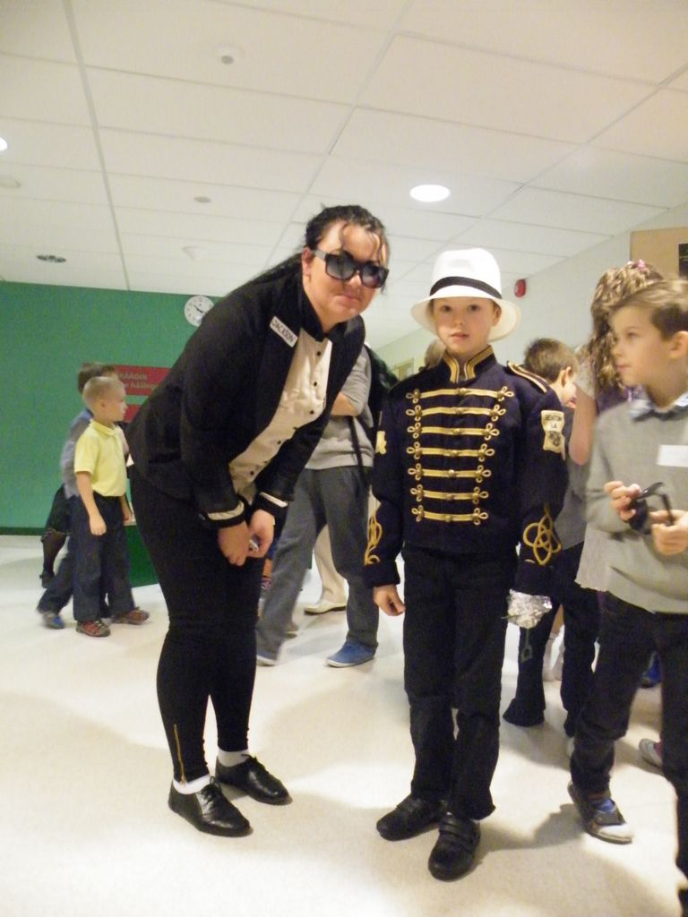
Style weeks

Slide 23
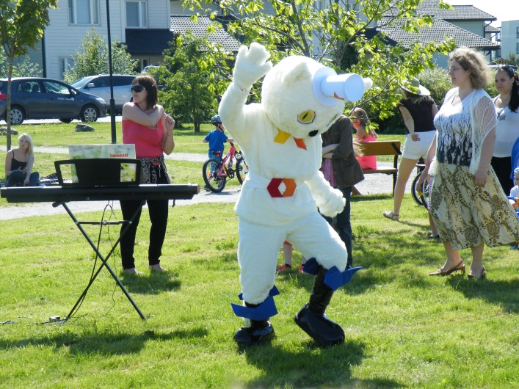
Summer picnic

Slide 24
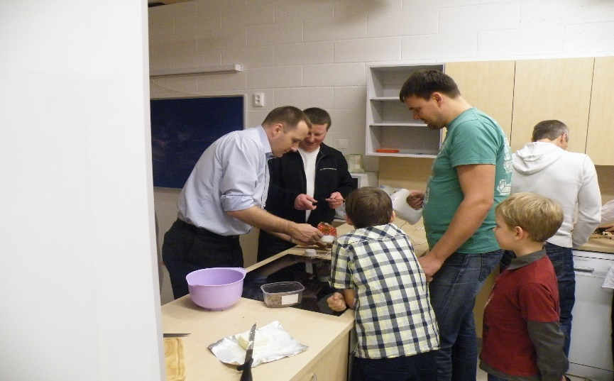
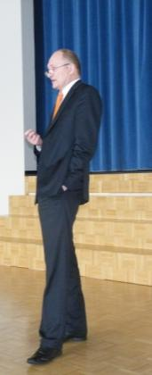
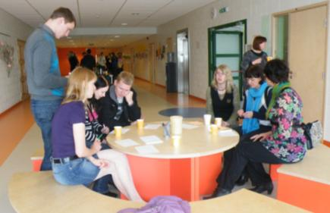
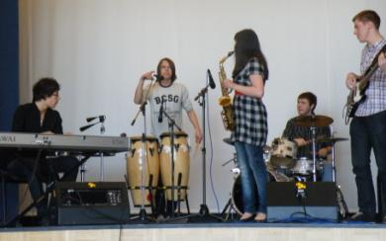
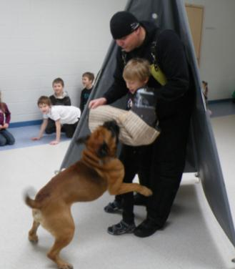
Parents and specialists from different fields of life are included in the study process

Slide 25
OUR STRENGTHS
collaboration between teachers;
collaboration with parents;
good opportunities for using ICT;
work on curriculum;
extracurricular activities;
good reputation;
good teachers;
extension of schoolhouse (rooms for dancing, drama, science lab, classrooms);
ICT equipment (laptops for students, projectors, document cameras);

Slide 26
CERTIFICATE

Slide 27
I - V class

Slide 28
VI-IX class

Slide 29
SELF-ASSESSMENT

Slide 30
I class

Slide 31
II-III class

Slide 32
IV- IX class

Slide 33
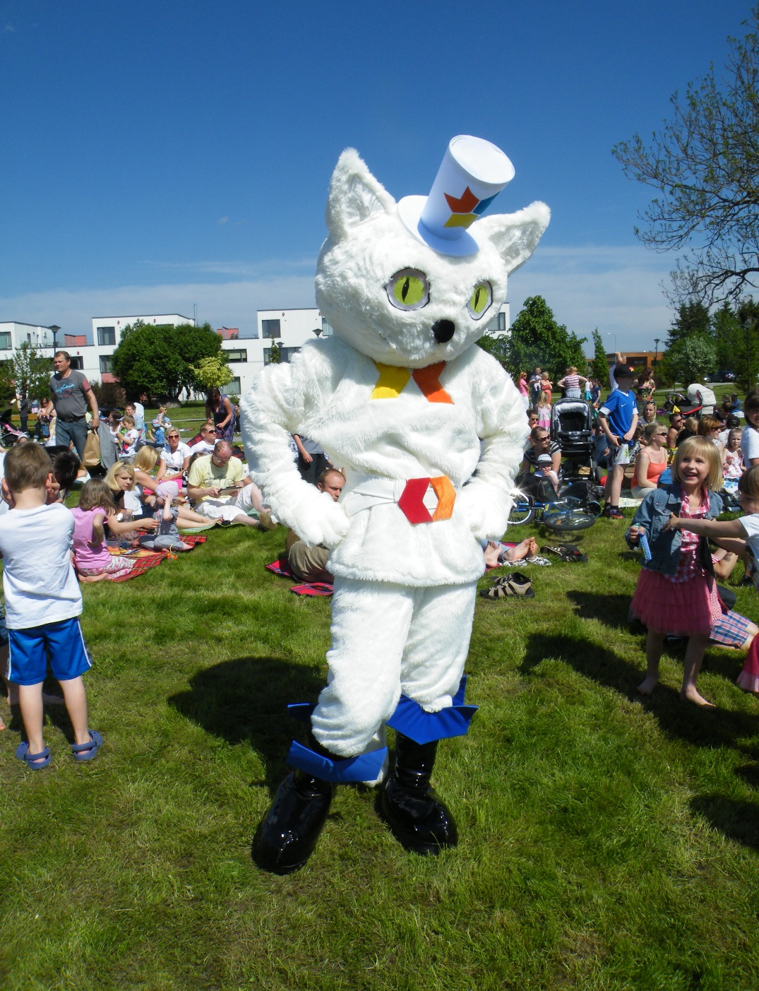
THANK YOU!

