Slide 1
Rezekne,
first Comenius meeting,
November 17-22

Slide 2
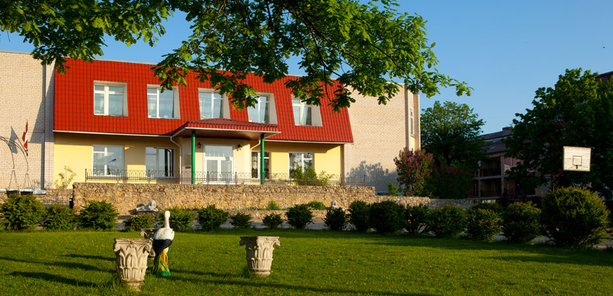
Welcome to Rezekne Polish State Gymnasium

Slide 3
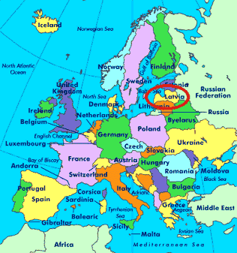
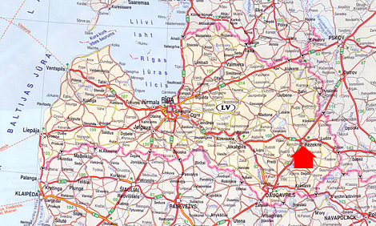
School location
Lubānas street 49
Rēzekne
Telephone/fax (+371) 64636680
poluvsk@rezekne.lv
www.rezpvsk.lv

Slide 4
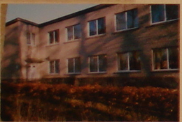
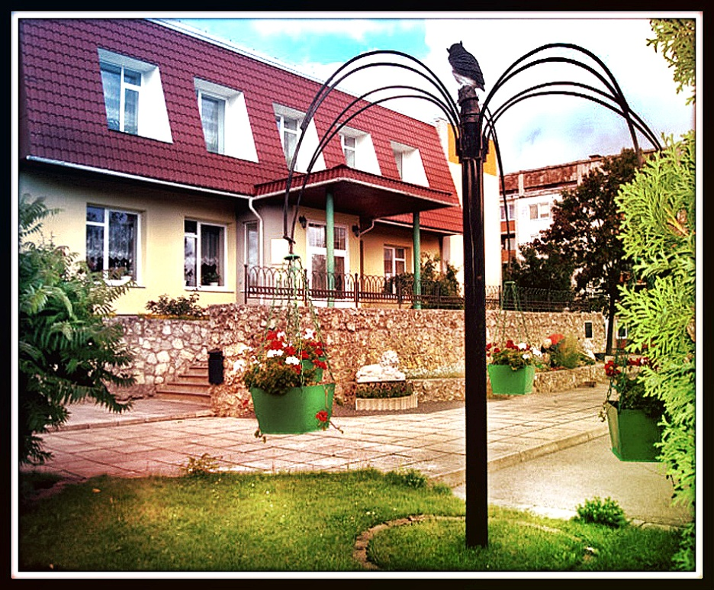
History of Rezekne Polish State Gymnasium
1993- The school was founded as a primary school with 22 pupils and 11 teachers;
1997 - The school was accredited as a basic school and moved to a new building;

Slide 5
History of Rezekne Polish State Gymnasium
2002 - The school became a secondary school;
2008 - The school was accredited for 6 years;
2010 – The historic name was returned to the school - "Rezekne Polish State Gymnasum";

Slide 6
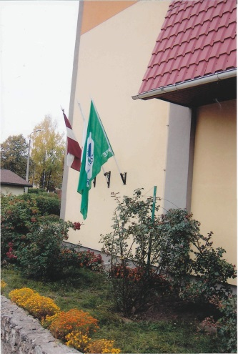
History of Rezekne Polish State Gymnasium
2011 - Mini football pitch was built;
2012 - EU school renovation project was carried out;
2012 - The school achieved recognition of eco-school.
2013 - Eco-Schools programme rewarded our school with the Green Flag.

Slide 7
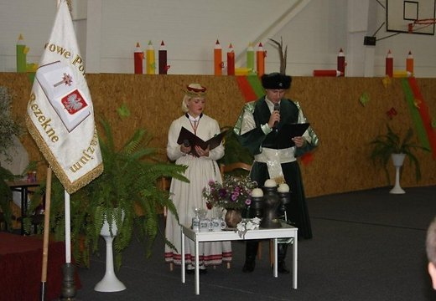
History of Rezekne Polish State Gymnasium
2013 - the Ministry of Education and Science of the Republic of Latvia recognised our school as the teacher- friendliest educational institution of the year.
2013 - The school celebrates its 20th anniversary.

Slide 8
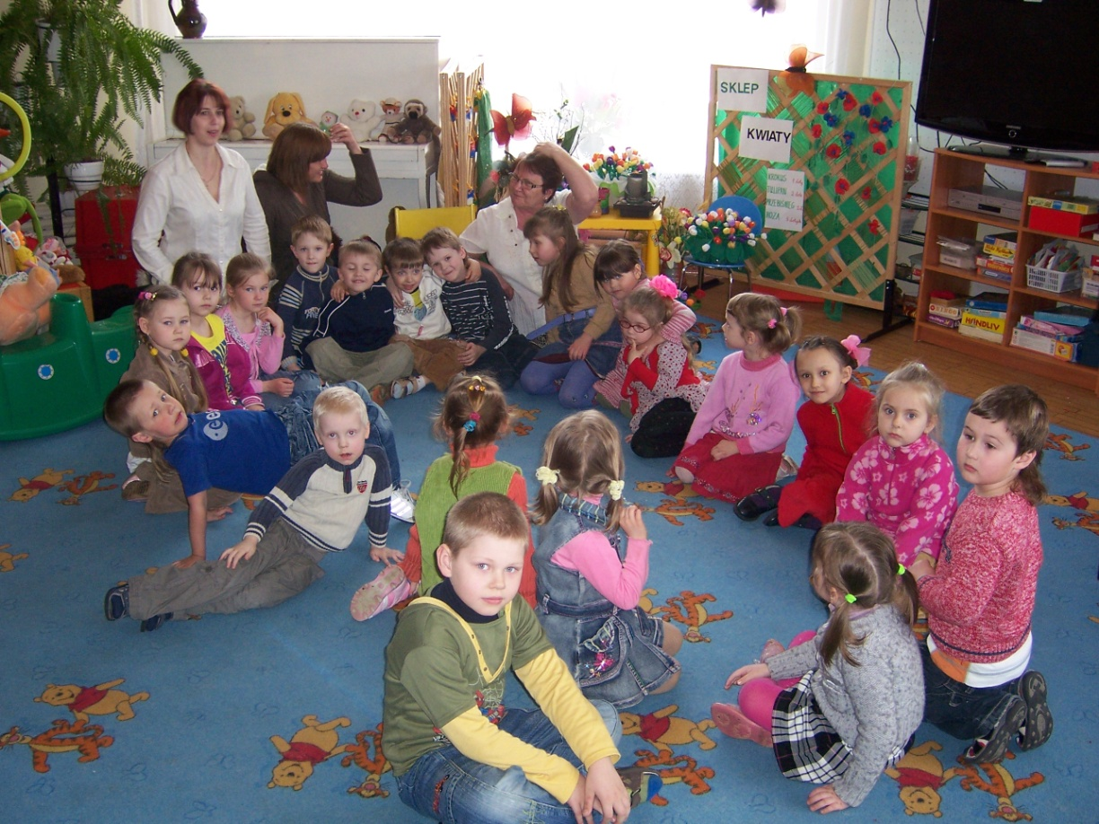
Pupils
There are 477 pupils, 22 classes in school.
The school has got a pre – school group for preparing 5- 6 year old children for school

Slide 9
Increase in the number of pupils

Slide 10
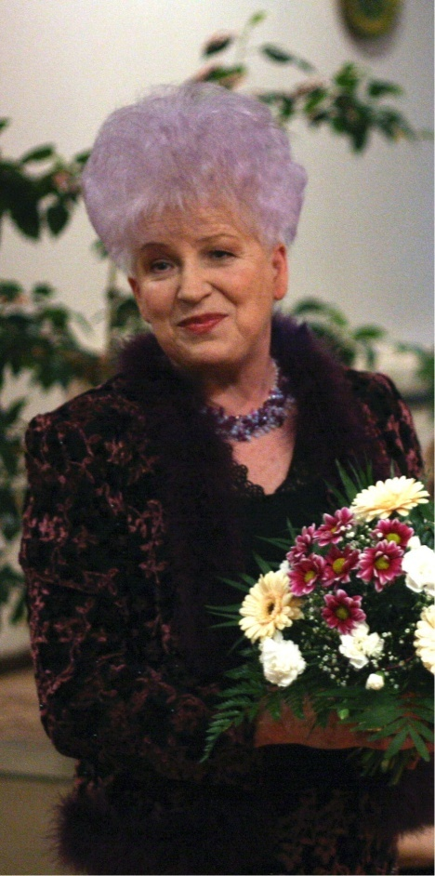
School administration staff
The head of the School
Master of Pedagogy
Valentina Sidlovska
Deputy head teacher
in charge of studies
Liga Abricka
Deputy head teacher
in charge of extracurricular activities
Master of Pedagogy
Bernadeta Geikina – Tolstova
Deputy head teacher
in charge of Information
Master of Natural Sciences in Computer Science
Anna Skripacenoka

Slide 11
School pedagogical staff
49 teachers of whom 2 teachers are from Poland.

Slide 12
School support staff
Psychologist
Speech Therapist
Social Teacher
School Nurse

Slide 13
Technical stuff

Slide 14
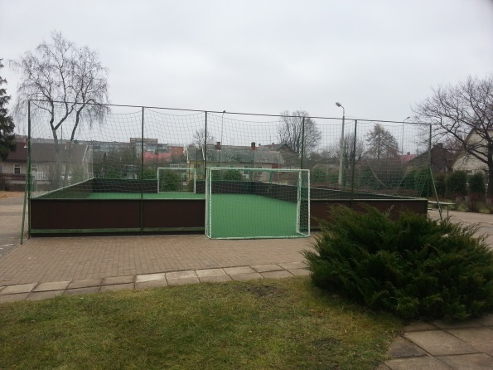
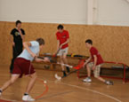
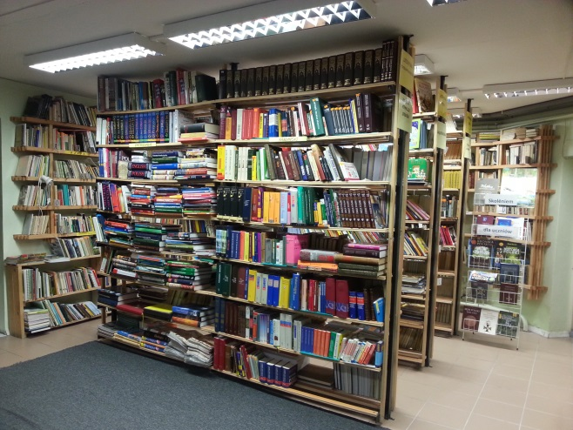
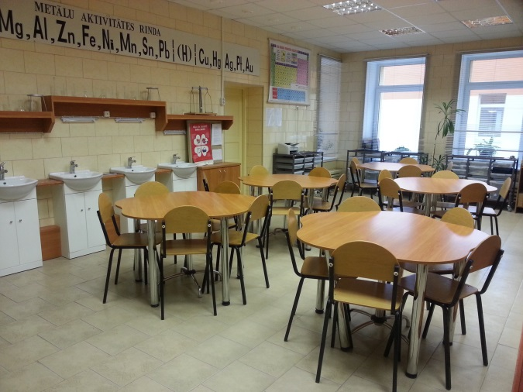
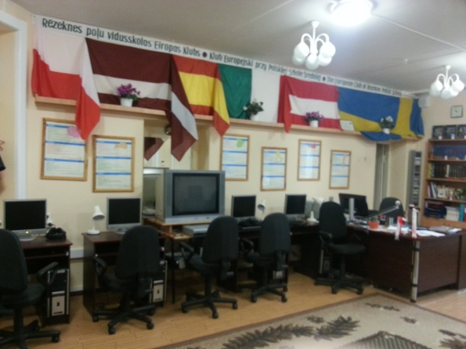
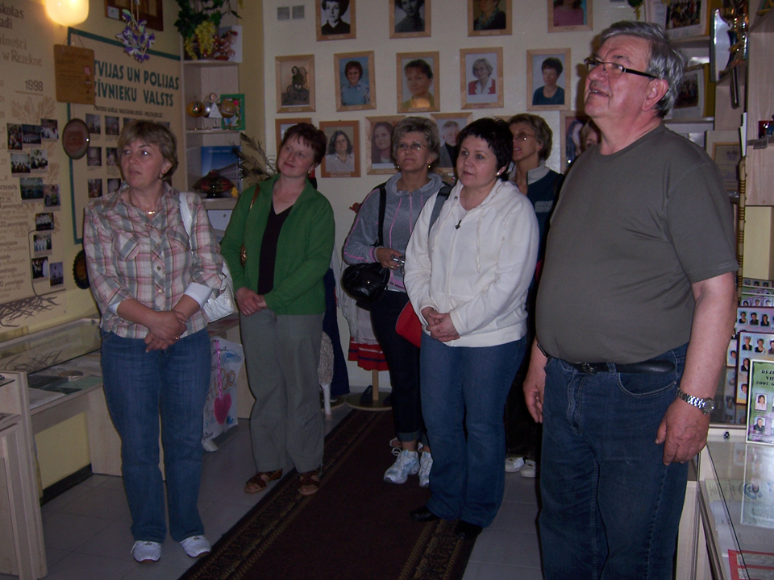
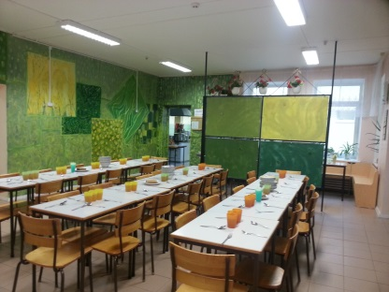
School facilities
Gym;
Mini football pitch;
2 IT classes;
Labs;
Library;
Museum;
School hall;
Canteen.

Slide 15
School logo
Rezekne Polish Secondary School logo
Rezekne Polish State Gymnasium logo

Slide 16
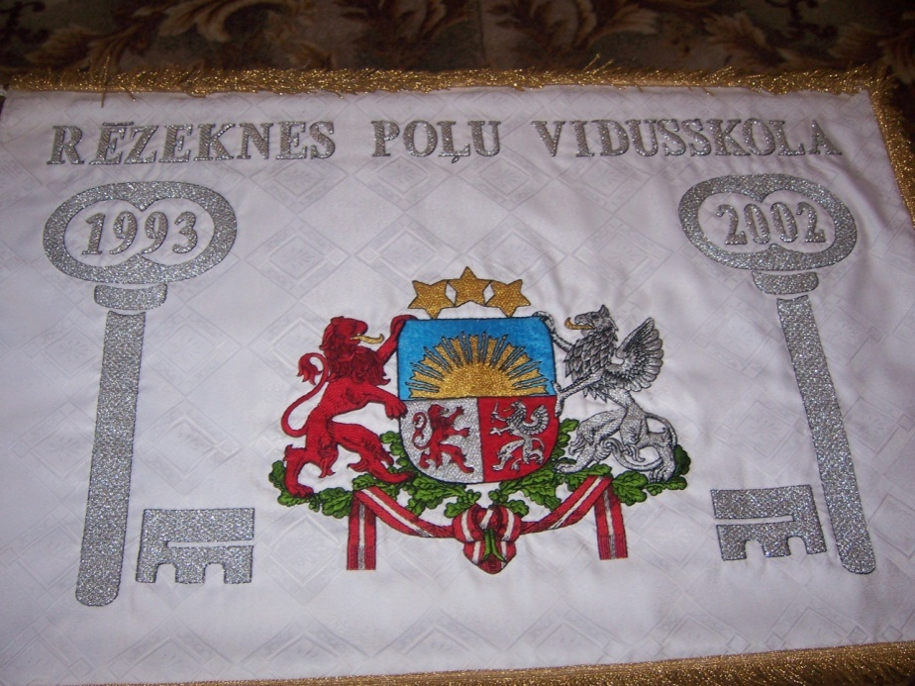
School flag
Rezekne Polish Secondary School flag
Rezekne Polish State Gymnasium flag

Slide 17
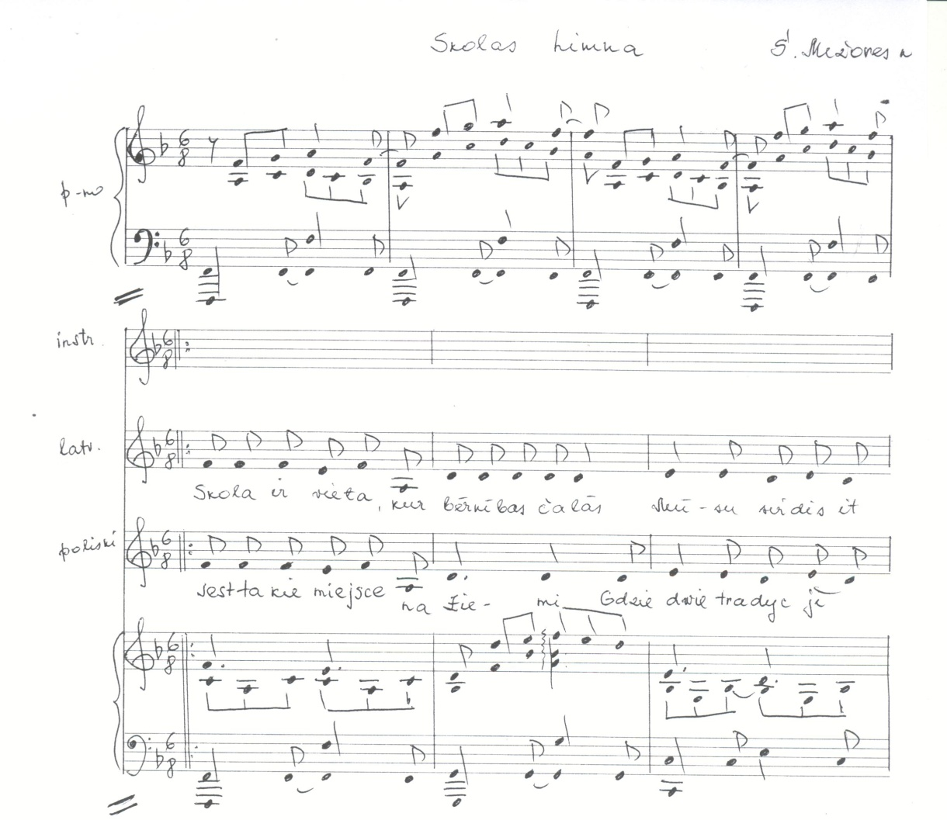
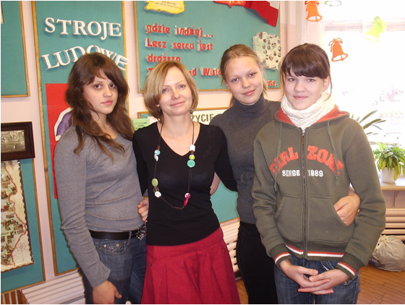
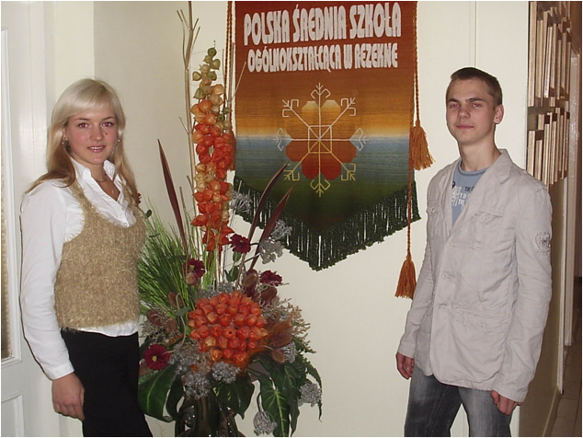
School Anthem

Slide 18
The out of school activities:
Latvian folk dance groups
folk instruments chapel,
pop group,
variety art group,
Polish folk dance group of 1st and 3rd -4th forms,
two choirs of 1st -4th and 4th -5th forms,
block flute,
aerobics,
boys band,
religious song ensemble,
acoustic guitar ensemble,
environmental erudite group.

Slide 19
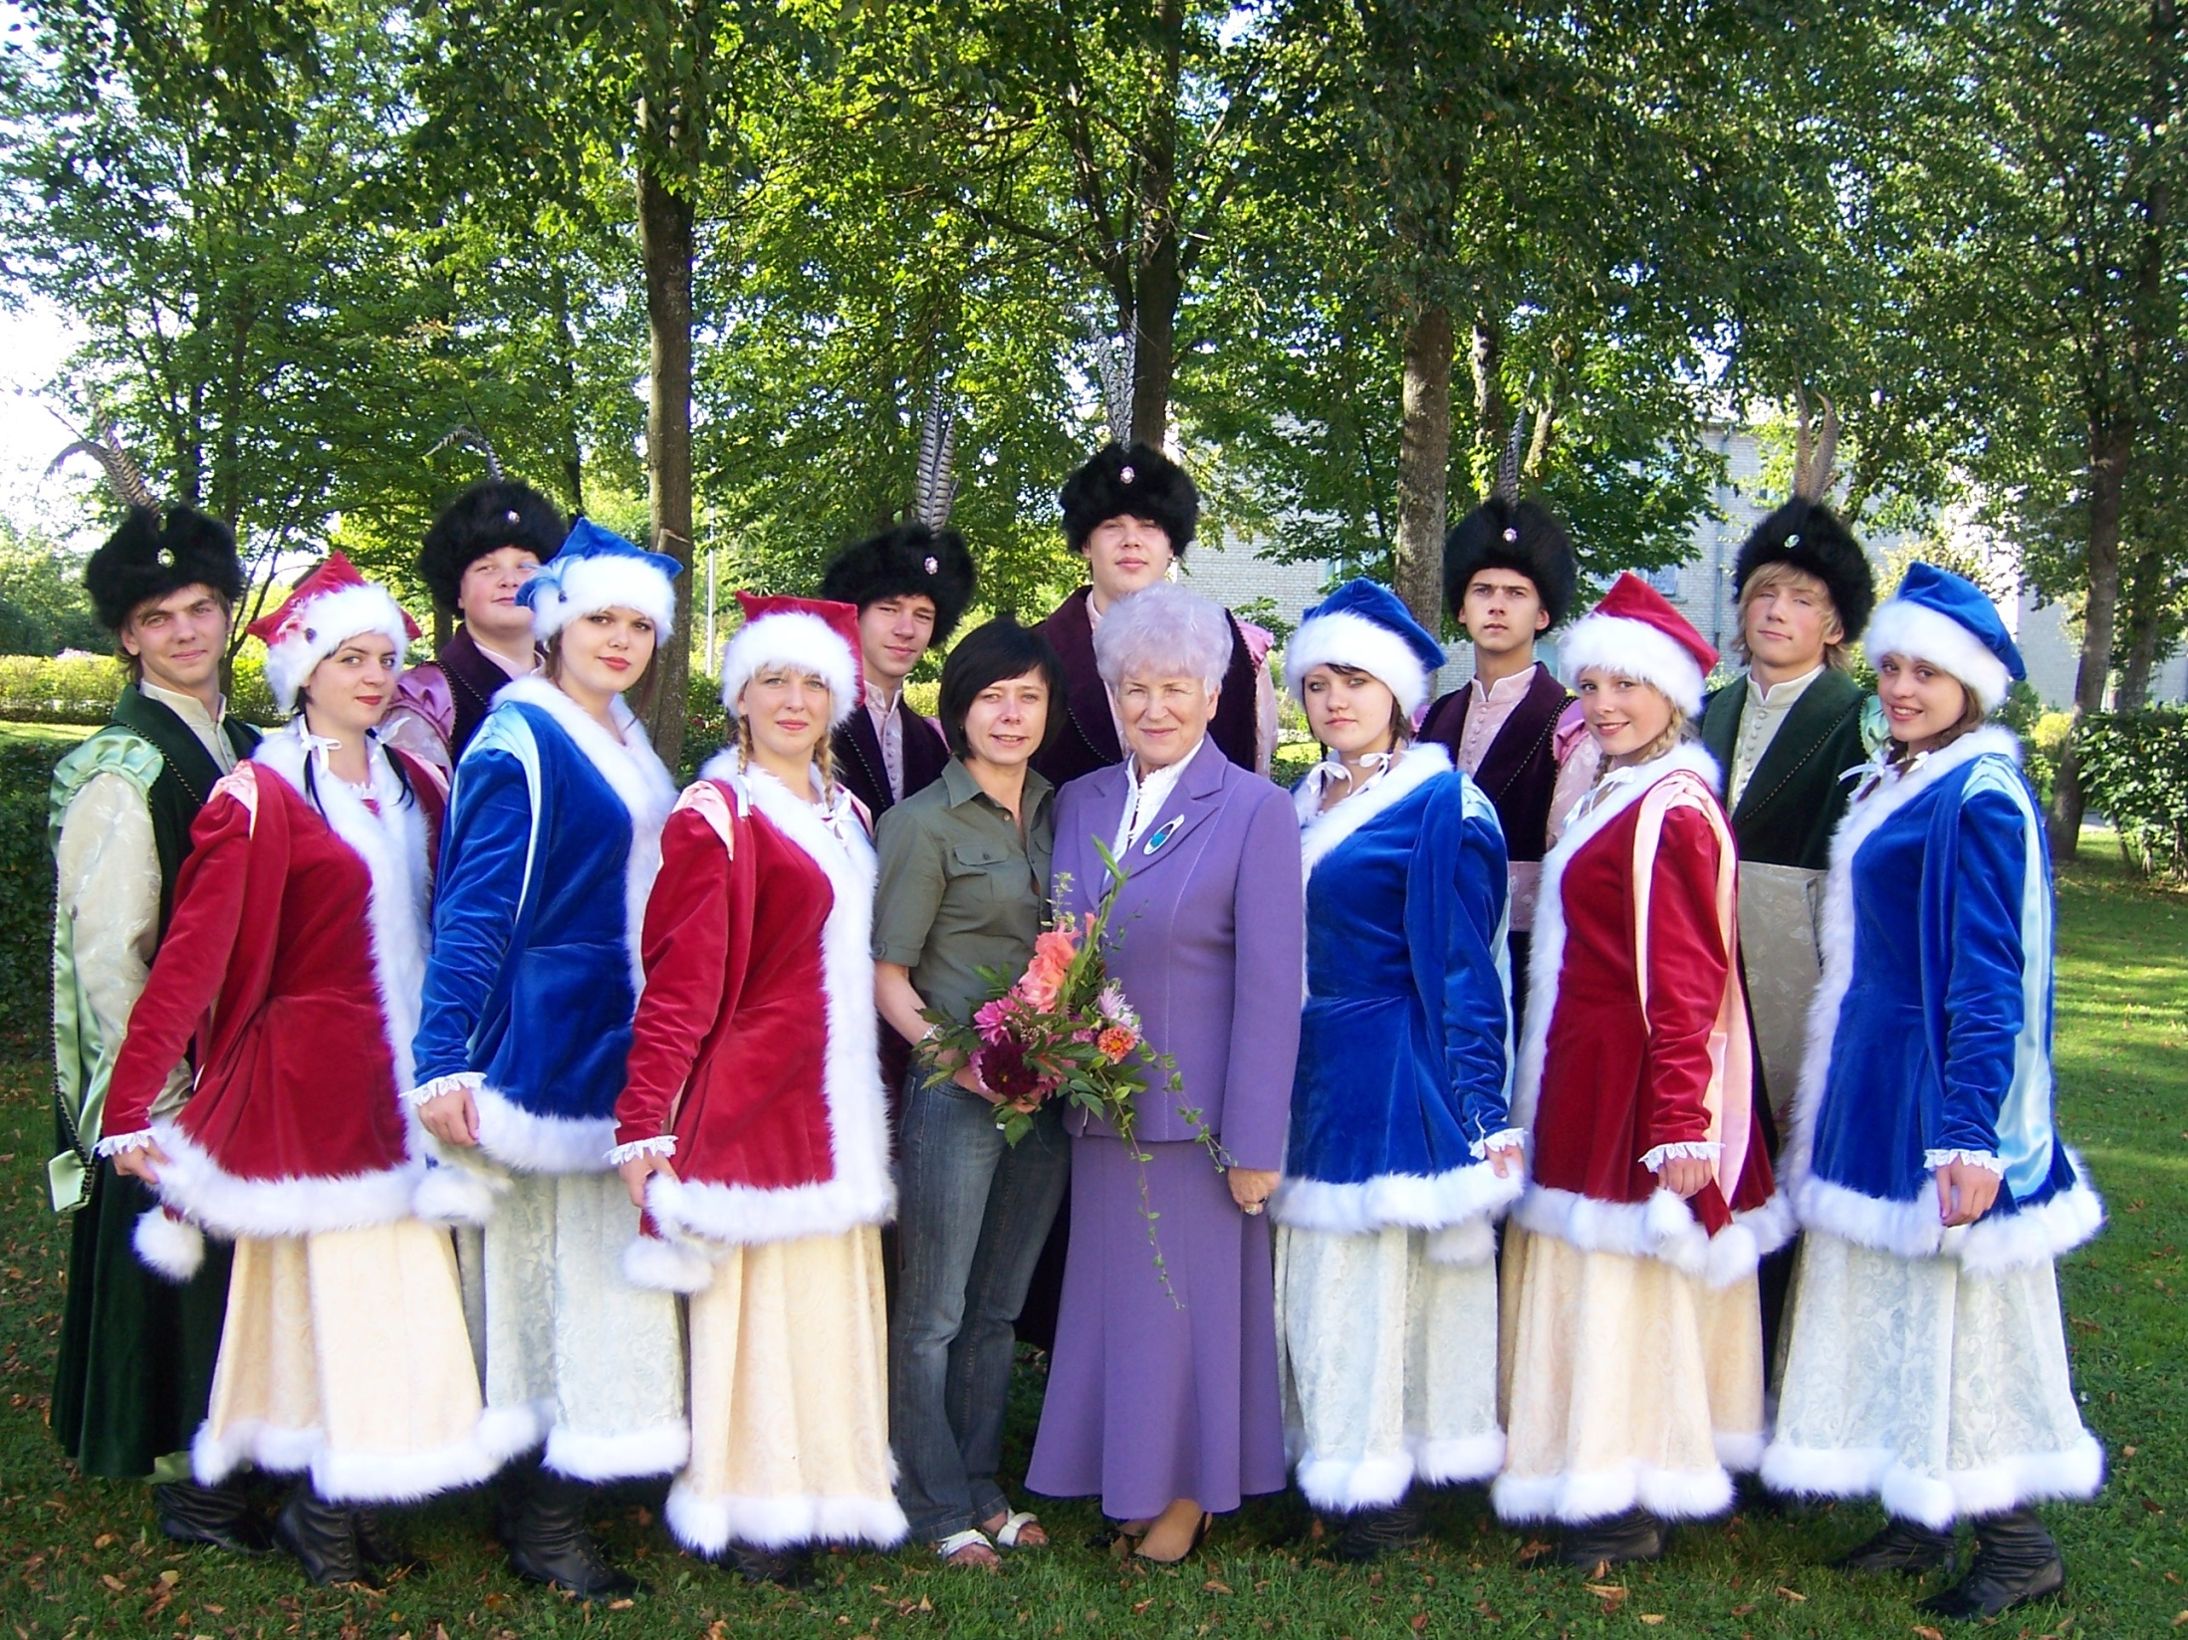

Slide 20
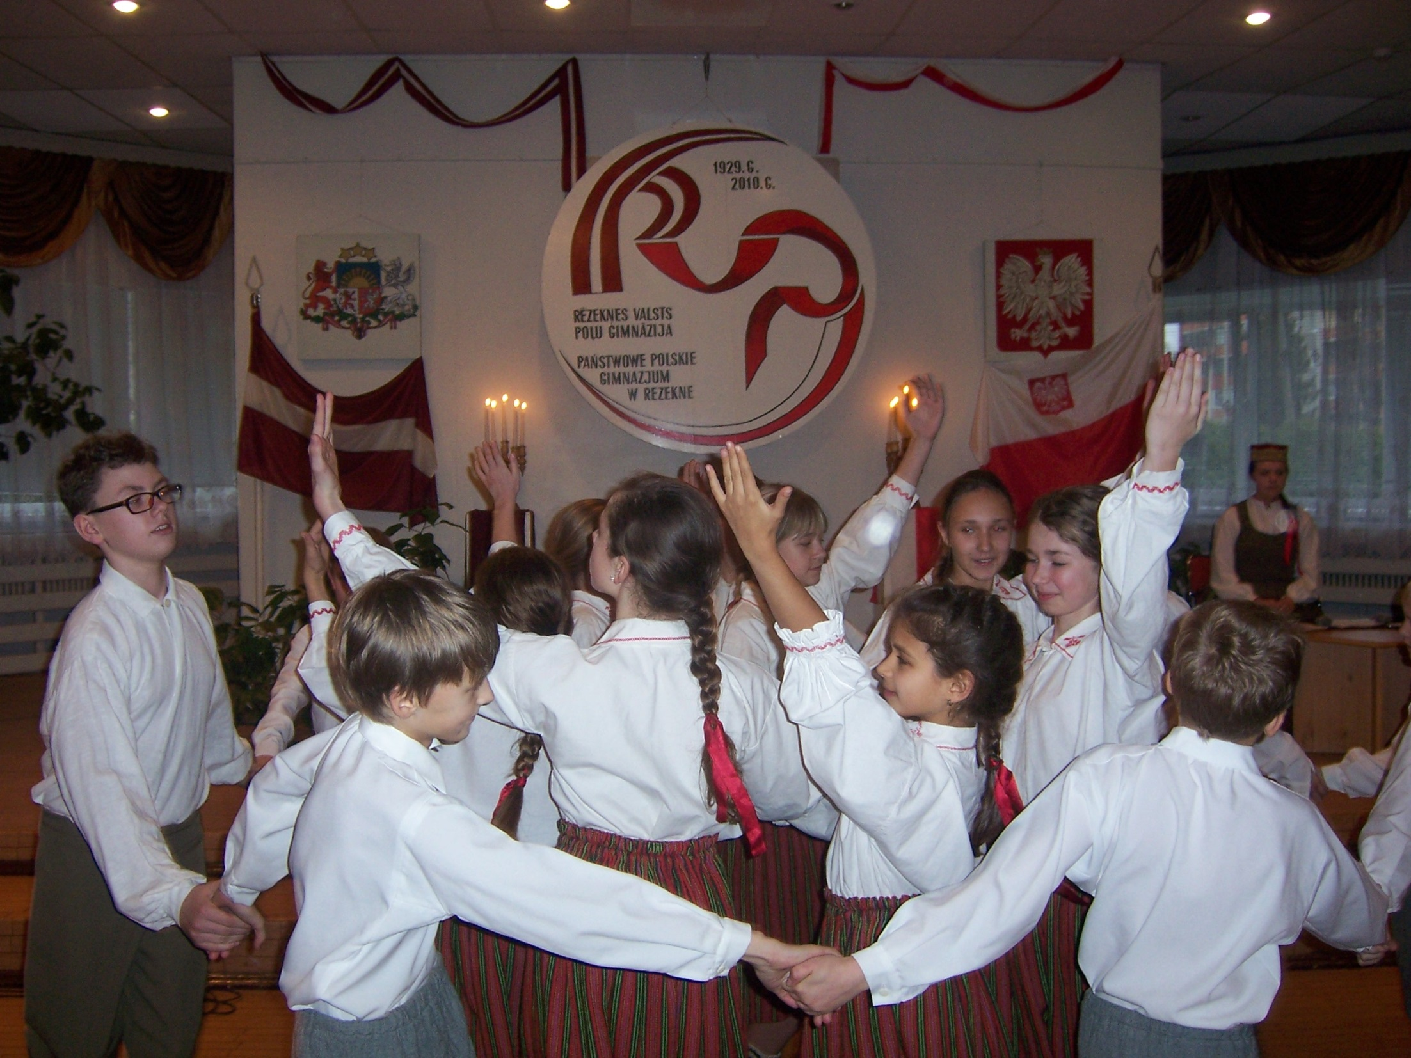

Slide 21
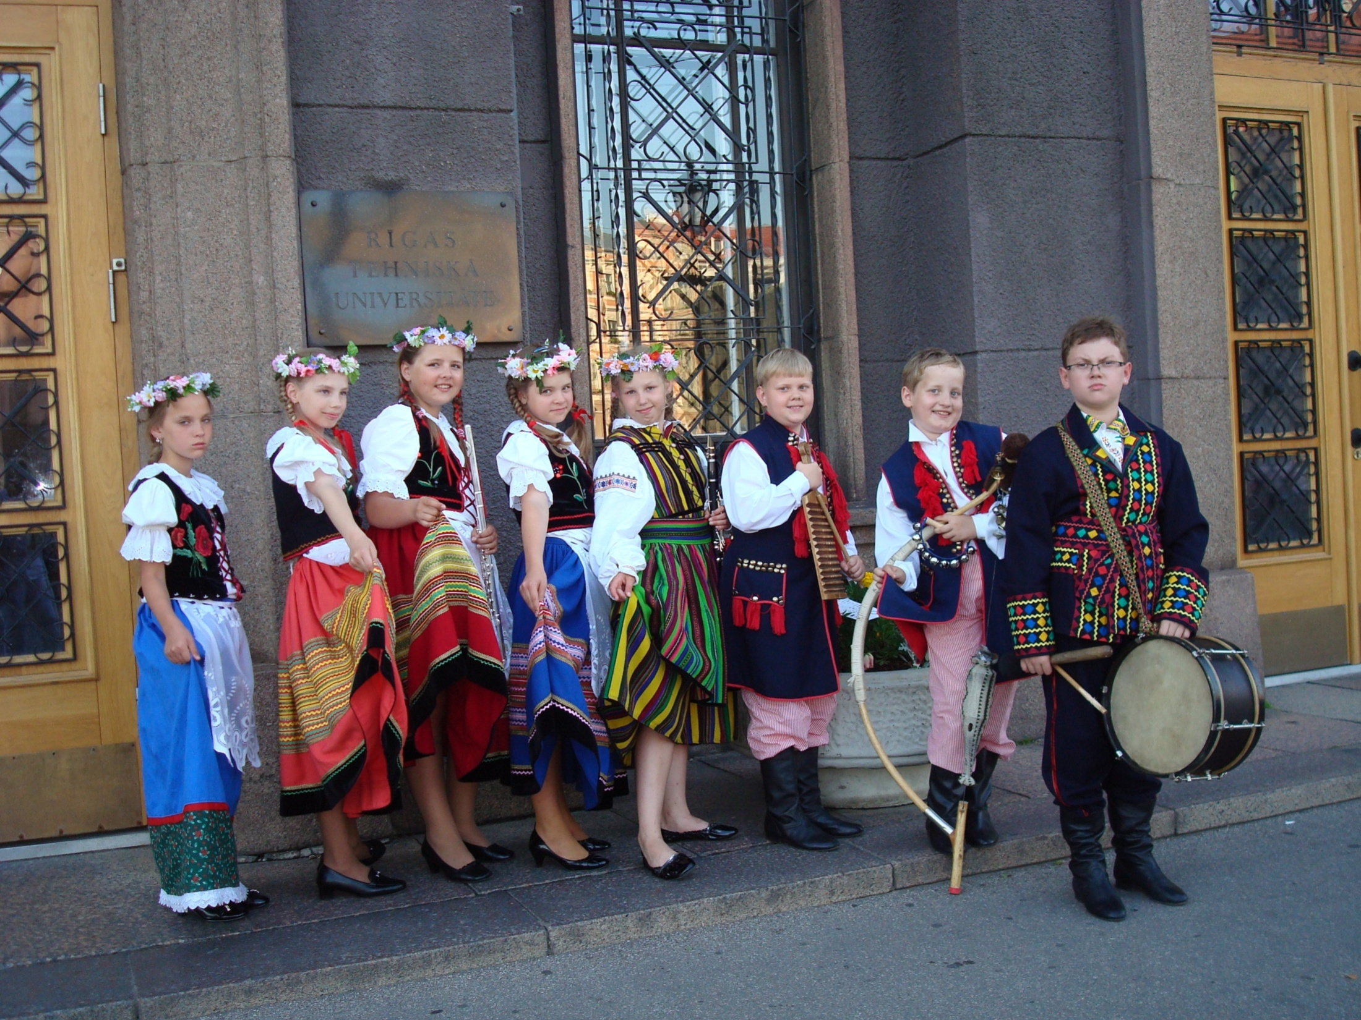

Slide 22
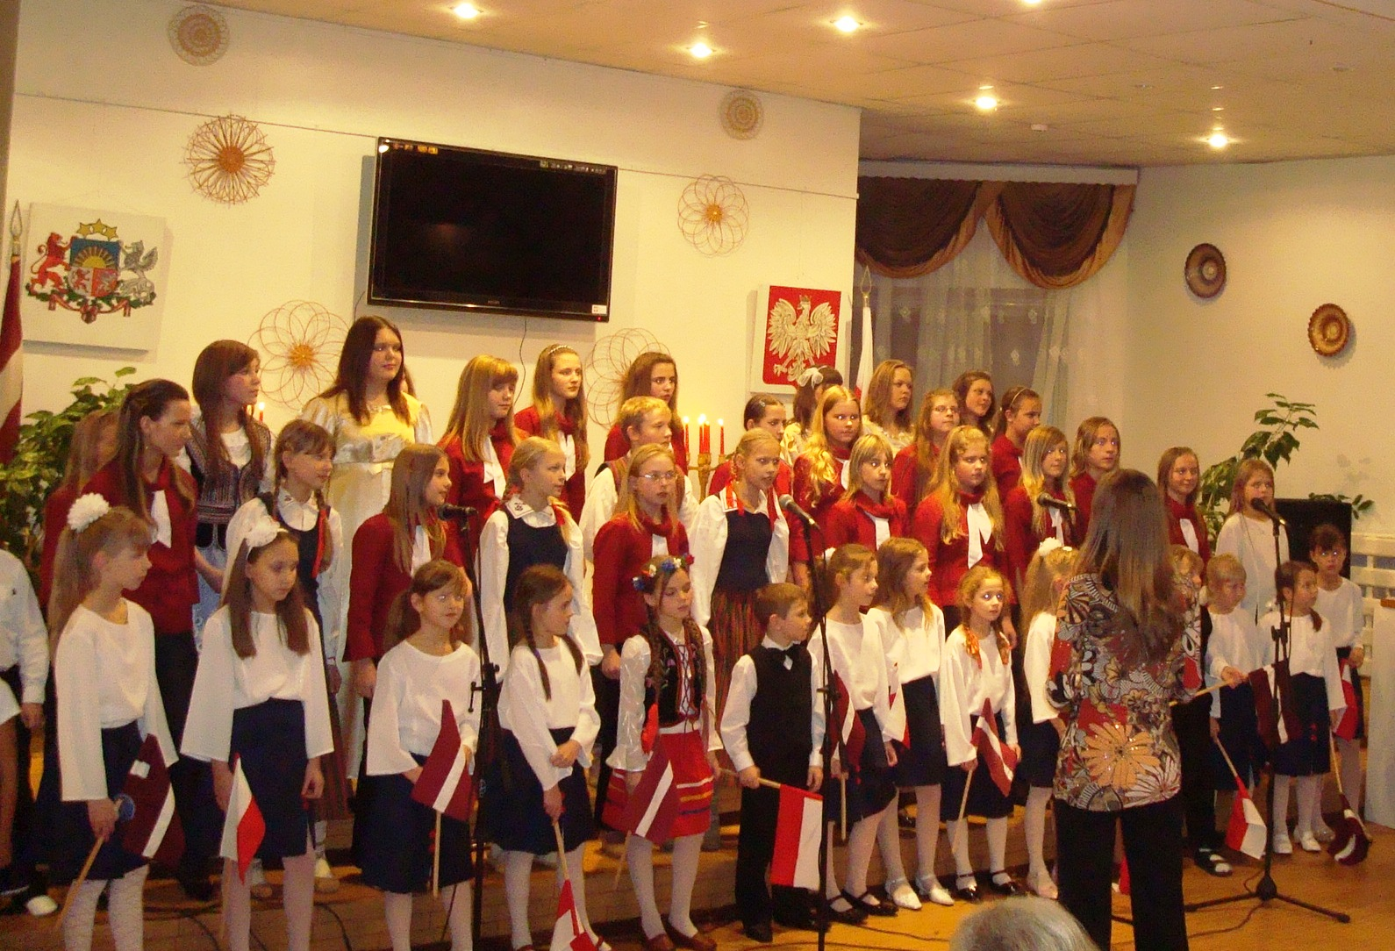

Slide 23
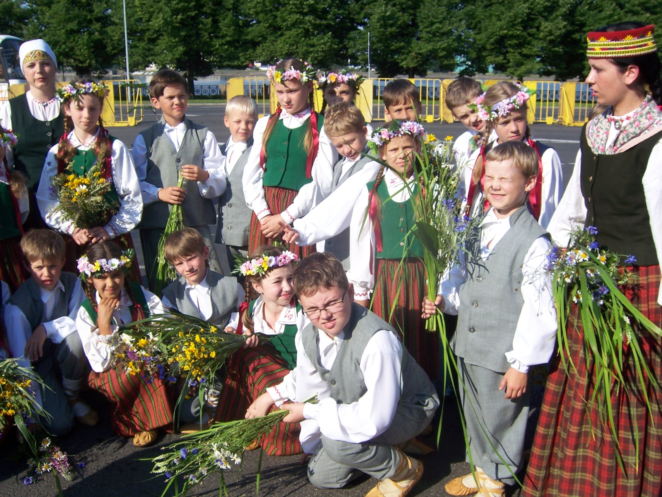
In 2010, 5 collectives took part in X Song and Dance Festival of the Republic of Latvia.

Slide 24
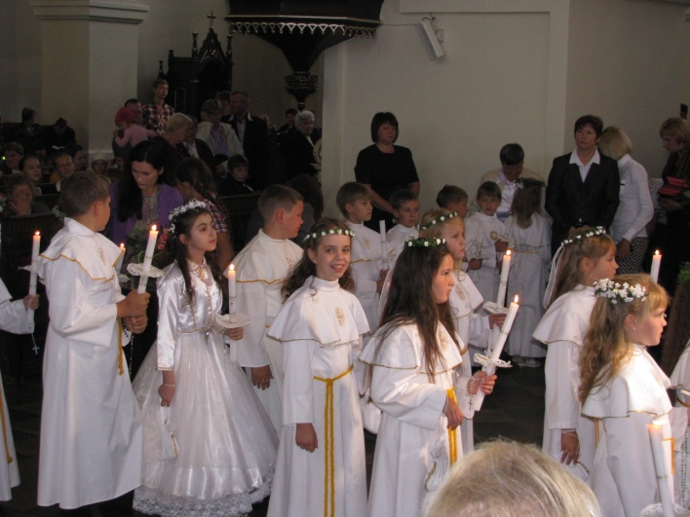
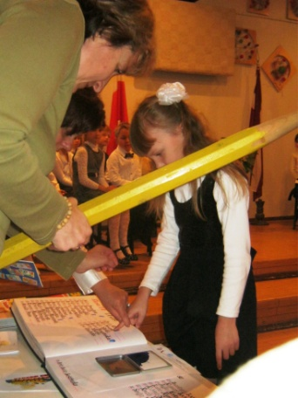
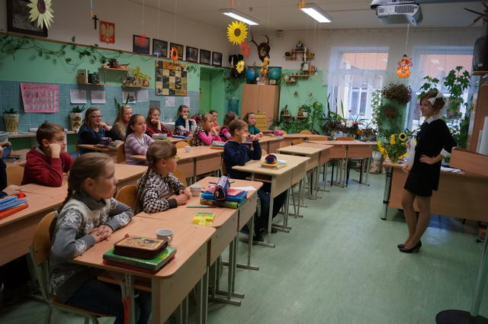
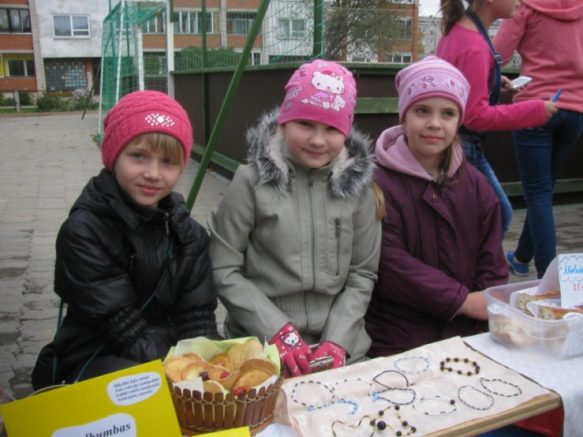
Traditions
Knowledge day
First Holy Communion
Poetry day
Enrollment of 1st formers into the school family
Teacher's Day
Autumn fair
Colourful week
Martin Day
Parents’ ball
Enrollment of 10th formers into the school family
Proclamation of the Republic of Poland
Latvian Independence Day

Slide 25
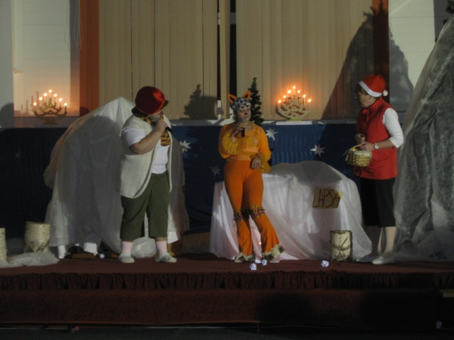
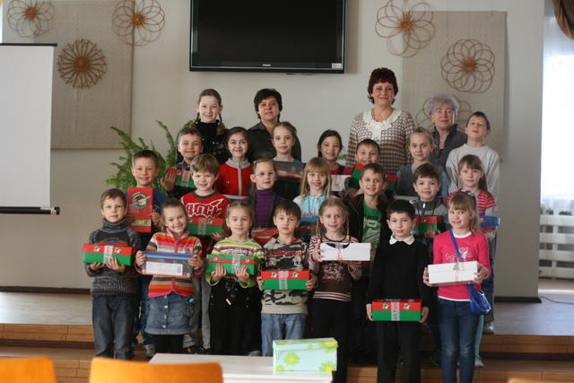
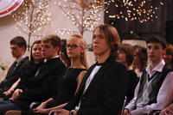
Traditions
St. Andrew's Day (Andrzejki)
St.Nicolas Day (Mikolajki)
Advent wreath exhibition
Christmas Fair
Christmas charity campaign "Let's open our hearts“
Christmas Concert
New Year Carnival
"Friendly Call" campaign
Grandparents’ ball
Get-together ball
School Badge Evening

Slide 26
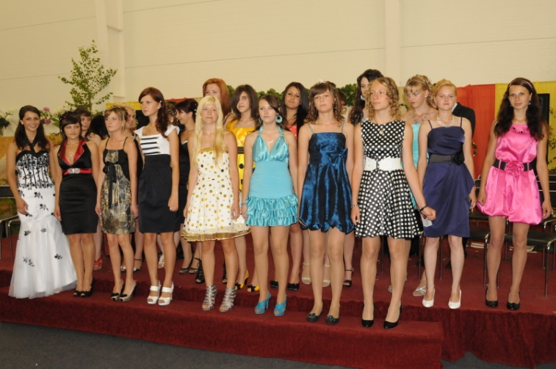
Traditions
Easter
Constitution Day of the Republic of Poland
Latvian Declaration of Independence Day
Mother's Day Concert
Honouring Ceremony
Last bell for 9th, 12th forms
Prom

Slide 27
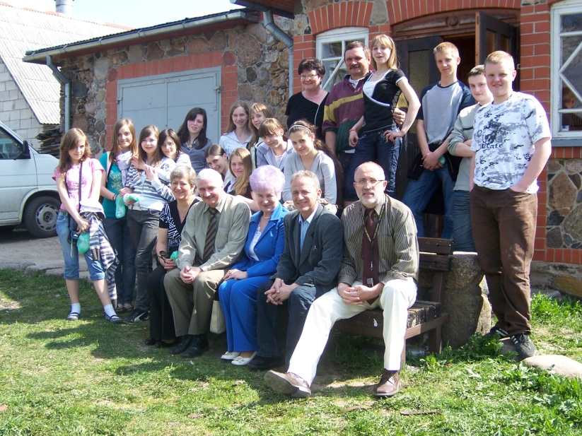
Cooperation
International camp "Parafiada" in Warsaw.
Language practice is organized in Bialystok, Czestochowa, Zgierz, Lopuszne, Jablonka, Sidzina, Bydgoszcz, Krakow, Zloty Potok, Iwiencino, Dabrowa, Sianow and other Polish cities.
The Polish language camp "Zuchy" has been organised for six years during the summer holidays. Guests from the USA, Canada, Poland, Russia, Norway, Israel, Sweden, Germany, Belorus Lithuania, Estonia and Spain have visited our school.
In spring 2007, foreign ambassadors, whose embassies are located in Latvia, visited our school.
In 2009 the school took active part in the celebration of 20th anniversary of Latvian Polish Union of Rezekne Department.

Slide 28
The school participated in the following projects:
The ESF project " Support to Ensure Pedagogues of General Education in the Priority Subjects“
The ESF project " Ensuring of adequate, high-quality material base for Science subjects in educational institutions of Rezekne ";
British Council project "School Leadership";
The ESF project "Competitiveness of Teachers within the Optimization of Educational System";
The SIF project "Encouragement of intercultural dialogue";
International Literacy Study PIRLS assessment;

Slide 29
School is our home

