Slide 1
Latvian Folk Dress

Slide 2
Latvian Folk Dress
Folk dress in Latvia has been and still is an important symbolic role of national values and cultural heritage.
Interest in national dress first was born in 1920s and 1930s, when Latvian nation was independent for the first time.
Folk dress became even more popular during the years of Soviet occupation and after the renewal of Latvian independence in 1991.
Today folk dress has a different application than in earlier centuries and now it is worn only on festive occasions or during performances.

Slide 3
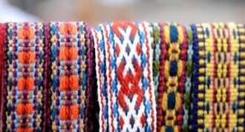
Latvian Folk Dress
There are two popular historic periods of specific traditions that characterise Latvian dress:
Costume of the 7th-13th century that is often referred as “ancient dress”
Clothing worn in the 19th century and referred as “ethnic” or “ethnographic dress”.

Slide 4
Ancient Latvian Dress
In the During the 7th-13th centuries, the territory known today as Latvia was already inhabited by Baltic and Finno-Ugric tribes.
In 7th-13th centuries there was a tradition of decorating people’s dress with bronze rings and spirals and of wearing bronze jewellery.
Bronze helps to conserve the cloth that it lies alongside, and therefore thanks to this tradition, many parts of cloth have been comparatively well preserved.

Slide 5
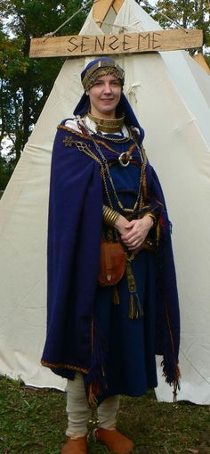
Ancient Latvian Dress
From the 7th-13th centuries both men and women wore clothing that was made from locally grown flax and fleece.
Shoes, belts and caps were made from leather and furs of domestic and wild animals.
All clothing was made at home while some of the jewellery was imported from Scandinavia, ancient Rus and even the Arabic world.
The primary piece of clothing for both sexes was a collarless shirt made from linen in the form of a long-sleeved tunic, long for women, shorter for men.

Slide 6
Latvian Ethnic Dress in 14th-17th century
German crusaders arrived in the first half of the 13th century and the Latvian territories were gradually conquered. Under German rule the living conditions of local people worsened and the tradition of decorating clothing with bronze disappeared.
The use of bronze jewellery also diminished significantly. This led to the consequence that very little clothing was preserved in gravesites.
Linen tunics remained of the same cut, as did woollen coats, however a front opening fastened with hooks became more prevalent from ancient clothing.
Women’s skirts, in addition to the older style of just a rectangular piece of fabric, were now also fixed to the sash in small folds.

Slide 7
Latvian Ethnic Dress in 14th-17th century
Most of the garments were still monochromatic, and stripes were rare. Knitwear began to appear in the 15th century, evidenced by the first knitted woman’s cap.
Starting from the 16th century, imported European broadcloth reached Latvian peasants, and clothes made from it were considered to be a sign of wealth. However there is much less jewellery from this period, and we can observe that its old forms had mostly disappeared. The only exception is the girls’ crowns that continued to be made either of bronze plate or red fabric that was ornamented with glass beads of various colours.
During this period, the most creative aspect and largest regional variations can be observed in women’s head coverings, while other parts of clothing remained fairly uniform.

Slide 8
Latvian Ethnic Dress in 18th-19th century
We have most knowledge of Latvian ethnic dress of the late 18th and 19th centuries as most records and items of festive clothing have been preserved from this period.
Written records from the 18th century affirm that the most common colour of Latvian peasant’s dress was the natural white and grey of linen and wool. Until the beginning of the 19th century, when natural dyes were still used, most Latvians’ clothes were natural grey, while for decoration they kept to the century-old traditional four-colour scheme of blue, red, yellow, and green.
During the 19th century, linen tunic-shaped shirts were still the main garment worn. Work shirts still looked very similar to the ancient ones. For festive occasions, however, there were now variations of collars, cuts, and embroidery. Shirts were pinned with small smooth or relief ring-shaped or heart-shaped brooches. Sometimes there was a row of brooches down the front opening of the shirt.

Slide 9
Latvian Ethnic Dress in 18th-19th century
Above the shirt, Latvian women wore long skirts, coats of various length, and woollen shawls instead of cloaks.
Often the only jewellery worn by Latvian women were silver brooches with thimble-like bubbles, red glass “stones” or beads and numerous tiny silver “leaves”. These were worn on the chest, usually as fasteners for shawls.
Young girls wore crowns that were made of cardboard covered in cloth and embroidered with glass beads, tinsel, and thin brass rings.
At the turn or the 19th century, men wore homespun coats, mostly of a natural grey colour, that were decorated with red, green or blue cord and matching appliqué on the sleeves.
Men’s clothes of dark blue, brown or natural black appeared in the second half of the 19th century when industrially-made cloth was used for festive clothing. Men wore vests for special occasions.
A distinctive place was assigned to mittens and gloves, which were probably not used in such great quantities by any other people. Mittens were commonly given as gifts, especially at weddings when a bride would present them to all the relatives of the groom, and also at funerals, to those who dug the grave and took part in the ceremony.

Slide 10
Latvian Ethnic Dress in 18th-19th century
Latvian ethnic dress shows a great variety of ornamentation.
Gloves, mittens, socks, sashes, coats, shawls and shirts were adorned with woven, knitted or embroidered ornamentation. These patterns do not display such abundant regional variety as does the clothing as a whole. The ornamentation of the 17th-19th century has a closer link with the town jeweller than with ancient tradition.
Ornamentation grew more vivid in colour with the introduction of chemical dyes in the second half of the 19th century.
Bast and leather footwear was similar all over Latvia. When working or travelling, people bound linen wraps around their feet and calves. Their shoes were sandals made of a simple piece of leather that was drawn together by strings through small holes. Footwear, especially that which was worn in winter, could also be made from linden or willow bast.
Woollen ornamented socks, and later cotton stockings were worn with festive clothes. Woollen socks or stockings for winter were either white or decorated with coloured ornaments or stripes.

Slide 11
Regional differences
There are five regions in Latvia with their own specific traditions in dialect, housing, and dress.
These regions are:
Kurzeme in the west;
Zemgale in the mid-south;
Selija in the south-east;
Latgale in the east;
Vidzeme in the central and northern parts of Latvia;
Regional variations were the most pronounced in women’s dress: in their cuts and the colour-schemes, embroidery techniques and compositions, and the decoration of sashes, shawls, mittens and socks.

Slide 12
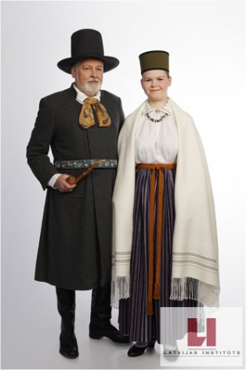
Vidzeme
The skirt existed in many different variations: most frequently they were striped, but occasionally were also tartan or patterned.
In cold weather, women sheltered themselves under felt capes or tartan scarves.
Throughout Vidzeme, married women covered their heads with so-called tower-caps, usually of white linen and sometimes tied with a silk scarf.

Slide 13
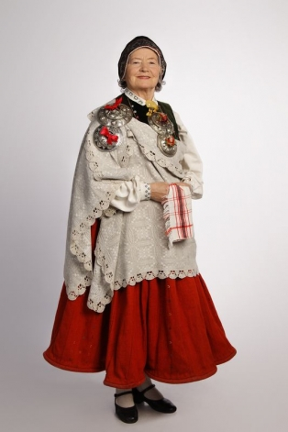
Kurzeme
Until the middle of the 19th century, women wore a dark mono coloured skirt and a white shawl embroidered around the edges.
Vests and jackets were also often decorated with bands of various colours, trimmings, embroidery and decorative buttons.
The clothing of Kurzeme, more than in other regions, contains industrially-produced textiles and clothing accessories - silk, velvet, brocade, glass, metal - either imported or produced by local manufacturers.

Slide 14
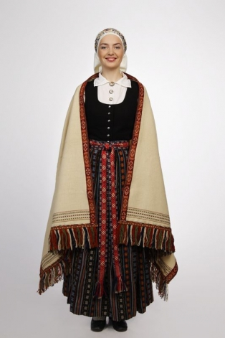
Zemgale
Zemgale is the region which was most industrialised and economically developed during the 17th and 18th centuries.
This influenced Zemgale dress:
Typical skirt has vertical weft-patterned stripes.
The most common is the rose motif; while zigzags, diamonds and triangles also appear.
It was usually patterned with red suns and crosses alternating on a white background.

Slide 15
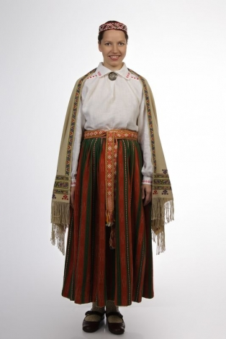
Selija
Selija or Augszeme is the smallest ethnic region as most of the Selonians actually live in the current territory of Lithuania.
The most typical Selija skirt has vertical stripes with tiny patterns or batiked yarn. The band of patterning has most often herringbone motifs, zigzags or twisted bicoloured yarn.

Slide 16
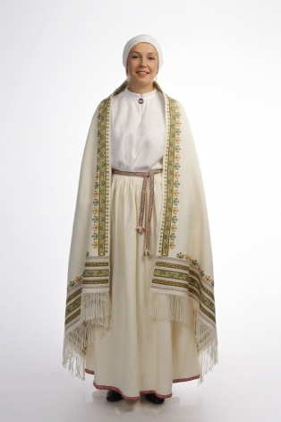
Latgale
Characteristic throughout Latgale was the intense use of linen in clothing, as garments such as shawls and skirts for summer festive dress were often made from linen.
In colder weather, large tartan woollen scarves were tied around the wearer’s head and shoulders. Aprons were often a part of the festive dress of Latgale, however they were never worn together with woven sashes.

Slide 17
Presentation made by 11th form students of Rezekne Polish State
Gymnasium:
Ieva Zeltiņa, Valērija Burova and Katrīna Paškeviča.
The source:
the Latvian Institute http://www.latvia.lv/library/folk-dress.

