Slide 1
Latvian folk songs in Kurzeme
Mārtiņš Mozga
Mārtiņš Seleckis

Slide 2
Latvian folk songs
Latvian folk songs (dainas) are very short, usually there is only one or two quatrains.
The Latvian folk song represents a tradition with a long history that is very much alive in Latvian culture today.
Dainas form the very core of the Latvian identity and singing becomes one of the identifying qualities of a Latvian.

Slide 3
Latvian folk songs
Folk songs usually contain observation of surroundings, such as processes in nature(sunrise, sunset, flood tide, flood ebb, etc.), communication, celebration - main celebrations in ones lifetime are – childbirth, wedding, burial).
Overall latvians are a singing nation and in our folk songs we sing about everyday life situations as well.

Slide 4
Themes
Latvian folk songs provide a multifaceted glimpse of a farmer's life and worldview.
They depict the cyclical passage of time in nature and the various work that must be accomplished at a certain time - ploughing, sowing, reaping and harvesting. The songs are dedicated not only to each type of work, but also to tools, everyday objects and domestic animals.

Slide 5
Latvian folk songs in Kurzeme
Kurzeme is region where most folk songs are about sea, fishing, trading, sailing.
People from Kurzeme like to brag about their pretty girls in their folk songs.
Pūt, vējiņ, dzen laiviņ', Nodzen man' Kurzemê, Kurzemê māte man solija Sav' meitin' malejin'.
Blow , wind, propel my boat,
Propel me to Kurzeme,
In Kurzeme mother promissed me
Her daughter grain grinder.

Slide 6
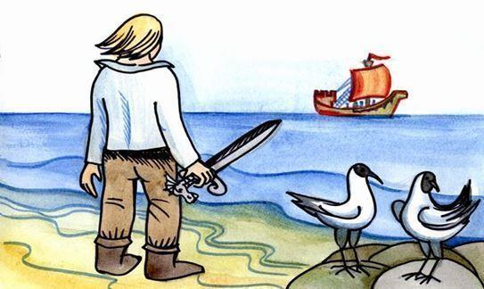
Latvian folk songs in Kurzeme
Balt' aitiņa jūrâ peld Sudrabiņa radziņiem; Būt' aitiņa noslīkuse, Nebūt naudas Kurzemê.
White lamb swam into the sea.
With silver horns
Had lamb drowned
There would be no money for Kurzeme.
Jūra šņāca, jūra krāca, Ko ta jūra aprijuse? Aprijuse zvejnieciņus Ar visàm laiviņàm.
The sea was hissing, sea was snoring,
What has sea swallowed?
Sea has swallowed fisherman
With all their boats.

Slide 7
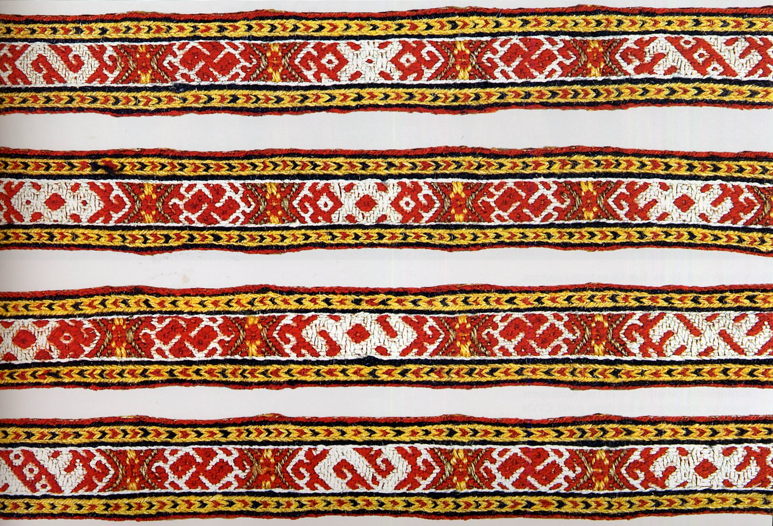
Thanks for watching!

