Slide 1
Latvian folk songs in Latgale
Valerija Burova

Slide 2
The Folk Song As a Latvian Folk Tradition
The oldest written documentations of Latvian folk songs that have survived are dated 1584 and 1632. These are scanty and fragmentary testimonies by non-Latvians that appeared randomly in the documents of that time period - protocols of witch trials and historical and geographical treatises.

Slide 3
The Folk Song As a Latvian Folk Tradition
Folk-song melodies have been published parallel to the folk-song texts. The first was Latvju tautas mūzikas materiāli (Latvian Folk Music Materials), which was compiled by Andrejs Jurjāns and was published in six volumes between 1894 and 1927. The Archives of Latvian Folklore is presently coming out with a publication of its collection of 30,000 folk melodies.

Slide 4
Folk Songs Today
Today the folk-song tradition has found a new living environment. From being used solely within the confines of everyday family life or festivities this tradition has moved on stage and has become a part of school curriculum and professional art. Folk songs are taught at school in literature and music classes.

Slide 5
Folk Songs Today
The frequent utilisation of folk songs at various moments in human life (birthday cards, weddings, and obituaries) shows that they continue to be a vibrant part of everyday culture. The aesthetic and ethical values expressed by the folk songs are still significant in modern times and they continue to find new manifestations.

Slide 6
Latvian folk songs in Latgale
Latgale is region where most of folk songs about work, every days life, orphans, tillage, girls, boys.
In many folk songs are mentioned Deities like God, Sun, Laima etc.
Izstaìgòju Jòņa nakti, Sev draudzeņa vaìcódama. Ka Jòneišu nadabòšu, To dabòšu Pìteréšu.
Walking through John night,
inquiring for a blighter for me
What John not gets,
That gets Peter.

Slide 7
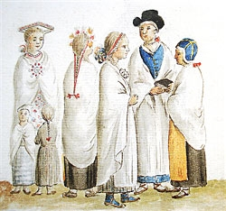
Latvian folk songs in Latgale
Div' pļaviņas es nopļāvu Sarkanāi āboliņ'. Dod, Dieviņi, siltu sauli, Labu vēju kaltējot! Pati māku sienu pļauti, Pat' izkapti asināt. Tik vien lūdzu tautu dēlu, Lai sameta kaudzītē. Es uzdevu baltu kreklu Savam siena pļāvējam. Lai tas līdzi līgojāsi Ar baltoi āboliņ'.
Two meadows I mowed
Red clover.
Give, God, warm sun,
A good drying wind!
I know myself how to mow hey,
How to sharpen a scythe.
So just ask the people of son
To throw a pile.
I give a white shirt,
For my haymaker.
Let it joy together
With a white clover.

Slide 8
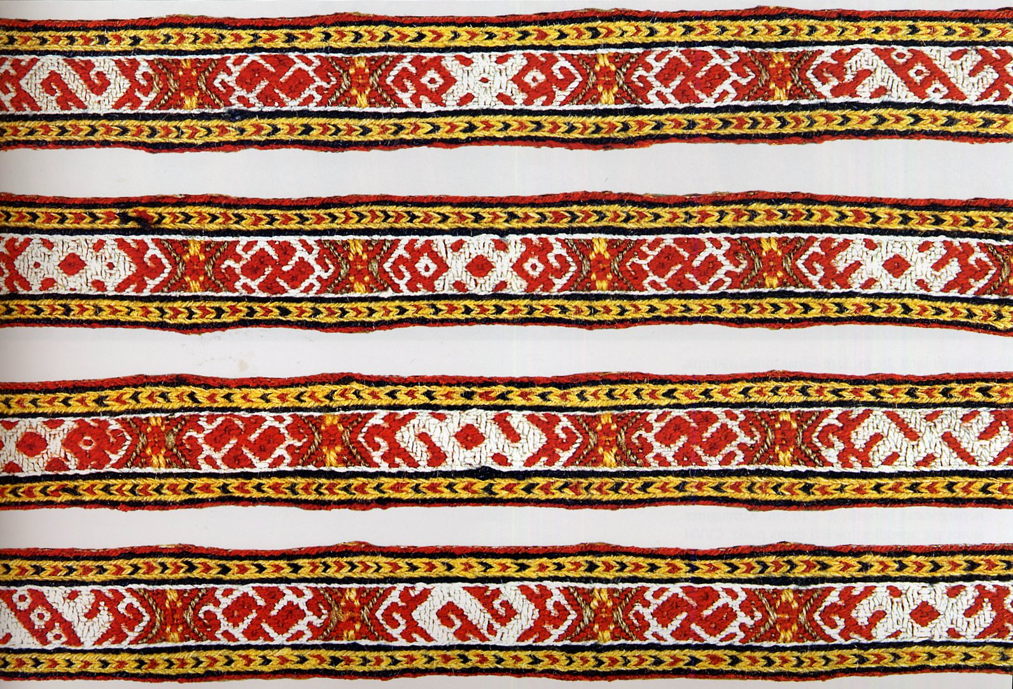
Thanks for watching!

