Slide 1
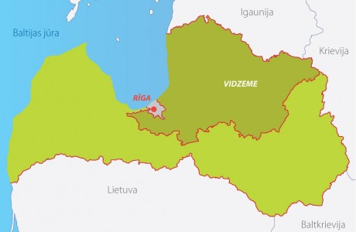
Folk songs in Vidzeme

Slide 2
About what is written in Vidzemes folk songs?
Girls songs
About Deities
About work
About orphans

Slide 3
Folk songs about Deities
Mēs bijàm div' bāliņi, Ne katrami līgaviņas. Jūgsim bērus kamanâs, Brauksim Dieva zemitê; Viens ņemsim Saules meitu, Otris Dieva kalponiti. Redzesim dzīvodami, Kà katram Dievs palīdz. Vienam Dievs palīdzeja, Otram Saule vizinaja.
In many folk songs are mentioned Deities like God, Sun, Laima etc.
Sun is one of the most powerful deities, the goddess of life and fertility, warmth and health. She is patroness of the unfortunate, especially orphans.

Slide 4
Folk songs about work
Work - one of the central themes in Vidzemes folk songs. The Latvians have always held in high esteem in work and in manners.
Bāleliņa dzirnaviņas Kà skaliņu vicinaju; Tautu dzirnas nevareju Kà patmaļu kustinàt.

Slide 5
Girls songs
Velti, puisi, tavas domas, Ka es tava līgaviņa! Vaj es iešu ar tevim Draugu duris virinàt?
Šitie puiši manis dēļ Vaj bijuši, nebijuši, Cita kunga māmuliņa Auklè manu arajiņu.
These folk songs are talking about girls and boys, the bride and groom relationships. Many girls do not want to go to the man who chose her.

Slide 6
Folk songs about orphans
Also there are mentions about orphans. In these folk songs it is being talked about as dear Mara helps orphans wash themselves and bring order.
How orphans go out in public.
Orphan laments the fact that God and Laimiņa have claimed her parents.
Again orphans may suffer not only the loss of their parents, but also acquiring new.
Bārenīte, sērdienīte, Bārenītes dziesmu dziedu. Nevienam nesacīju, Kur vess mani šoruden: Pie tētiņa, pie māmiņas Uz dzeltānu smilšu kalnu.
Skaisti dzied lakstīgala Smalkajos krūmiņos; Vēl skaistāki bārenīte Zaļajos klajumos.

Slide 7
Presentation made by 11th form student of Rezekne Polish State
Gymnasium:
Dagnija Volodjko
The source:
http://latviandainas.lib.virginia.edu
http://www.dainuskapis.lv

