Slide 1
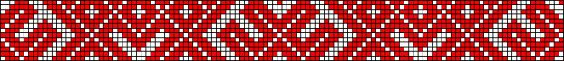
Latvian folk songs in Zemgale
Ieva Zeltiņa
Laura Viļuma

Slide 2
Latvian folk songs
Latvian folk songs are short, usually in quatrains.
It may contain an observation, a conclusion, guidance, a description of a magical or practical activity, or emotion.
Family or seasonal ritual songs are arranged in accordance with the ritual's scenario. Simultaneously the songs helped to organise the ritual and also provided an explanation toward the meaning of a certain activity.

Slide 3
Latvian folk songs
When singing on other occasions the quatrains are mutually linked by association, using a theme, personage or word as a basis. The text is divided into sections when singing, which are either repeated or the repetition is replaced by a refrain.
In some of Latvia's regions one or two melodies that were well known were used for all occasions. These songs were sung in a polyphonic bagpipe manner.

Slide 4
Themes
Latvian folk songs provide a multifaceted glimpse of a farmer's life and worldview.
They depict the cyclical passage of time in nature and the various work that must be accomplished at a certain time - ploughing, sowing, reaping and harvesting. The songs are dedicated not only to each type of work, but also to tools, everyday objects and domestic animals.

Slide 5
Themes
Crossroads in everyday work life are marked by festivities and rituals and the songs that accompany them.
Astronomical processes are also observed - especially winter and summer solstice. The largest number of songs is sung at Jāņi (summer solstice). These songs reflect the ancient fertility rituals of the Latvian farmer.

Slide 6
Latvian folk songs in Zemgale
Zemgale is known as most agriculture region. Most of eco food, provender and home made products are made in Zemgale.
Since the beginning of Latvian culture Zemgale has been region where all the rich and prosperous farmers and peasants come from.
Name of the region is derived from word “zeme” which means land, ground, earth.

Slide 7
Latvian folk songs in Zemgale
Zemgale is region where most of folk songs about agriculture, farming, tillage, earthwork, digging and sowing came from.
People from Zemgale always sing folk songs which honour countryman work in farm or peasantry.
Ai, auziņas, jūs' bij daudz,
Kur bij man jūsus likt?
Lai māsiņa jūs samaļ
Bērajam kumeļam.
Oh, oats, had you a lot,
where had I to put you?
Let sister flour you
To poor horse.

Slide 8
Latvian folk songs in Zemgale
Ai, manu bāleliņ,
Tavu lielu rudzu lauku!
Maliņā stāvēdama
Otras malas neredzēju.
Oh, my brother,
Your big rye field!
Standing on the edge
Didn’t see other one.
Audziet, mieži, griezdamies
Lielajā tīrumā;
Vec' ir mana māmuliņa,
Jāņem jauna līgaviņ'.
Grow barley, while spinning
In the biggest field;
Old is mine mother,
Should take young bride.

Slide 9
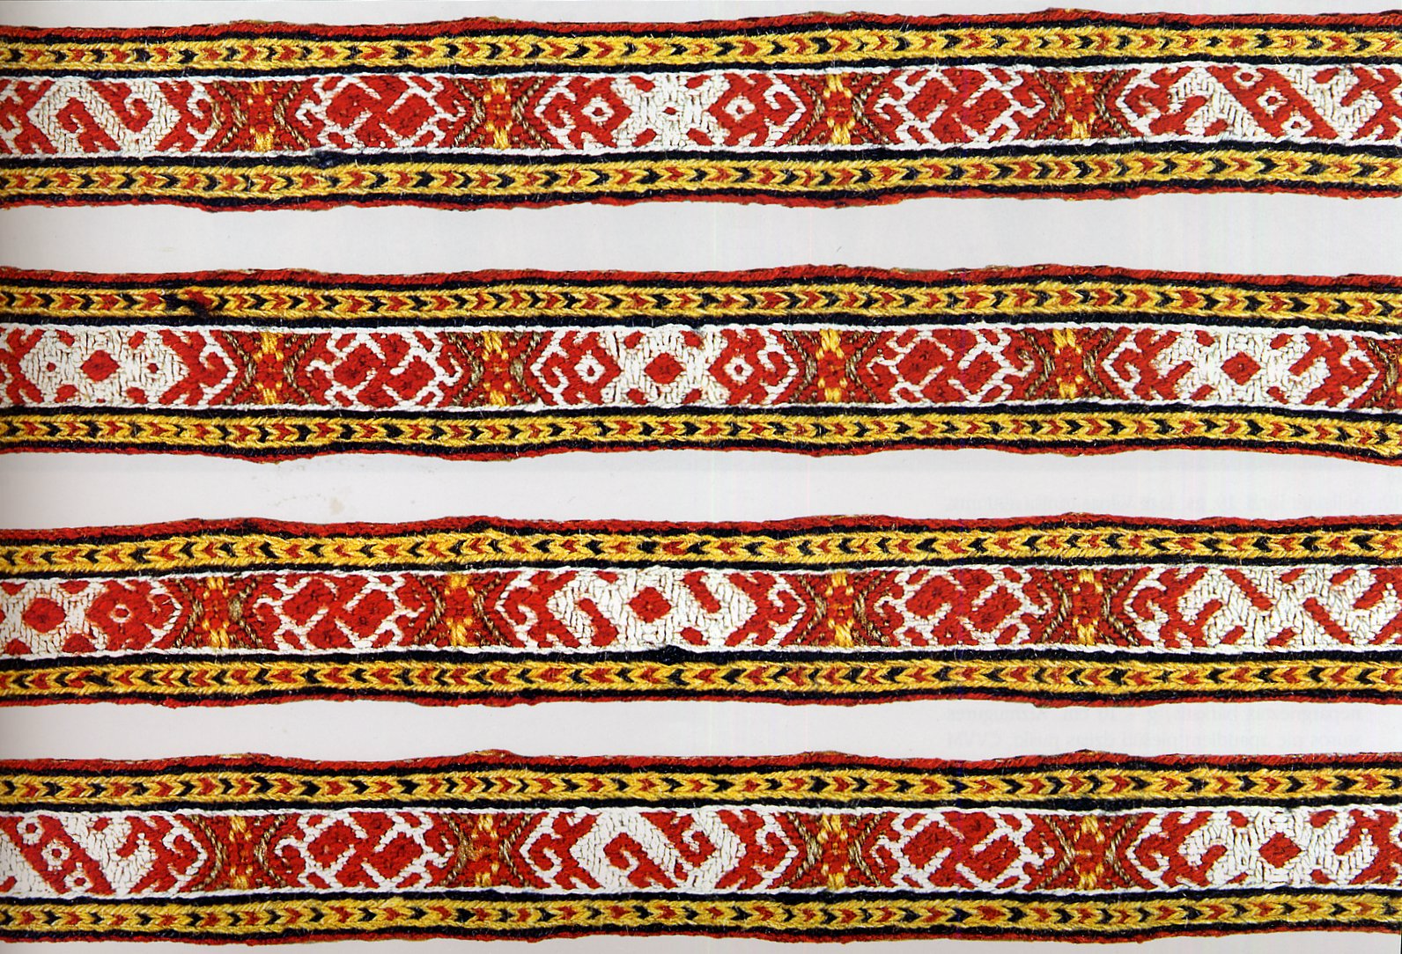
Thanks for watching!

