Slide 1
Rezekne,
first Comenius meeting,
November 17-22

Slide 4
School Location

Slide 5
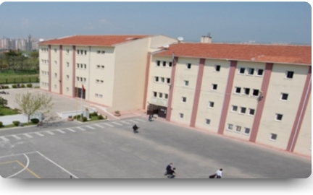
Avcılar Vocational School for Trade establishedin 1992, but moved to current building in 2001.

Slide 6
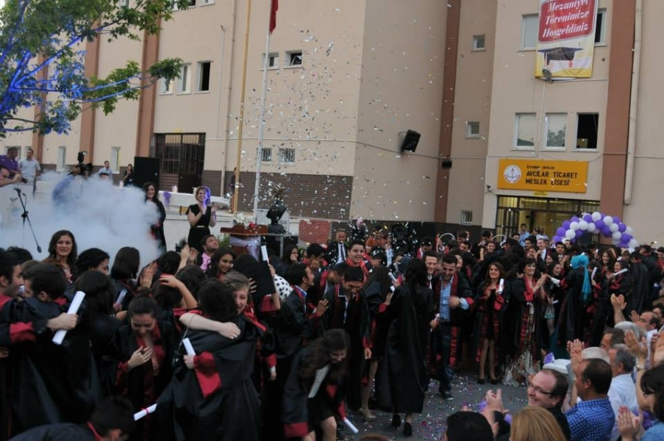
The Double shift School, having 61-teachers, 1.510-students capacity.

Slide 7
Adult Education
Our School has Open Vocational High School Department for people age 18 +
They learn Accounting.
The period of educaiton:
Weekdays 18:00 +
They hold the same diploma with formal students.

Slide 8
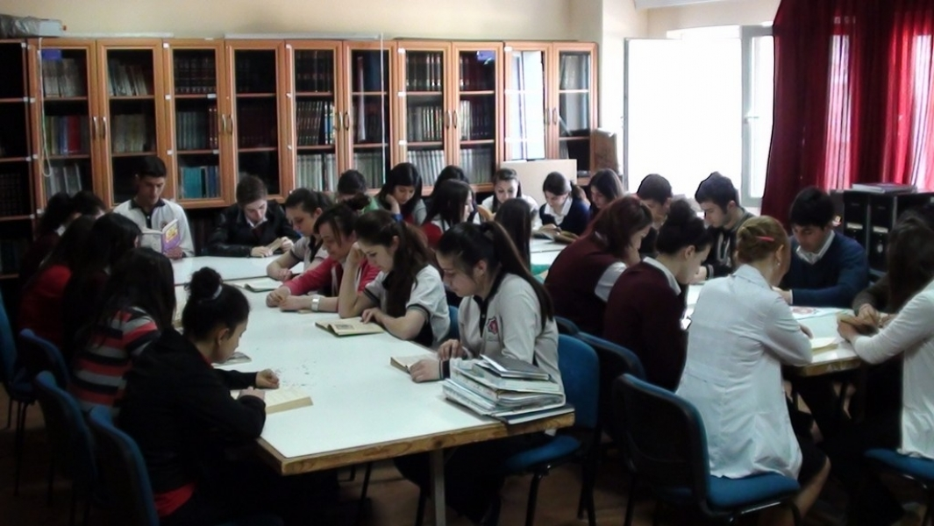
There are 4 computer laboratories, 21 classes each with 30-student capacity, 1 music class , a library with a capacity of 30 students, and a conference room for 120 people for conference organizations and presentations.

Slide 9
The school prepares its students for business life and higher education in the fields of
Information Technologies,
Accounting And Finance
Transportation Services
Office Management

Slide 11
Dual Education System
Students at 12th grade have to attend both to school and to companies.
They come to school for 2 days and attend Literacy, math, etc calsses,
They go to companies as apprentice to learn the job on the site.

Slide 12
Extra Curricular Activities
Sport (football, volleyball, basketball, running)
Thatre Club
Modern Dance Club
Folk Dance Club
Music Club
Science Club
School Band

Slide 13
Music Club
Our Music club has been awarded the best in a Rock Contest tghough the Istanbul

Slide 14
International Experience
Our school was a part of International Theatre Festival held In Ruhr Region of Germany.
The project supported by Istanbul 2010 European Cultural Capital Program.

Slide 15
Contact Information
Address: Firuzköy Mh. Pehlivan Cd. Labirent Sk. No10 Avcılar İSTANBUL
Tel: (212) 690 58 07
Fax : (212) 690 51 06
Web Site: http://avcilartml.meb.k12.tr
Principle: Necip KİREZ
E-Mail: talhabektas@gmail.com

