Slide 1
LATVIAN FOLK DANCES
Sarmīte Gaidule, Antra Loce,
Zane Novika, Jūlija Ivanovska,
Kristaps Karzubovs, Kaspars Mozga

Slide 2
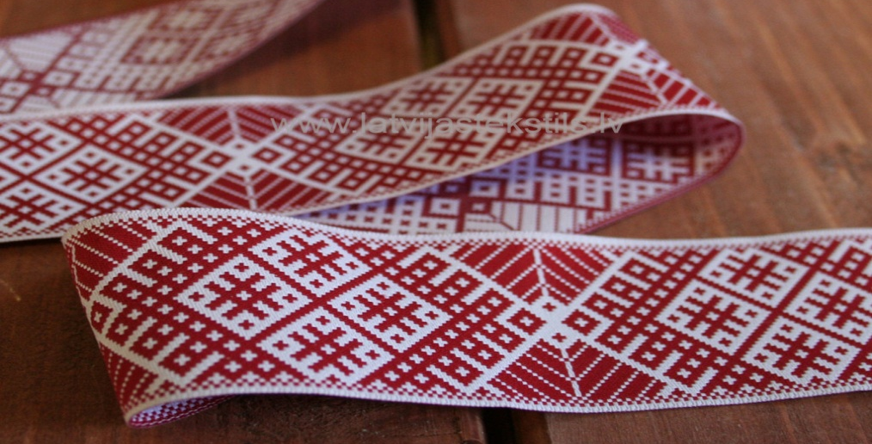
Latvian folk dance history
Latvian folk dance history starts at one time with the Nationwide Latvian Song and Dance Celebration, what is a traditional cultural event in Latvia. Since the 1873 this festival has taken place 25 times.

Slide 3
Celebration History
Festival have a 140 year-old history. It is a most characteristic cultural tradition of the Baltic. Festival is a unique Latvian folklore heritage.
2008 the tradition of the Latvian Song and Dance Celebration was included in the UNESCO.

Slide 4
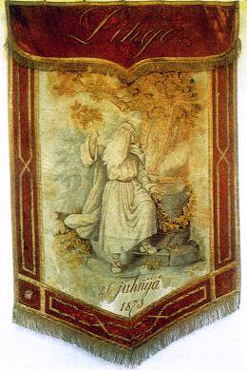
The Latvian Song Festival flag
The first Latvian National Song and Dance Festival was the 1873 in Riga.
Festival organizer: Latvian Society of Riga

Slide 5
X-XIX Song Festival took place during the Soviet time.
Dance groups the first time participated in the festival in 1948.
Since the 1960, every 5 years take place the Latvian School Youth Song and Dance Festival.

Slide 6
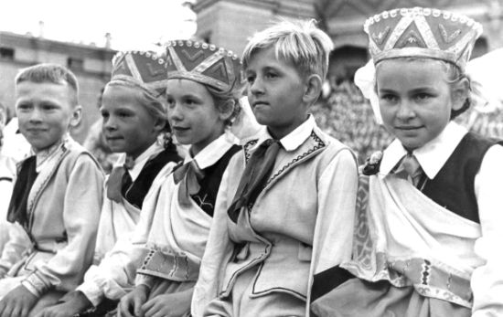
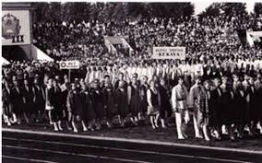
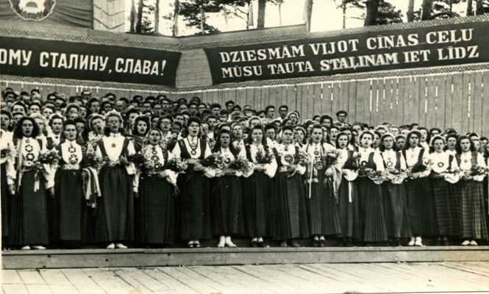
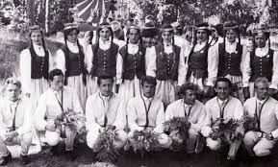
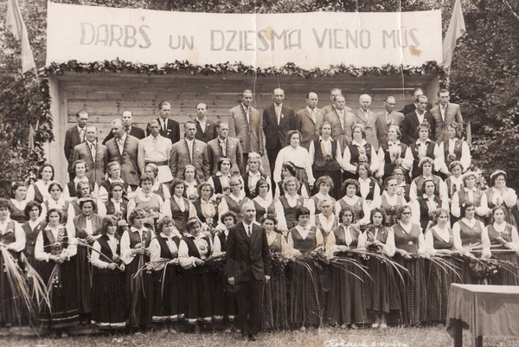
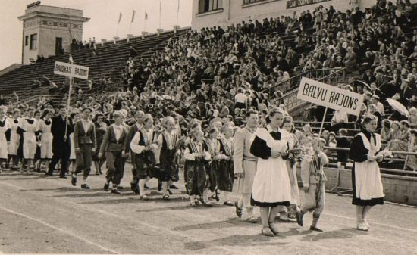

Slide 7
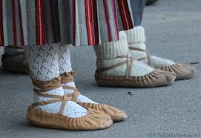
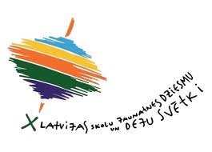
The Latvian Song and Dance Festival
The Latvian Song and Dance Festival is one of the largest amateur choral events in the world and an important event in Latvian culture and social life. The All-Latvian Song and Dance Festival has been held since 1873, normally every five years. During the festivals exhibitions of photography, art and folk craft, orchestra concerts, and a festive parade also take place. Approximately 30,000 performers altogether participate in the event. Although usually folksongs and classical choir songs are sung, with emphasis on a cappella singing, recently modern popular songs have been incorporated into the repertoire.

Slide 8
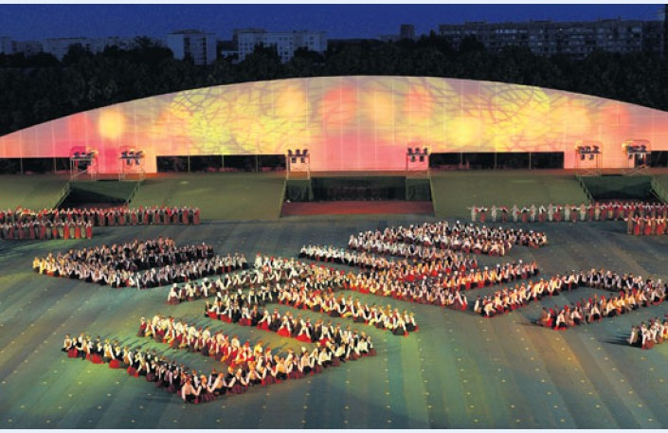
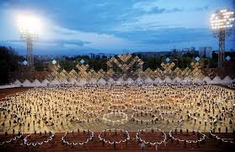
The Latvian Song and Dance Festival
The tradition of song festivals originated in the first half of the 19th century in many European countries and later was also organized by the Baltic Germans. 1003 singers and 30 orchestra players participated in the first festival. Only once festival was held outside Riga- in Jelgava in 1895. Since 1960 a distinct Latvian Youth Song and Dance Festival is held in an alternate five year cycle, on a matching scale. The last event took place in July 2010. It will be followed by the 2015 one.

Slide 9
Procession of the Nationwide Latvian Song and Dance Festival participants

Slide 10
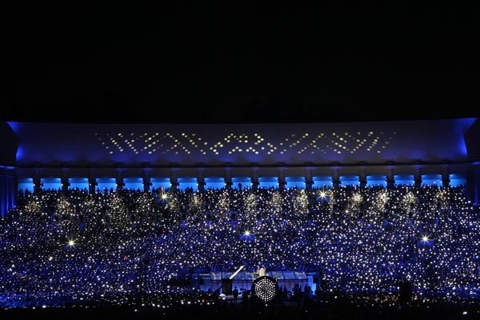
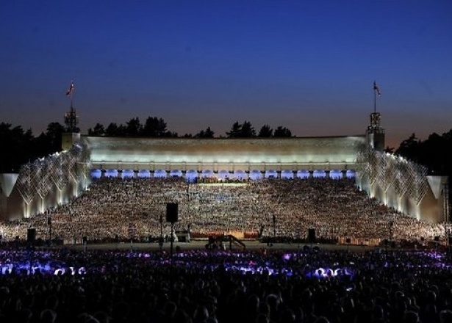
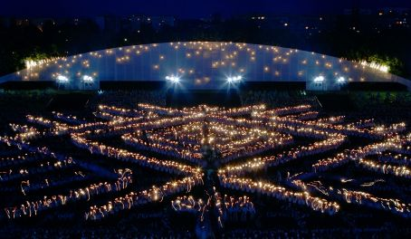
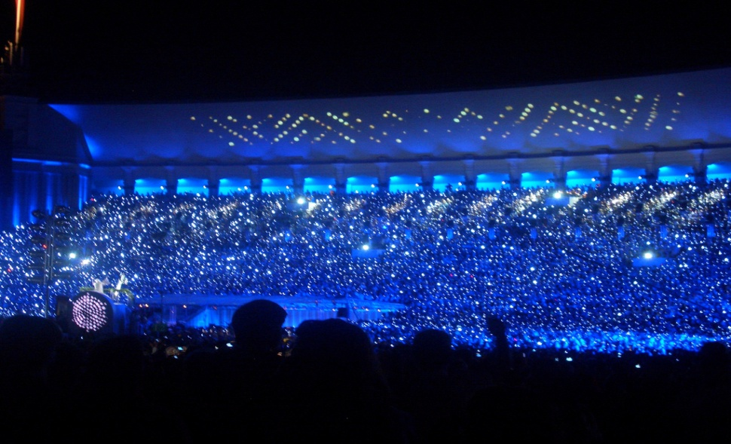

Slide 11
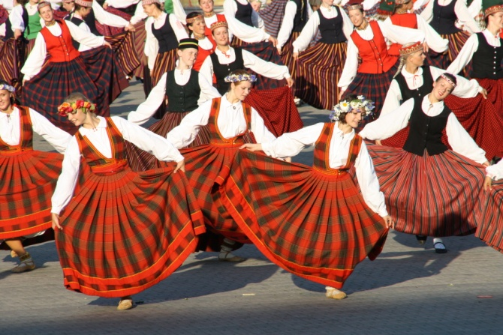
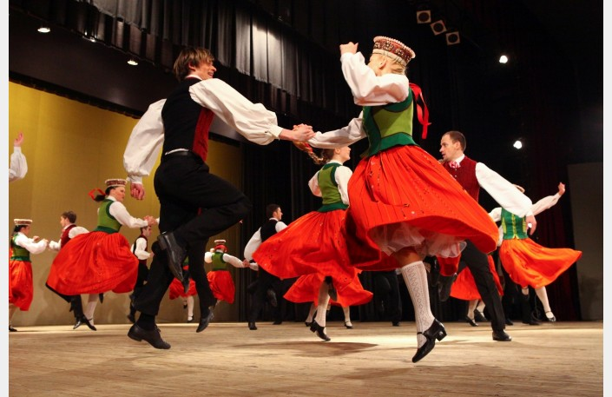
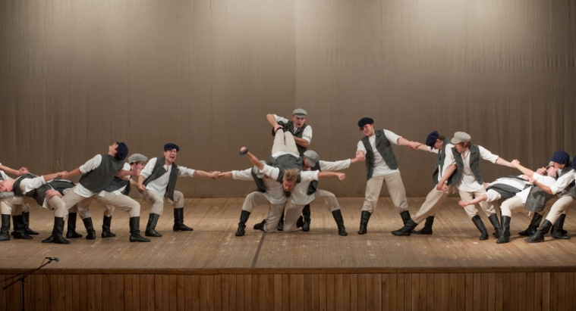
Dances are divided into:
Mixed
(dancing boys and girls
together)
Girls
(dancing only girls)
Boys
(dancing only boys)

Slide 12
Mixed dance ‘’Kazaks’’(Cossacks)
Participants line up in 2 rows with the same number of pairs in each.
The first row moves forward to the second and then steps back.
Then the opposite row repeats the same motion. Afterwards, both rows simultaneously approach, pass through each other - dancers turn around and return to their initial place.

Slide 13
In the second run males from the first and females from the second row move forward, spin with a partner of the opposite sex using the enclosed hand grip.
Then return to their place and turn round by elbows with their partner. The same repeat females from the first and males from the second row, etc.

Slide 14
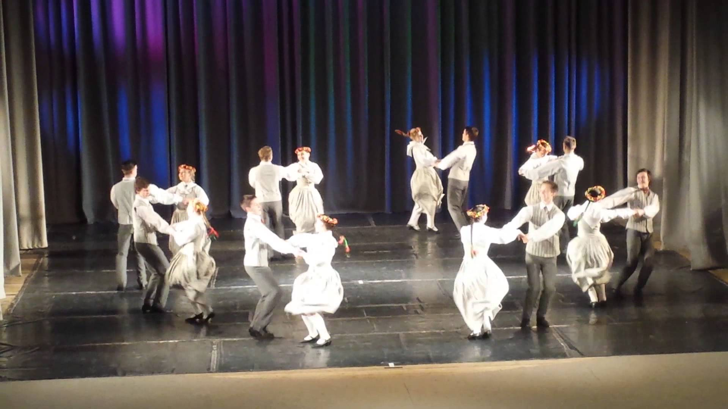
The most fun and active dance, which we know is ‘’Ābrama polka’’
https://www.youtube.com/watch?v=14YlFCuQ4fI

Slide 15
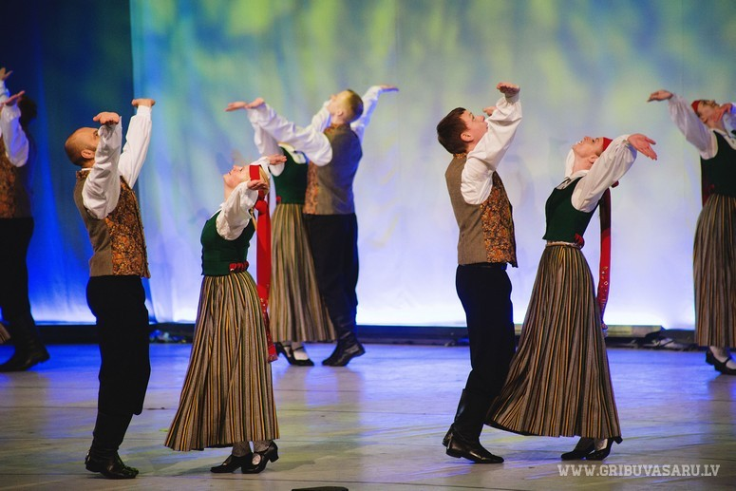
The most romantic and favorite dance is ‘’Es noaudu zvaigžņu segu’’
https://www.youtube.com/watch?v=5fvfzXHEucU

Slide 16
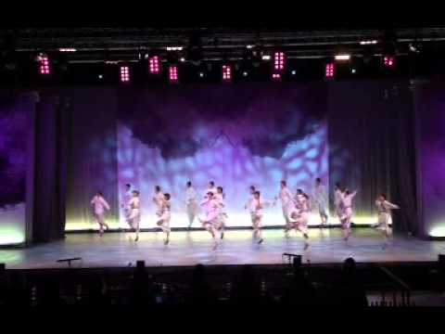
Modern Latvian folk dance ‘’Līdz pašām debesīm’’
https://www.youtube.com/watch?v=NEpwY1sXbsc

Slide 17
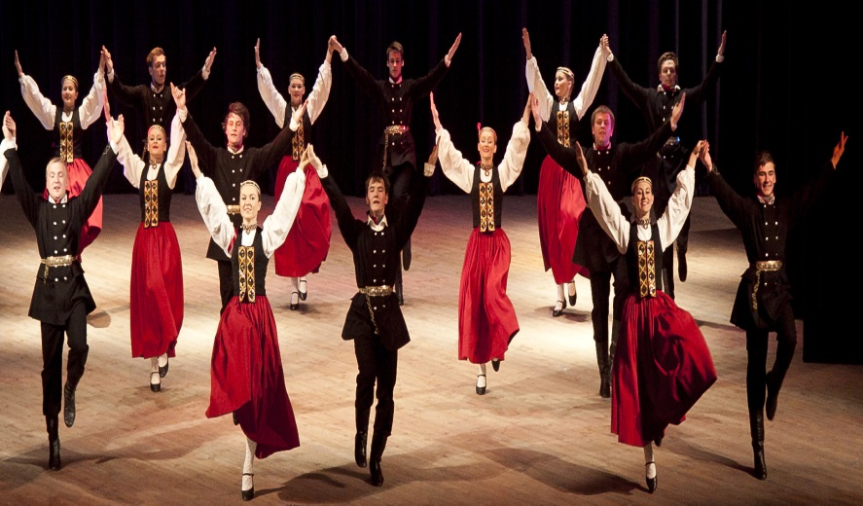
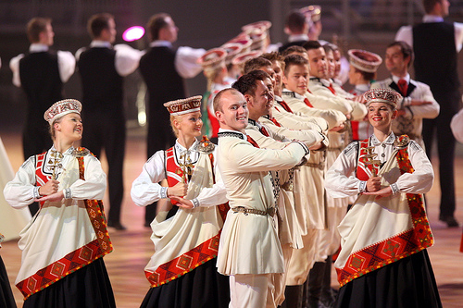
Folk Dress
Folk dress in Latvia has played and still plays an important symbolic role in the preservation of national values and cultural heritage and in the creation of a feeling of unity of the people. This occurred in the 1920s and 1930s, when the independent Latvian nation was founded for the first time and interest in folk dress was born; during the years of Soviet occupation; and after the renewal of Latvian independence in 1991. Today folk dress has a different application than in earlier centuries and now it is worn only on festive occasions or during performances. Nevertheless the great amount of interest that Latvians express in folk dress has helped to preserve, research and popularise it.
There are five regions in Latvia with their own specific traditions in dialect, housing, and dress.

Slide 18
Our dance group in Rezekne. Dancing – “Es noaudu zvaigžņu segu”.

Slide 19
THANK YOU FOR ATTENTION!

Slide 20
LATVIAN FOLK DANCES
Sarmīte Gaidule, Antra Loce,
Zane Novika, Jūlija Ivanovska,
Kristaps Karzubovs, Kaspars Mozga

