Slide 1
Latvian tradicional food
Jūlija Ivanovska
Kristaps Karzubovs

Slide 2
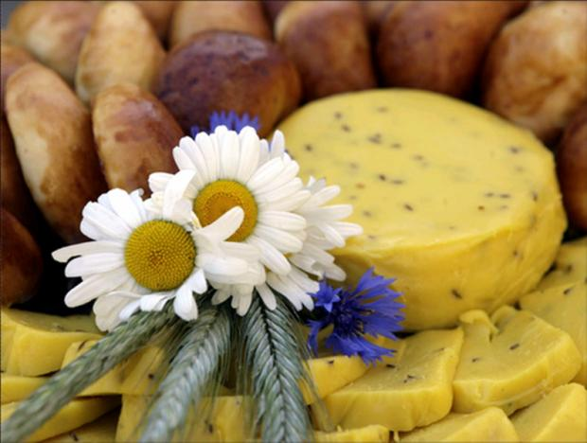
“Jāņu siers’’
A traditional Latvian cheese is Jāņu siers (caraway cheese); this is traditionally served during the celebration of Jāņi or midsummer.

Slide 3
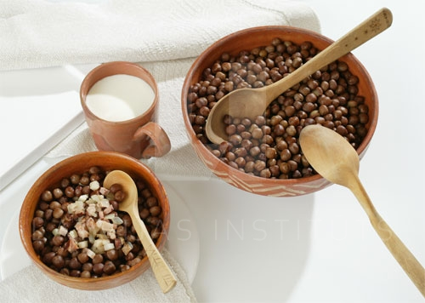
“’Pelēkie zirņi’’
Grey Peas with Bacon perhaps is the most traditional Latvian hot dish. It can be served as a snack with beer, or as a main course.
Grey peas with bacon are usually prepared for Christmas time, but it can be eaten as a main dish, as well. People prefer to have it together with buttermilk or sour milk.

Slide 4
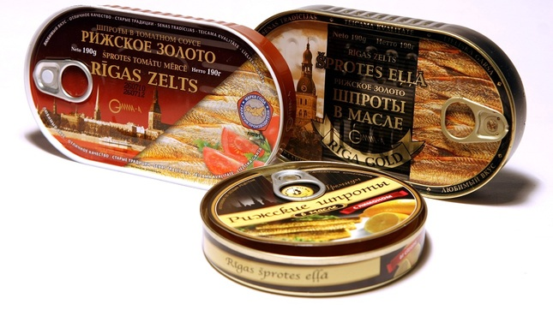
‘’Rīgas šprotes”
Riga Sprat in oil is a carefully canned sprat, which was cached in waters of the Baltic Sea. Packed in various different cans, Riga Sprats in oil are exported to some 30 different countries.

Slide 5
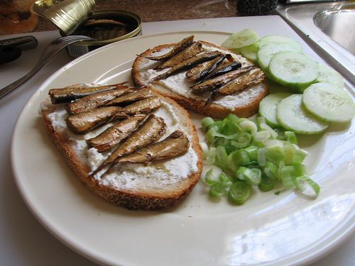
Sprat is a small oily fish that can be found in light salted waters, as the Baltic Sea. Usually sprats are used for fish conserves. Sprats are often eaten simply with bread and butter, flavoured with a little bit of lemon juice. However, there are also plenty of tasteful recipes with conserved sprats and various vegetables.

Slide 6
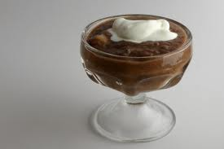
‘’Maizes zupa’’
One of the famous desserts in Latvian traditional kitchen used to be the Bread Soup. Made of black tasty bread, flavoured with raisins and other dried fruits, cold bread soup can be a perfect refreshment during the hot sunny day.

Slide 7
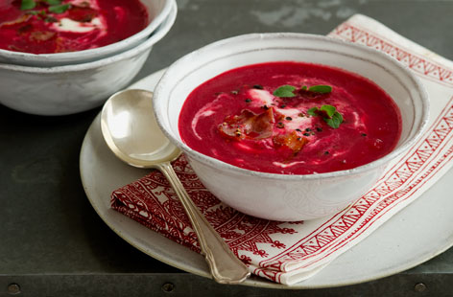
“Biešu zupa’’
A burgundy colour soup smells really nice when steaming in a bowl – it’s Beetroot Soup. Especially in the cold time of the year, this soup is like an elixir of renewal. The soup usually is served with sour cream and a few peaces of black or white bread. Traditional Latvian Beetroot Soup is without meat or mushroom. However, today it’s often flavoured with these ingredients.

Slide 8
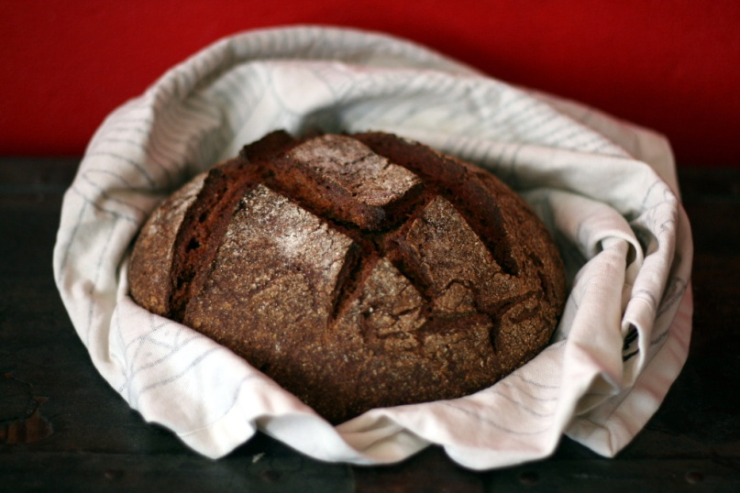
‘’Rye bread’’
Rye bread is Latvian speciality. This recipe is for bread made of parboiled flour, Plaucēta Rupjmaize in Latvian. Hundred years ago the baking of rye bread was a weekly activity in every country household while nowadays this is a rarity, because to bake the read rye bread one needs a real bread stove

Slide 9
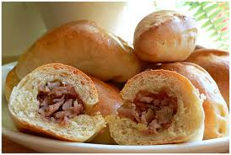
Latvian Bacon Buns
These buns can be used as appetizers, as part of a light lunch (with cup of bouillon-soup) or as a part of a party table. They are best straight from the oven, but can be eaten frozen or re-heated as well. Usually they are made from flour, milk, pork, onions, yeast, sugar, salt and eggs. This dish is always prepared for and a must at Christmas.

Slide 10
Thank you for your attention!☺

