Slide 1
Latvian traditional recipes

Slide 2
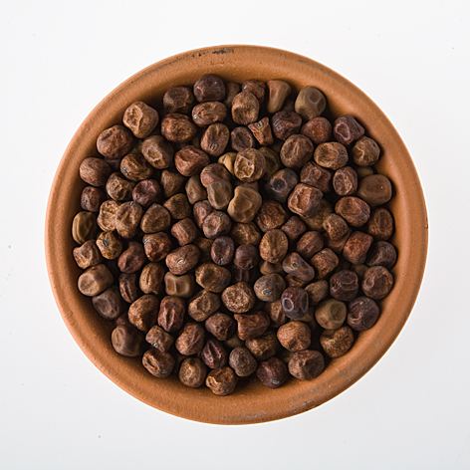
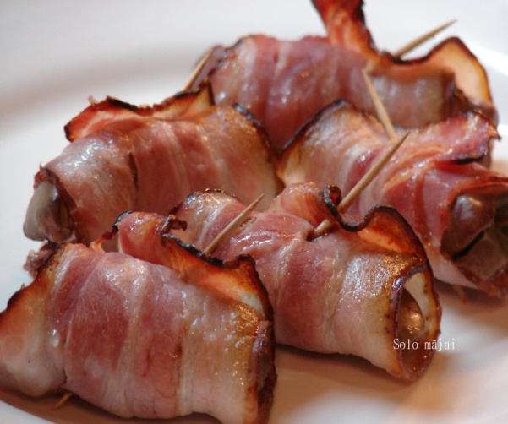
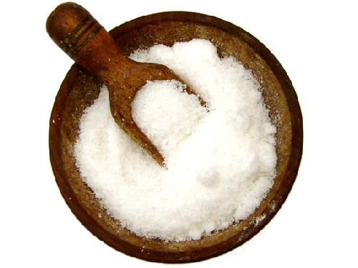
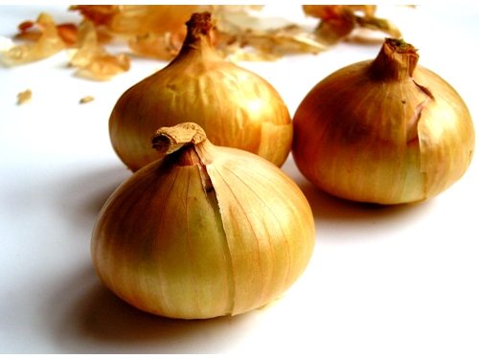
Grey peas with bacon
Ingredients:
200g grey peas
Smoked bacon
Onion
Salt

Slide 3
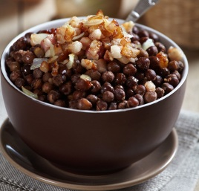
Preparation methods in the previous evening cover the peas with water. Next day cook until soft (add salt).
Prepare Bacon and onion sauce. Add the boiled peas to the sauce and fry four couple of seconds. Serve with Kefir.

Slide 4
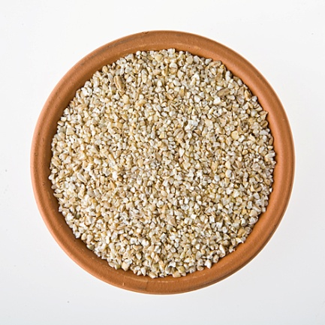
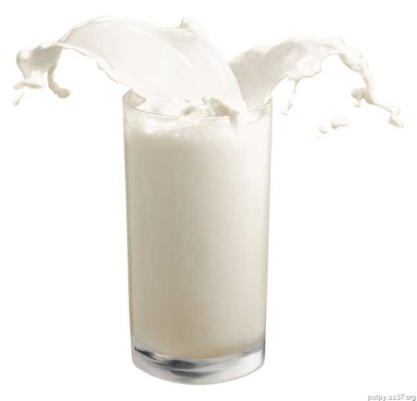
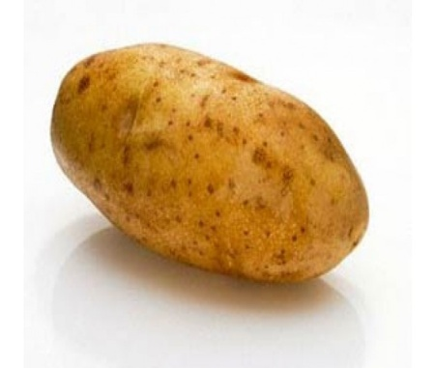
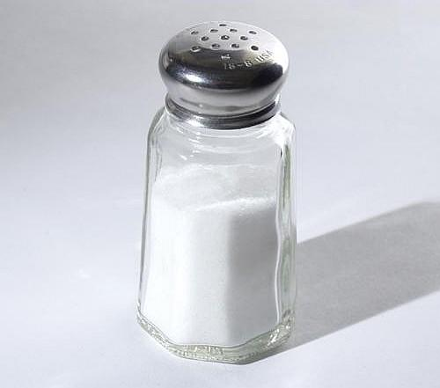
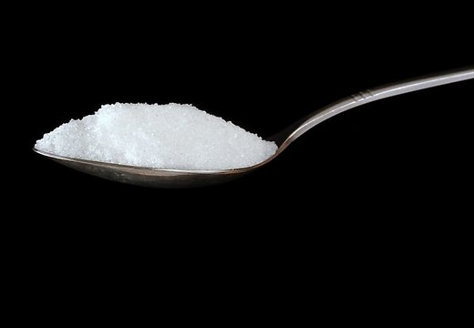
Groats porridge
Ingredients:
1 cup of barley groats
1 cup of warm milk
1 medium size potato
500ml water
salt
1 tea spoon sugar

Slide 5
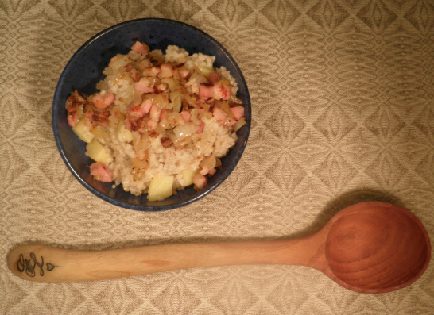
Preparation method:
Peal the potato and cut into 5mmx5mm cubicles. Put in the pot barely groats, cut potato cubes, water, milk, add sugar and salt.
Cover the pot and put on low heat for 20 minutes. Switch off the heat and leave on the stove or other warm place for another 20 minutes.
Serve together with Bacon and onion sauce.

Slide 6
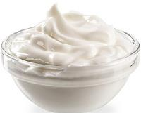
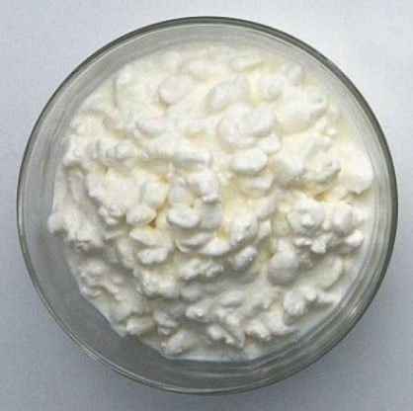
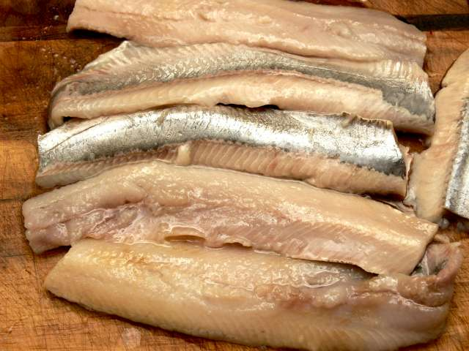
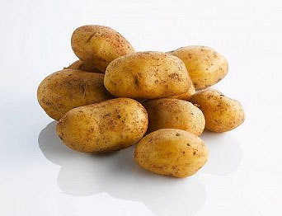
Potatoes with herring and curds
Ingredients:
5 potatoes
1 salted herring
200g curds
3 table spoons of sour cream
salt

Slide 7
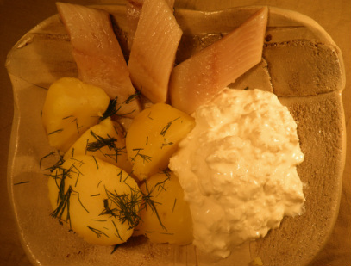
Preparation method:
Peel the potatoes, but in half and put in a cold water to boil until soft. Add salt to the potatoes just before they are ready. Pour off the water and leave the pot with the potatoes on the for couple of seconds so that potatoes get floury. Remove the fishbones from the herring and cut it in pieces. Smash curs with sour cream and salt. In the season you can add finely chopped dill as dressing. Serve potatoes, herring and curds and enjoy!

Slide 8
Cold soup
Ingredients:
Jar with pickled beets
1 liter of kefir
2 cucumbers
2-3 eggs (depending on their size)
Green spring onions
Dill

Slide 9
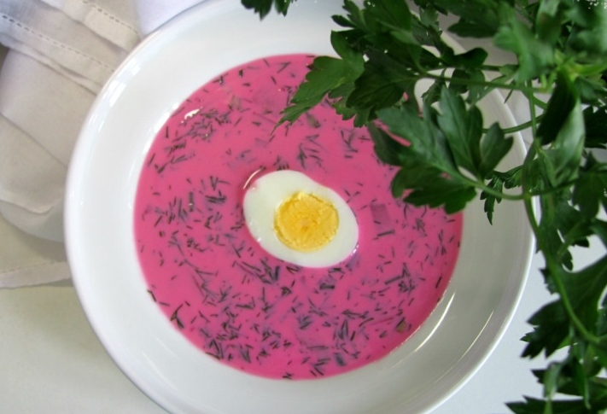
Preparation: 15 min.
Pour into a saucepan or in a dish with high sides of pickled beets with fluid. Add kefir. Before that cook eggs and cut into cubes. Cut the cucumber into cubes. Eggs and cucumbers add to beets. All mix thoroughly. Sprinkle with dill and / or onion.

Slide 10
Quickly salted cucumbers
Ingredients:
1kg small cucumbers
0.5l water
0.5 tbsp sugar
1 tbsp salt
black pepper, dill, garlic
black currant leaves/ oak tree leaves/ horseradish leaves or root (for a crispy result)

Slide 11
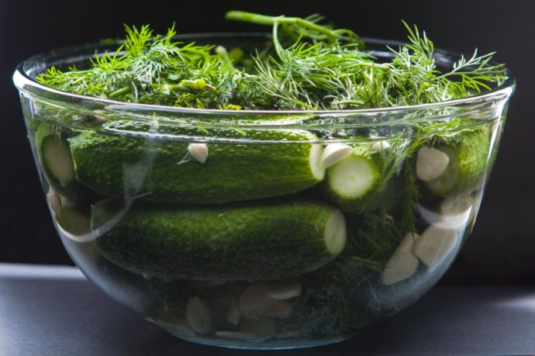
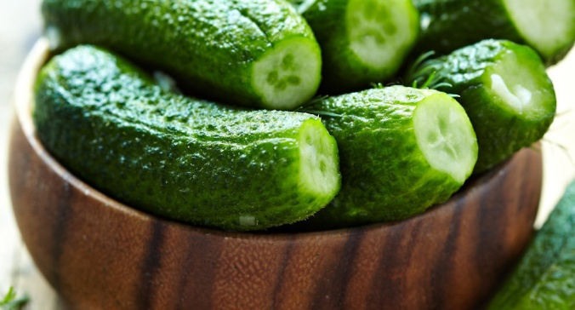
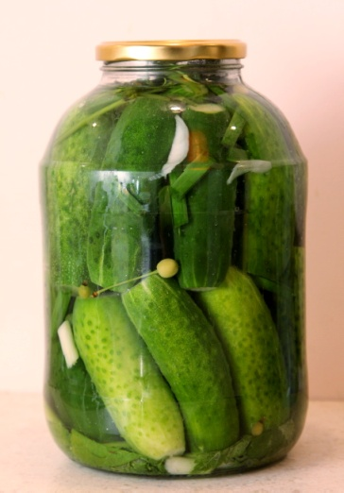
Preparation method:
Melt the sugar and salt in a boiling water, chill it afterwards. Cut off both ends of the cucumbers (this helps to speed up the salting process). Arrange in a bowl spices and cucumbers in layers. Finally pour over the chilled marinade and put something heavy on the top, e.g. a stone. Alternatively you can use a jar - just make sure that the cucumbers get staffed very tight.

Slide 12
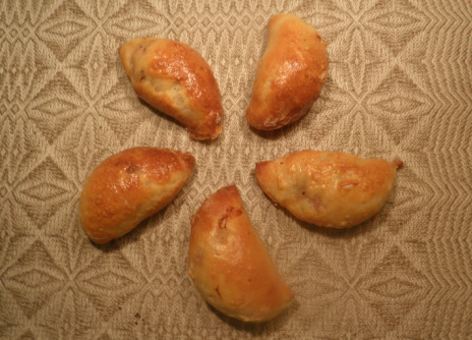
Bacon rolls
Ingredients:
Yeast dough
Filling:
Smoked bacon
Onions
Black pepper

Slide 13
Preparation method:
Prepare the filling by cutting the bacon and onions into cubicles and mix those with ground pepper.
You will need freshly prepared Yeast dough. Put the dough on the table, use the fingers to press one corner of the dough flat until you get ~4x4cm surface (0.5cm width), put on the surface 1/2 teaspoon of filling and roll it up - lift the front edge of dough over the filling and press to the far end of the surface. Use a glass to squeeze off a half-moon shaped roll - you have made the first Pīrādziņš. Repeat the activity until all dough and filling is used up.
Put Pīrādziņi on the pan and let them rise before the baking. Bake until ready.

Slide 14
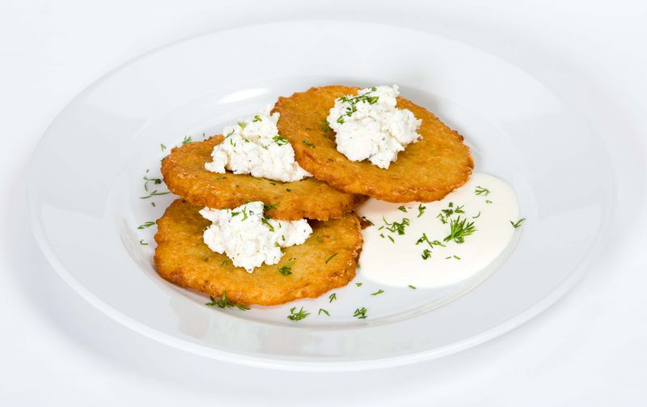
Potato pancakes
Ingredients:
5 potatoes
1 cup of milk
2 eggs
1 onion
wheat meal
salt
ground pepper

Slide 15
Preparation method:
Peel the potatoes and grate finely, squeeze off the potato juice (put it aside in a separate bowl). Now you need to be pretty fast - cover the potato mass with boiling milk to prevent them from getting dark. Take the bowl with the potato juice and carefully pour off the liquid until you see starch in the bottom. Add the starch to the potato mass. Add eggs, salt and stir well. Add finely chopped onion and ground pepper. Add wheat flour to make the dough more tick. Fry pancakes in preheat oil from both sides until golden. Eat hot with sour cream or lingo berry jam.

