Slide 1
Metalsmiths
Julia Ivanovska
Kristaps Karzubovs

Slide 2
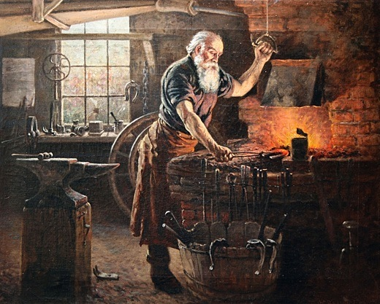
History
In pre-industrialized times, smiths held high or special social standing since they supplied the metal tools needed for farming (especially the plough) and warfare. This was especially true in some West African cultures.

Slide 3
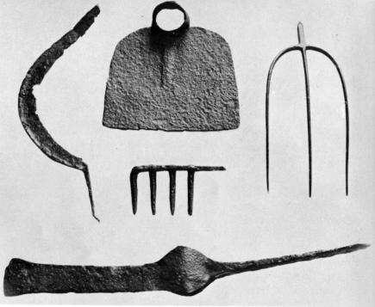
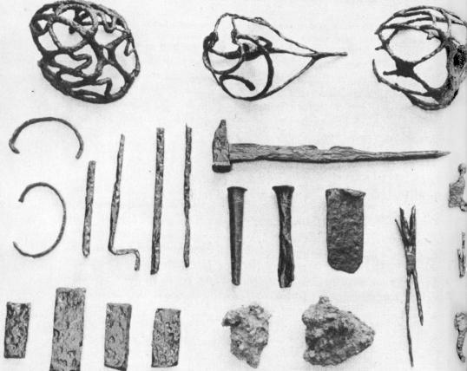
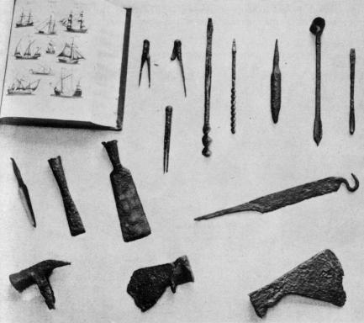

Slide 4
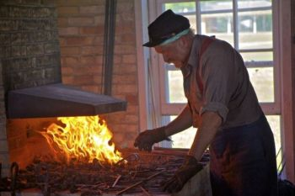
WHAT IS METALSMITHING?
Metalsmithing is creating jewelry through the manipulation of various metals.

Slide 5
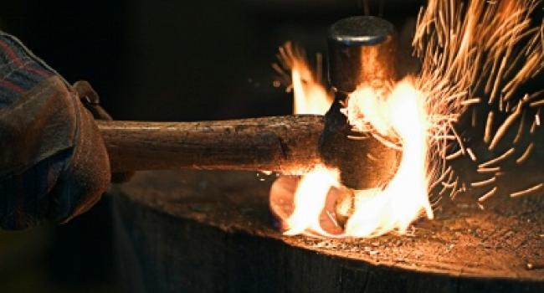
Metalsmith needs to know manipulations or metalsmithing techniques including fabricating metal jewelry by forming and shaping it with hammers, mandrels, and other tools, sawing with a jeweler's saw or cutting with metal snips, doming with a metal dapping set, forging, fold forming, drilling holes for design elements or for use with cold connections such as rivets and screws, soldering, texturing metal with hammers and other metalsmithing tools, and metal stamping.

Slide 6
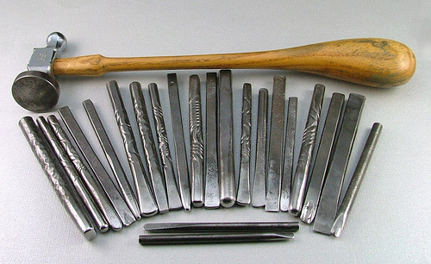
Other specialty metalsmithing techniques, that metalsmither need to know include chasing and repoussé, etching and engraving, electroforming and electroplating, raising, swaging, reticulation, casting, and creating settings such as bezels.

Slide 7
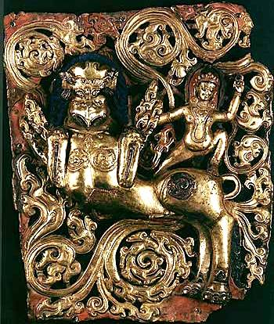
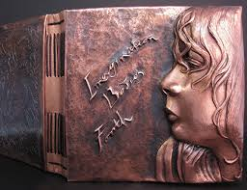
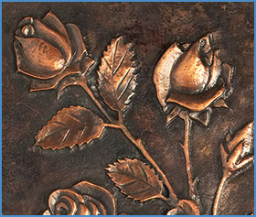
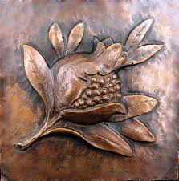

Slide 8
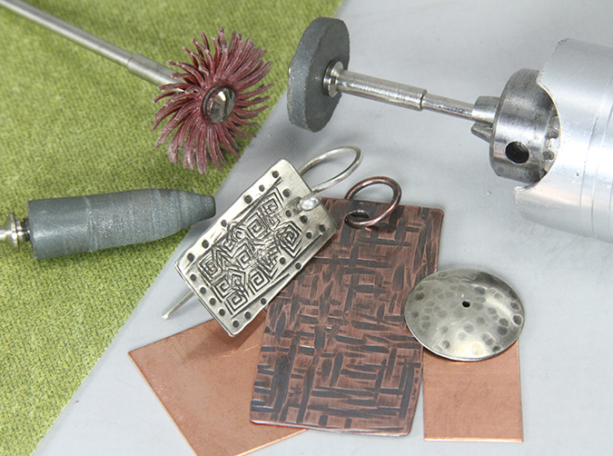
All metalsmithers’ work should end with proper finishing techniques, such as filing, buffing, polishing, and then perhaps adding patinas with liver of sulfur and/or heat, if desired.

Slide 9
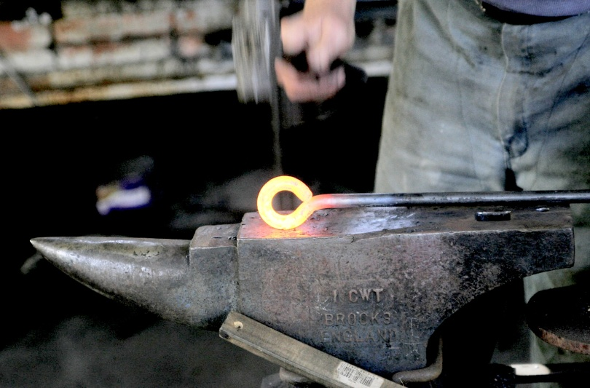
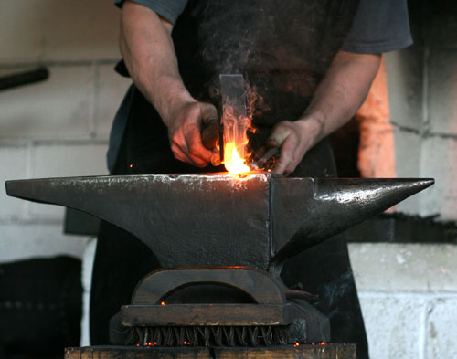
WHAT IS METALSMITH?
The term, metalsmith, often refers to artisans and craftpersons who practice their craft in many different metals, including gold, copper and silver.
Machinists are metalsmiths who produce high-precision parts and tools. The most advanced of these tools, CNC machines, are computer controlled and largely automated.

Slide 10
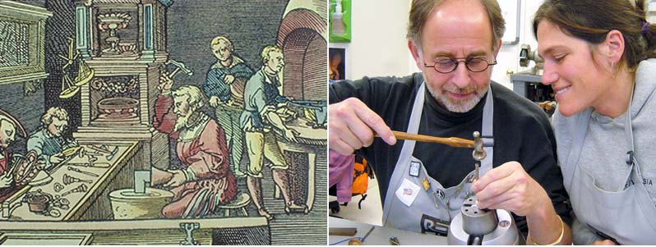
Jewelers often refer to their craft as metalsmithing, and many universities offer degree programs in metalsmithing, jewelry, enameling and blacksmithing under the auspices of their fine arts programs.

Slide 11
Thank you for attention!!!

