Slide 1
ES Mūžizglītības programmas
Comenius daudzpusējais projekts „The treasure chest and ICT or ICT in reading and writing”
Līguma nr. 2013-1-BG1-COM06-00006 2

Slide 2
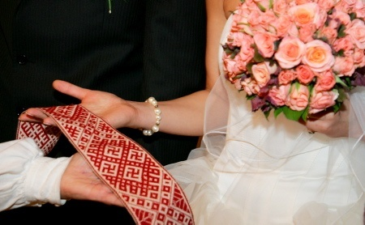
WEDDING TRADITIONS IN LATVIA from 18th to 21st CENTURY

Slide 3
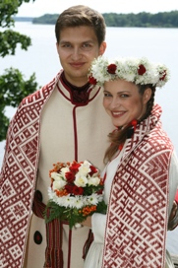
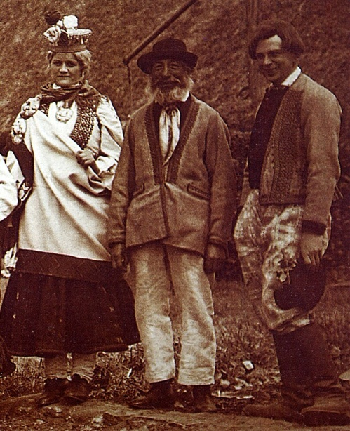
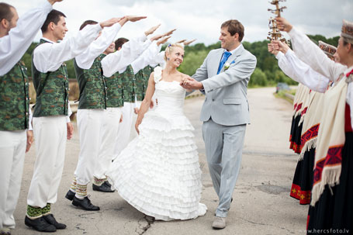
Wedding – an important event
To establish a family is one of the most important events in any person’s life, therefore it is still believed that the wedding should be celebrated according to the ancient rituals that guarantee the happiness and sustainability of the young couple in future.

Slide 4
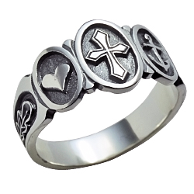
Engagement
When a young man has chosen his eventual bride he shall visit her family for engagement or for asking her parents and brothers for the hand of his beloved. Receiving a positive answer, they agree on wedding date.

Slide 5
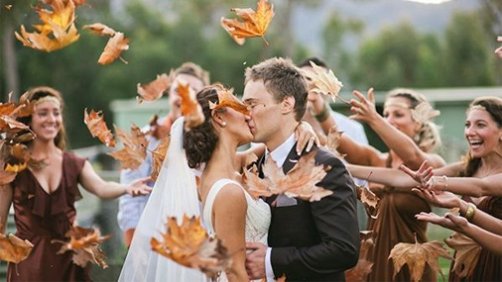
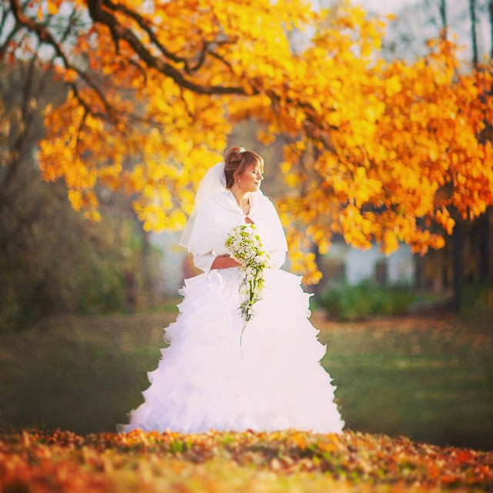
The best time for wedding
Traditionally it is believed that autumn is the best season to celebrate the wedding as the harvest of the year is collected and the main agricultural works are completed.
Nowadays, the engagement can last as long as the couple wants and of course they can marry whenever they wish as less attention is now paid to the ancient agricultural calendar of the area.

Slide 6
The place and length of the ceremony
Formerly the wedding was celebrated both in bride’s and groom’s houses and the duration of the celebration varied between three days until entire week.
Nowadays in the wedding morning the bride has to be in her parents’ house and the groom cannot see her before that. The wedding usually lasts for two days.

Slide 7
Wedding rituals and trials
The wedding procedures include different trials for the young couple. On their way to a wedding banquet the groom and bride are tested through performing daily housekeeping activities.

Slide 8
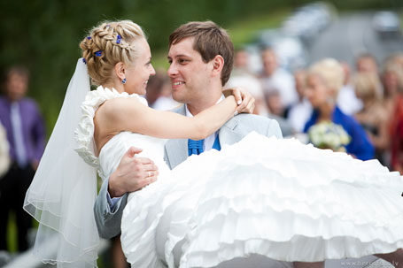
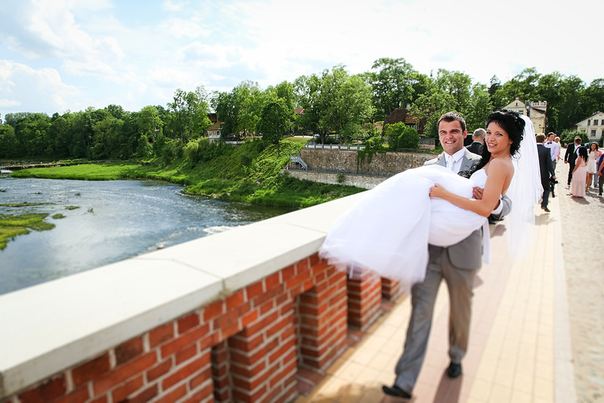
One of the most popular trials - the groom has to carry his bride over seven bridges, where crossing the bridge symbolizes a conversion from status 'mine' and 'yours' to the status 'ours'.

Slide 9
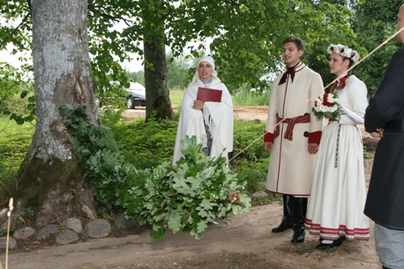
Another trial is ‘gate of honor’ which is erected by the invited or even uninvited guests in the path the young couple must walk. It was believed that the bigger the gate of honor, the better conjugal life of the couple as the redemptions paid or completed prevent the problems in family.

Slide 10
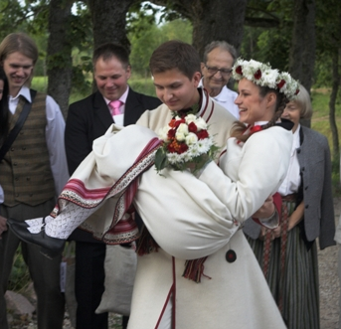
Besides, the groom shall carry the bride over the path of towel with a plate hidden under it. Going over the plate it shall be broken in many pieces. The more pieces the more luck, richness and fertility in the conjugal life.

Slide 11
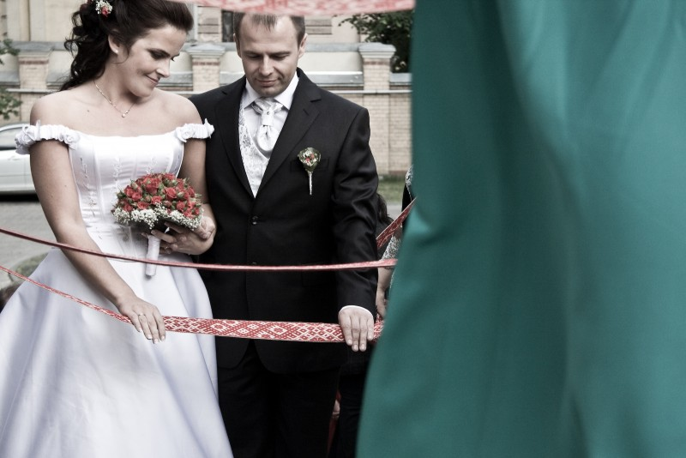
A particular attention in wedding procedure is paid to the door and the threshold; special protective rituals before entering the house are carried out.

Slide 12
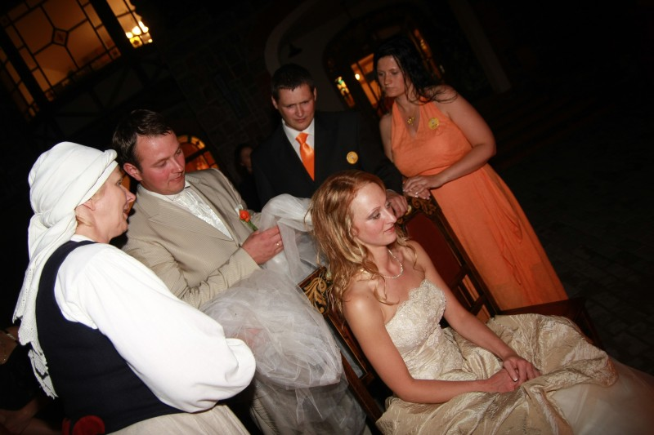
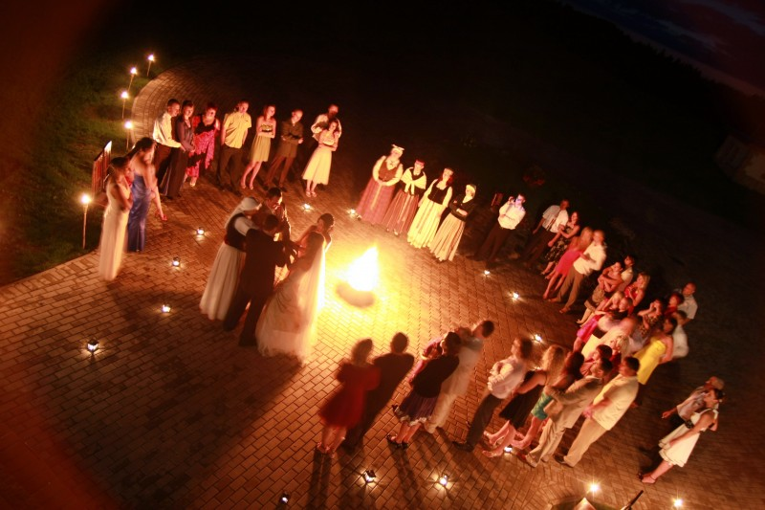
The culmination of the traditional wedding is “mičošana” or “tuckering” when the crown of the bride is taken off and the headdress of a wife – a kerchief or a tucker is put on. Afterwards the bride’s crown is put on the head of one of the unmarried female relatives or friends. Sometimes it is done blindfolded, guessing the next couple to be married.

Slide 13
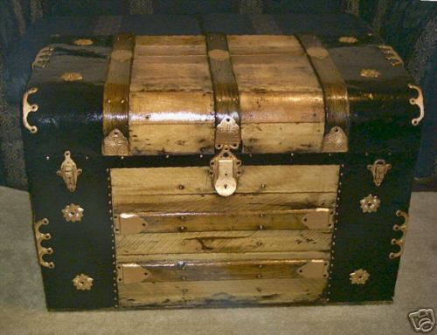
Very important ritual of the wedding is gift giving to all the relatives, gifts offered to the new house, auxiliary buildings and other places further supervised by the new wife.

Slide 14
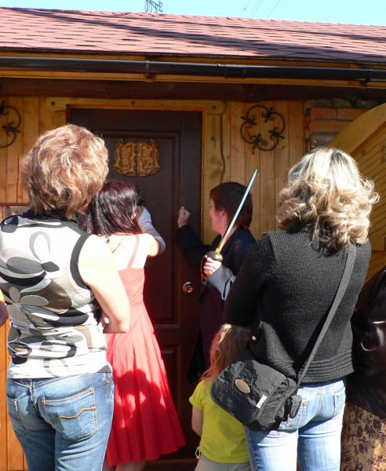
After the tuckering the young couple is accompanied to bed while singing songs – usually the young couple slept in a granary.
Also the awakening of the new couple is ritualized. Normally the husband and wife are awakened by the guests, who try to make noise with drums, voices, pans and cooking pots. Afterwards they wash in the same bowl and wipe in the same towel as well as offer a present to a person bringing the water.

Slide 15
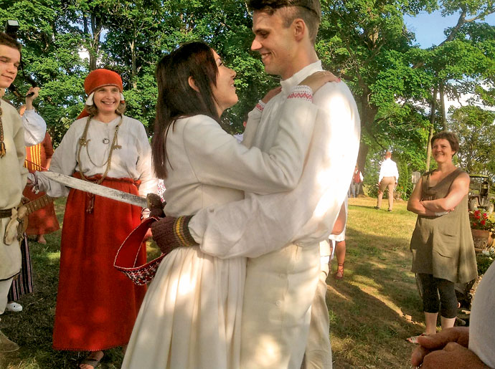
A lot of the wedding customs were derived from the times of our ancestors and a lot of them are inspired from other countries. Each generation adds something new to the wedding rituals.

Slide 16
http://www.worldweddingtraditions.net/latvian-wedding-traditions/
http://www.latvia.eu/library/latvian-traditions
http://www.traveloutthere.com/riga/show/page/latvian-wedding-traditions

