Slide 1
Wicker
Sarmite Gaidule
Kaspars Mozga

Slide 2
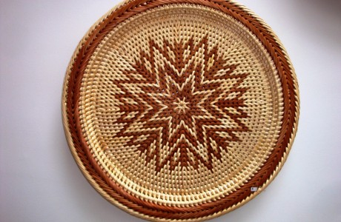
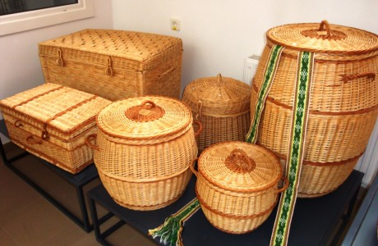
Wicker
" Wicker " members of a fine cloth , mesh material divided into four parts , use the special weaving techniques figured combination also creates artistic value . Basketry uses natural materials - wicker , cane, straw.

Slide 3
From wicker consists of both household containers, boxes and decorations, bracelets and souvenirs. Each work is individual and unique, and specific to the Latgale region. Creative thought and human dedication are key success in all exhibitions, which participated in the studio. Its members continuously improve their skills, introduce new weaving techniques to improve the quality of the material processing, preserving its natural properties.

Slide 4
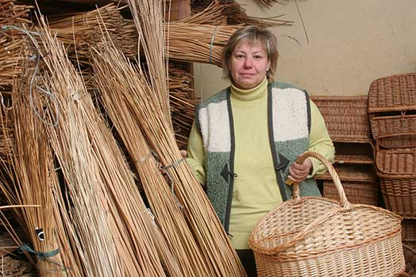
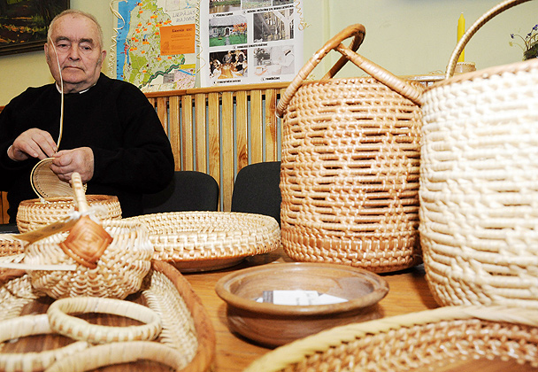
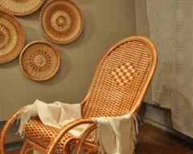
Wicker

Slide 5
Wicker makers
Guntars Velviks.
He is a wicker maker. He made from recycled and virgin willow wicker baskets, baskets, trays, slippers and other products.

Slide 6
Natālija Vuškārniece.
Wicker maker, who made from treated and untreated wicker baskets trays, decorations, etc. products. Works are displayed in Latgale Art and Craft Centre weavers workshop.

Slide 7
Boļeslavs Munda
Good Latgalian wicker maker. With their webbing participate in various craft markets and woven products you can always buy his products.

Slide 8
Some facts.
The idea is to work and produce things that are not only beautiful, but also practical.
Braiding requires enormous patience, and it only remains in the workshop, who likes to work.
Wicker for this purpose proved to be very suitable: flexible, durable and easy makeable.

Slide 9
Thank you for attention!

